Slide 1

56
Phonetics and Phonology
Dr. Mohammed Al-Hilal
مقرر الصوتيات والنظام الصوتي
_{قسم اللغة الإنجليزية}
جامعة الملك فيصل
عمادة التعلم الإلكتروني والتعليم عن بعد
1

Slide 2
Lecture 10
Phonetics and Phonology

Slide 3
In this lecture, we will study
English Affricatives
How affricatives are produced?
The definition of the affricates.
English nasal consonants.
Places of closure for nasal consonants.
Pronouncing /g/ after /ŋ/

Slide 4
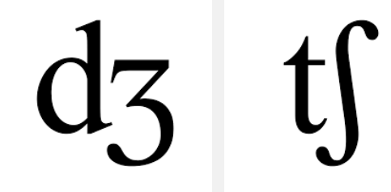
Affricates: /tʃ/ /dʒ/
Definition:
Affricates are complex consonants that begin as a plosive and end as a FRICATIVE.
Ex. Judge, Change, church

Slide 5
Affricates: /tʃ/ /dʒ/
PROBLEM WITH THE DEFINITION:
we cannot class all plosives plus fricative as affricates
Ex.
B r e a k f a s t s t u d e n t s
plosive + fricative plosive + fricative
Affricate Affricate

Slide 6
Affricates: /tʃ/ /dʒ/
PROBLEM WITH THE DEFINITION:
we need to restrict the definition:
“the plosive and the fricative must be made with the same articulators; that is the plosive and the fricatives must be homorganic.”
/k/ and /f/ in breakfast are not homorganic.
/t/ and /ʃ/ are homorganic but /k/ and /f/ are not homorganic

Slide 7
Affricates: /tʃ/ /dʒ/
PROBLEM WITH THE DEFINITION:
But what about the /t/ and /s/ in students.

Slide 8
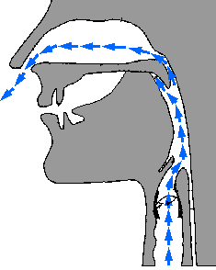
Nasal consonants /m/, /n/, / ŋ/

Slide 9
Nasal consonants /m/, /n/, /η/
The basic characteristic of nasal consonants is that the air escapes through the nose.
The soft palate is lowered. The air cannot pass through the mouth, it is prevented by complete closure in the mouth at some point.

Slide 10
The three types of closure are
bilabial - /m/
alveolar - /n/
velar - /ŋ/

Slide 11
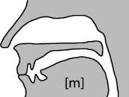
/m/ bilabial nasal consonant
The soft palate is lowered.
The lips are slightly spread, pressed together forming a complete obstruction to the air stream through the oral cavity.
The air passes through the nose. The vocal cords vibrate

Slide 12
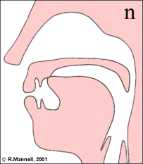
/n/ alveolar nasal consonant
The soft palate is lowered,
the tip of the tongue touches the alveolar ridge, forming a complete obstruction to the flow of air through the oral cavity.
The air passes through the nose. The vocal cords are vibrating.

Slide 13
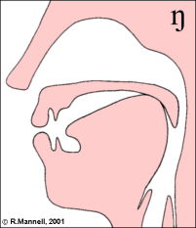
ŋ velar nasal consonant
A closure is formed in the mouth between the back of the tongue and the velum.
This closure is similar to the one we have for /k/ and /g/.
The soft palate is lowered.
The vocal cords vibrate.

Slide 14
Distribution
/m/+/n/ are fully distributed:
man famous ham
nap find can
/ŋ/
- Unusual sound. controversial
- Never occurs in initial position
Medially: frequent finger, singer

Slide 15
Distribution of /ŋ/
The nasal /ŋ/ and the fricative / ʒ / are the only two consonants that do not occur initially

Slide 16

Pronouncing /g/ after /ŋ/
/g/ is not pronounced if the word can be divided into two morphemes:
Singer /sIŋə/ hanger /hæŋə/
So, we use morphological analysis to decide whether /g/ is pronounced or not.

Slide 17
Pronouncing /ŋ/
n
nk | ng
always pronounced Think: / θIŋk / Bank: /bæŋk/ | can/cannot be pronounced -ng =/ŋg/ -ng= /ŋ/

Slide 18

Pronouncing /ŋ/
Middle of the word: / ŋ / + /g/= /ŋg/
Plosive /g/ is pronounced after nasal/ŋ/ if the word cannot be divided into two morphemes:
Ex:
finger /fIŋgə/
anger /æŋgə/

Slide 19
Pronouncing /ŋ/
Middle of the word: / ŋ /+/g/= /ŋ/
Plosive /g/ is not pronounced after nasal /ŋ/ if the word can be divided into two morphemes
Ex:
Singer =sing+er singer / sIŋə/
Hanger = hang+er hanger /hæŋə/

Slide 20
Pronouncing /ŋ/
Explain how /g/ is pronounced in the these words:
finger /fIŋgə/
hanger /hæŋə/
The two words are morphologically different

Slide 21
Pronouncing ng at the end of the word
Rule:
NO/g/ is pronounced after /ŋ/ at the end of a morpheme.
Ex.
sing /siŋ/
hang /hæŋ/
sang /sæŋ/
bang /bæŋ/

Slide 22
Pronouncing g after ŋ
Plosive /g/ is not pronounced after nasal /ŋ/ if the word can be divided into two morphemes
Exceptions: comparative and superlative
Longer */lɒŋə/ /lɒŋgə/
Longest */lɒŋəst/ /lɒŋgəst/

Slide 23
Pronouncing /g/ after /ŋ/
INTERESTING FACTS
English speakers in general (apart from those trained in phonetics) are quite ignorant of this rule.
However, if a foreigner uses the wrong pronunciation (i.e. pronounces / ŋ / where / ŋg/ should occur, or / ŋg/ where /g/ should be used, they notice that a mispronunciation has occurred.

Slide 24

بحمد الله

