Slide 1

Phonetics and Phonology
Dr. Mohammed Al-Hilal
مقرر الصوتيات والنظام الصوتي
_{قسم اللغة الإنجليزية}
جامعة الملك فيصل
عمادة التعلم الإلكتروني والتعليم عن بعد
1

Slide 2
Phonetics and Phonology
Lecture 11

Slide 3
In this lecture, we will study:
Segments
Complementary distribution
Type vs token
Phonemic vs phonetic transcription.
BBC Phonemic System

Slide 4

What do we mean by sound?
something that you can hear or that can be heard:

Slide 5
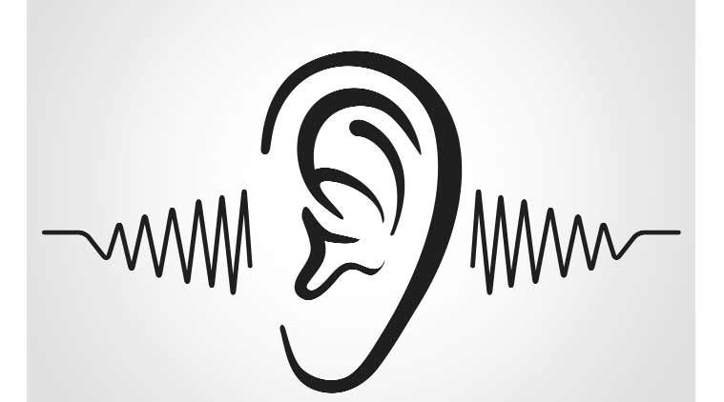
the sensation produced by stimulation of the organs of hearing by vibrations transmitted through the air

Slide 6
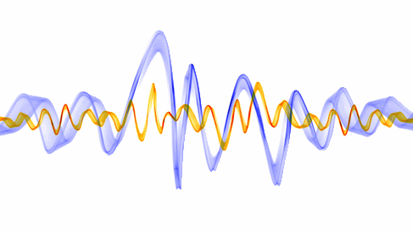
When we speak we produce a continuous stream of sounds

Slide 7

Segments.
When we study speech, we divide the stream of sound into small pieces.
man /mæn/
m one segment
æ another segment
n another segment

Slide 8
Segments. 31
Segments: separate sound units (segments) that correspond to phonemes
Cat /k/, /æ/, /t/.
Fate /f/, /eI/, /t/
Time: /t/, /aI/, /m/
Segmentation: dividing speech up into segments (segmentation).

Slide 9
Segmentation: problematic cases
Double sounds and undetectable sounds
Ex. It is not always easy to decide on the number of segments.
Ex. mime /maIm/
/aI/ one segment or two

Slide 10
Segmentation: problematic cases
Ex. It is not always easy to decide on the number of segments.
Sequences of fricatives often overlap
Ex. it is difficult or impossible to split the sequence or /fθs/ in ‘fifths’.

Slide 11
Segmentation: problematic cases
Two points of view.
First
some people believe that segmentation is fundamentally misguided.
Second
The opposite view is that since segmentation appears to be possible in most cases, we should not reject segmentation because there are problematical cases.

Slide 12
How many segment type do we have?
Type vs token
Each vowel can be pronounced in many slightly different ways (tokens).
Phonemes are types, and their actual pronunciations by speakers are tokens.
Does that mean that the total number of sounds produced by speakers is practically infinite.!!!???? No.

Slide 13
How many segment type do we have?
We feel quite confident in saying that the number of English vowels is not greater than twenty.
Why?
When we have two slightly different ways of pronunciation, there will be no change in the meaning of the word.
Ex. If we substitute /æ/ with a more open vowel like cardinal vowel number 4 [a], there is no difference in meaning.

Slide 14
Similar situation: letters of the alphabet
The letters of the alphabet that we use in writing English:
Phonetics
Phonetics
Phonetics
PHONETICS
phonetics
Different ways of writing the same letters.

Slide 15
Thus, there is an abstract alphabet as the basis for our writing system.
Similarly, there is an abstract set of units as the basis of our speech.
These units are called phonemes. The complete set of these units is called the phonemic system of the language.

Slide 16
The phonemes themselves are abstract
The phonemes themselves are abstract (types), but there are many ways (tokens) in which we may make the sounds that represent the phonemes

Slide 17
Complementary distribution
A phoneme can only occur where the other cannot.
/t/ can be aspirated or unaspirated
Tea eat
Both aspirated and unaspirated /t/ are realized as /t/. But the aspirated realization will never be found in the place where the unaspirated realization is appropriate and vice versa. We call this Complementary distribution.

Slide 18
Phonemes Vs Allophnes
Allophones: Allophones are different realizations of the same phoneme.
t
/ʔ/
[tʰ]

Slide 19
Symbols and transcriptions
Transcriptions: converting from one representation (e.g. written text) into another (e.g. phonetic symbols).
Ex.
chip /tʃɪp/
put /pʊt/
house /haʊs/

Slide 20
Symbols and transcriptions
IPA
The International Phonetic Alphabet/Association
The Association has taken the responsibility for maintaining a standard set of phonetic symbols for use in practical phonetics, presented in the form of a chart.

Slide 21
Phonemic vs. Phonetic transcription
Phonemic transcription: the only symbols that may be used are those which represent one of the phonemes of the language, and extra symbols are excluded. We use slant brackets or slashes.
Ex. pan /pæn/
Every speech sound must be identified as one of the phonemes and written with the appropriate symbol.

Slide 22
Phonemic vs. Phonetic transcription
Phonetic transcription: the transcriber may use the full range of phonetic symbols (including diacritics) if these are required. We use square brackets [ ]
Pan: [p^{h}æ̃n]

Slide 23
BBC Phonemic System
The BBC accent contains forty-four phonemes:
44 phonemes
24 consonants
7 short vowels
5 long vowels
8 diphthongs

Slide 24
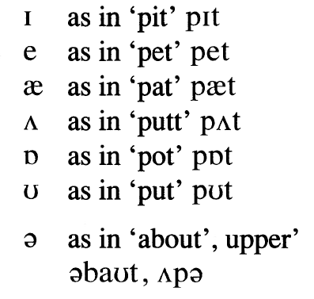
BBC Phonemic System
The BBC accent contains forty-four phonemes:
7 short vowels

Slide 25
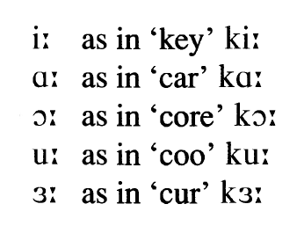
BBC Phonemic System
The BBC accent contains forty-four phonemes:
5 long vowels

Slide 26
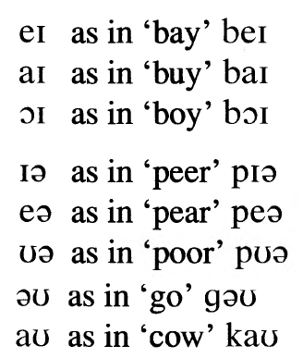
BBC Phonemic System
The BBC accent contains forty-four phonemes:
8 diphthongs

Slide 27
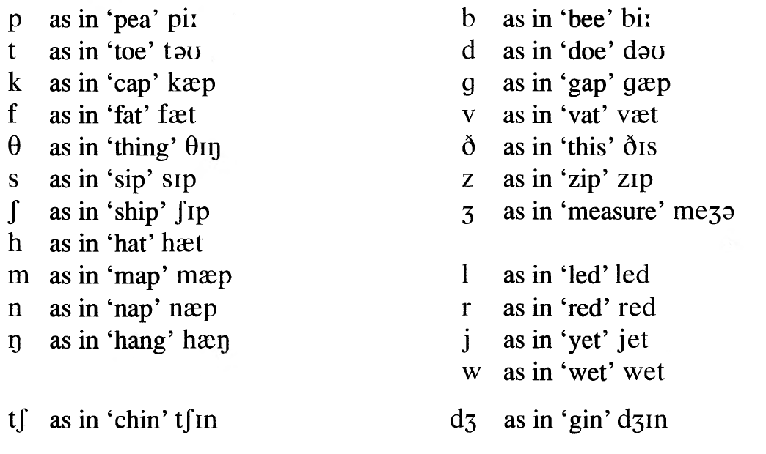
BBC Phonemic System
The BBC accent contains forty-four phonemes:
24 phonemes

Slide 28
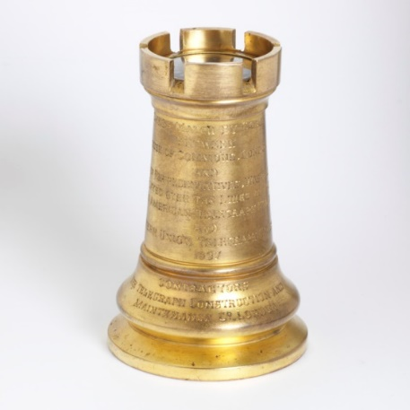
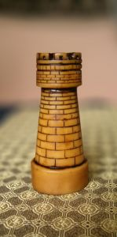

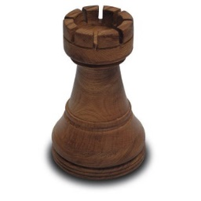
The study of the phonemic system
The phonemic system is similar to the set of pieces used in a game of chess; the exact shape and colour of the pieces are not important as long as they can be reliably distinguished.

Slide 29
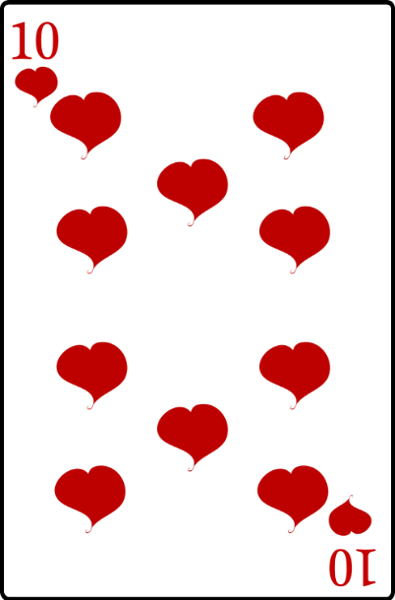
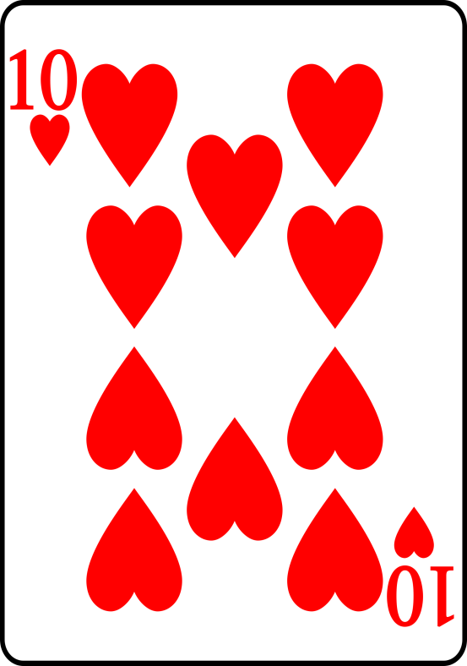
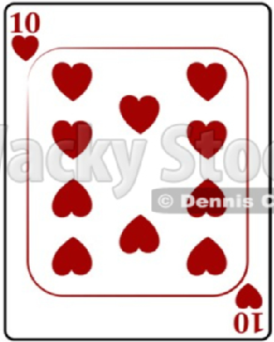
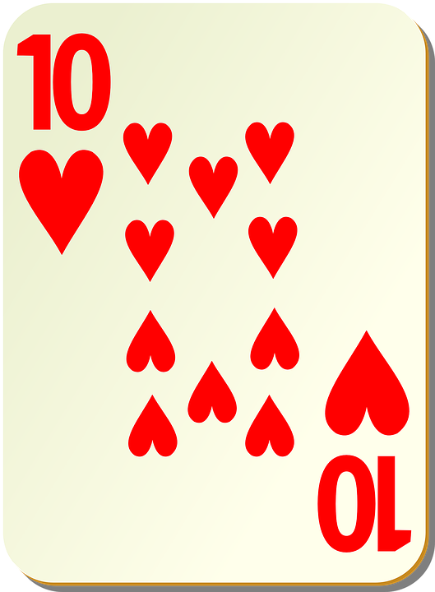
The study of the phonemic system
The phonemic system is similar to the set of cards; the exact shape and colour of the pieces are not important to the game as long as they can be reliably distinguished.

Slide 30
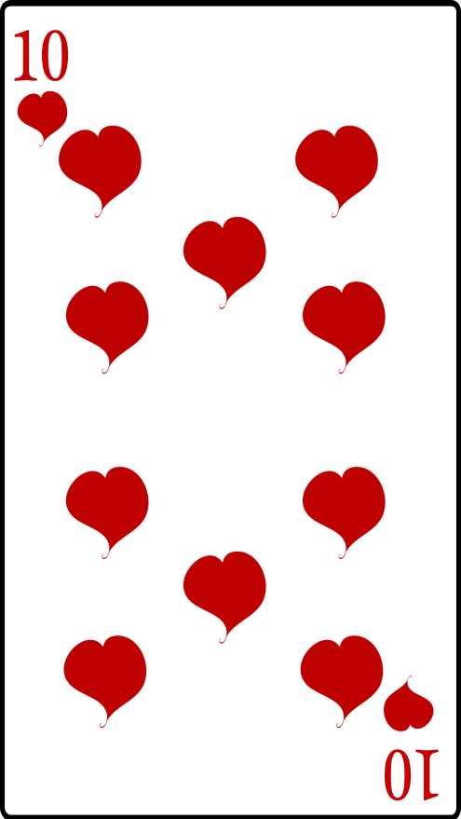
The study of the phonemic system
playing cards can be printed in many different styles and sizes, but these do not affect the game played with them.

Slide 31
The study of the phonemic system
We have a more or less fixed set of phonemes which can be used in speaking English.
44 phonemes
24 consonants
7 short vowels
5 long vowels
8 diphthongs

Slide 32

بحمد الله

