Slide 1

Phonetics and Phonology
Dr. Mohammed Al-Hilal
مقرر الصوتيات والنظام الصوتي
_{قسم اللغة الإنجليزية}
جامعة الملك فيصل
عمادة التعلم الإلكتروني والتعليم عن بعد
1

Slide 2
Lecture 13
Phonetics and Phonology

Slide 3
In this lecture, we will study
Places of Articulation for /w/ and /j/
The Syllable. Unit: 8.
Minimum syllable:
zero coda syllable
zero onset syllable
Consonant cluster
Syllabic consonants
Weak syllables
Lateral release
Nasal release

Slide 4
Approximant /j/ and /w/
They are found at the beginning of words like:
yet /jet/
wet /wet/

Slide 5
Approximant /j/ and /w/. P50
The main point about /j/ and /w/
They are phonetically like vowels, but phonologically like consonants
In earlier work on phonology, they were called semi-vowels.

Slide 6
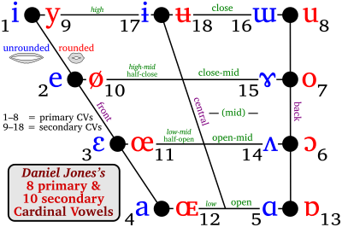
Approximant /j/ and /w/. P50
The main point about /j/ and /w/
They are phonetically like vowels
The /j/ is very similar to the cardinal vowel [i] but it is very short.

Slide 7
Approximant /j/ and /w/. P50
The main point about /j/ and /w/
They are phonetically like vowels
The /w/ is very similar to the cardinal vowel [w].

Slide 8
Approximant /j/ and /w/. P50
Are /j/ and /w/ consonants or vowels?
/j/ and /w/ are consonants:
1- They occur before a vowel phoneme
The indefinite articles test: (a (before consonants), an (before vowels)).
EX.
A way. an incident.
A year. an orange.

Slide 9
Approximant /j/ and /w/. P51
Are /j/ and /w/ consonants or vowels?
/j/ and /w/ are consonants:
1- They occur before a vowel phoneme
The definite articles test:
(the: /ðə/ before consonants; ex: /ðə/ student
(the: /ði/ before vowels, /ði/ oldman ).
EX.
The /ðə/ way. The /ði/ incident.
The /ðə/ year. The /ði/ orange.

Slide 10
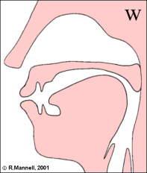
Places of Articulation for /w/ and /j/
/w/ is bilabial:
A bilabial sound is a sound made with both lips.

Slide 11
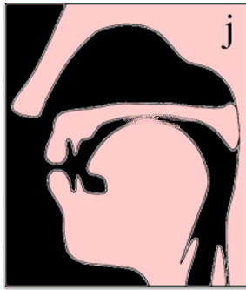
Places of Articulation for /w/ and /j/
/j/ is palatal
Palatal consonants are consonants in which the tongue makes contact with the highest part of the hard palate.

Slide 12
Places of Articulation
glottal | velar | palatal | Post-alveolar | alveolar | Dental | Labio-dental | bilabial
h | K g |  | ʃ ʒ | t d | θ | f | P b
 | η |  | tʃ dʒ | s z | ð | v | m
 |  |  | r | n |  |  | w
 |  | j |  | l

Slide 13
Manners of Articulation
approximant | Lateral approximant | Nasal | Affricate | Fricative | Plosive
r | l | m n | tʃ dʒ | F v | P b
w |  | η |  | S z | T d
j |  |  |  | ʃ ʒ | K g
 |  |  |  | θ ð
 |  |  |  | h

Slide 14

Places of Articulation
glottal | velar | palatal | Post-alveolar | alveolar | Dental | Labio-dental | Bilabial
MANNER OF ARTICULATION
Plosive
Fricative
Affricate
Nasal
Lateral approximant
approximant
p b
t d
k g
f v
θ ð
s z
ʃ ʒ
h
tʃ dʒ
m
n
η
l
w
r
j

Slide 15
voiceless consonants (fortis) | Voiced consonants (lenis)
p, t, k | b, d, g
f, s, ʃ, θ, h | v, z, ʒ, ð
tʃ | dʒ
 | m, n, ŋ
 | l, r, w, j
Lenis Vs fortis
Lenis consonants are weak
Fortis consonants are strong

Slide 16
Choose the voiced affricative consonant.
  tʃ
  dʒ
  d
  k
  g
The consonant /dʒ/ is ……..
  A voiced fricative consonant
  A fortis affricate consonants
  A plosive alveolar consonant
  A voiced affricate consonant.
  An alveolar lateral approximant
Sample exam question

Slide 17
Choose the fortis plosive alveolar consonant.
  tʃ
  dʒ
  d
  t
  g
The consonant /t/ is ……..
  A voiced approximant consonant
  A fortis affricate consonants
  A fricative alveolar consonant
  A fortis plosive alveolar consonant.
  A lenis plosive alveolar consonant.

Slide 18
The place of articulation for / ʃ / is . . . . . . .
  Velar
  Alveolar
  Post-alveolar
  Bilabial
  Labio-dental
The consonant /. . . . . . / has a post-alveolar place of articulation.
  tʃ
  dʒ
  d
  ʃ
  g

Slide 19
The manner of articulation for / ʃ / is . . . . . . .
plosive
affricate
fricative
nasal
approximant
The consonant /. . . . . . / has a fricative manner of articulation.
tʃ
dʒ
d
ʃ
g

Slide 20
The Syllable. Unit: 8. Page 56.
Components of a syllable:
1- an onset
2- A center
3- a coda
Ex:
ran /ræn/
sat /sæt/
fill /fɪl/

Slide 21
Minimum syllable:
Minimum syllable: It is a single vowel in isolation. It is followed and preceded by silence.
Ex:
are /ɑː/ or /ɔː/ err /ɜː/

Slide 22
zero coda syllable
Onset + centre syllable:
Definition (1)
zero coda syllable: A syllable that has one or more consonants preceding the centre.
Or
A syllable that does not have a final consonant.
Ex:
bar /bɑː/
key /kiː/
More /mɔː/

Slide 23
zero onset syllable
Centre + coda syllable = zero onset syllable
Features:
It is a syllable that ends with one or more consonants.
It is a syllable in which there is no consonant preceding the centre.
It is a syllable that begins with a vowel.
Ex:
am /æm/
ought /ɔːt/
ease /iːz/

Slide 24
Consonant cluster
Consonant cluster: when we have two or more consonants together, without any intervening vowels between these consonants.
consonant cluster: A group of consonants at the beginning or end of a syllable.
strong
prompt

Slide 25
Syllabic consonants P: 64
Ex. Bottle [bɒt[l̩]]
The second syllable is weak
The second syllable contains no vowel at all,
The second syllable consists entirely of the consonant [l̩]
A syllabic consonant is a weak syllable that contains no vowel at all and it consists entirely of the consonants.

Slide 26

Weak syllables
The vowel in a weak syllable tends to be:
shorter,
of lower intensity (loudness)
and different in quality .

Slide 27
Syllabic consonants
It is usual to indicate that a consonant is syllabic by means of a small vertical mark [ˌ] that goes below the lateral /l/.
Example
‘cattle [kætl̩]

Slide 28
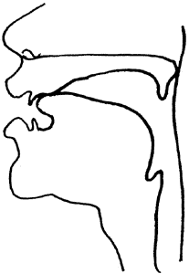

Syllabic consonants
Lateral release
When we have a plosive followed by a lateral /l/, the plosive is released through the sides of the tongue. We call this lateral release of the plosive.
‘muddle’ [mʌdl̩]

Slide 29
Syllabic consonants
Syllabic [l̩]
It occurs after another consonant
‘bottle [bɒtl̩]
Lateral release
The plosive /t/ in bottle [bɒtl̩] is laterally released through the sides of the tongue. The centre of the tongue is still in contact with the alveolar when /t/ is released: only the sides of the tongue are lowered.

Slide 30
Syllabic consonants
Syllabic [l̩]
‘muddle’ [mʌdl̩]
Lateral release
The plosive /d/ in muddle [mʌdl̩] is laterally released through the sides of the tongue. The centre of the tongue is still in contact with the alveolar when /d/ is released: only the sides of the tongue are lowered.

Slide 31
Syllabic consonants
Where do we find syllabic [l̩] in the BBC accent?
’
Cattle [kætl̩]
Bottle [bɒtl̩]
Muddle [mʌdl̩]

Slide 32
Syllabic consonants
Syllabi [n̩]
Syllabic [n̩] is most common after alveolar plosives and alveolar fricatives.
t, d, s, z
‘eaten’ [i:tn̩]
Sudden [sʌdn̩]

Slide 33
Syllabic consonants
Syllabi [n̩]
Nasal release
‘eaten’ [i:tn̩]
the plosive can be nasally released by lowering the soft palate, so that in the word ‘eaten’ [i:tn̩] the tongue does not move in the /tn/ sequence but the soft palate is lowered at the end of /t/ so that the compressed air escapes through the nose. We call this nasal release.

Slide 34

بحمد الله

