Slide 1

Phonetics and Phonology
Dr. Mohammed Al-Hilal
مقرر الصوتيات والنظام الصوتي
_{قسم اللغة الإنجليزية}
جامعة الملك فيصل
عمادة التعلم الإلكتروني والتعليم عن بعد
1

Slide 2
Lecture 14
Phonetics and Phonology

Slide 3
In this lecture, we will study
Weak forms
The most common weak-form words
Linking
Assimilation

Slide 4
WHY DO WE USE WEAK FORMS?
Most native speakers of English find an “all-strong form” pronunciation unnatural and foreign-sounding, something that most learners would wish to avoid.

Slide 5
WHY DO WE USE WEAK FORMS?
speakers who are not familiar with the use of weak forms are likely to have difficulty understanding speakers who do use weak forms;
learners of the language need to learn about these weak forms to help them to understand what they hear.

Slide 6
The most common weak-form words
The
Strong /ðə/ weak /ði/
-Strong /ðə/.
It occurs before consonants.
The classroom. /ðə/ classroom
Shut the door. shut /ðə/ door.

Slide 7
The most common weak-form words
The
Weak /ði/ .
it occurs before vowels.
the end. /ði/ end
The old man. /ði/ old man
The apple. /ði/ apple.

Slide 8
The most common weak-form words
That
Strong form /ðæt/. Weak form /ðət/.
Strong form /ðæt/ :
when that is sentence-initial and when it is used with a demonstrative sense.
That girl. /ðæt/ girl.
That apple /ðæt/ apple.
That she was clever made them employ her.
/ðæt/ she was clever made them employ her.

Slide 9
The most common weak-form words
That
Weak form /ðət/: only when used as a relative pronoun.
Ex.
This is the book that Sally bought.
This is the book /ðət/ Sally bought.
This is the book that I bought.
This is the book /ðət/ I bought.

Slide 10
Linking 115
liaison (from French)
“Linking” or “joining together”
Linking: The way the end of one word is joined on to the beginning of the following word.
In real connected speech, we link words together in in a number of ways.

Slide 11
Linking 115
Linking /r/ and intrusive /r/
Linking /r/
BBC is non-Rhotic = no /r/ in syllable final position.
here /hɪə/
four /fɔː/
Car /kɑː/

Slide 12
Linking 115
Linking /r/
when when a word ends with /r/ is followed by a word that begins with a vowel, /r/ is PRONOUNCED.

Slide 13
Linking 115
Linking /r/. Examples:
here /hɪə/. here is /hɪər ɪz/ */hɪə ɪz/
four /fɔː/. four eggs /fɔːr egz/ */fɔː egz/
Car / kɑː/. the care is /ðə kɑːr ɪz/ */ðə kɑː ɪz/
this is done to link the words without sliding the two vowels together

Slide 14
Linking 115
Intrusive /r/.
speakers often use /r/ in a similar way to link words ending with a vowel, even when there is no “justification” from the spelling.

Slide 15


Linking 115
Intrusive /r/.
speakers often use r in a similar way to link words ending with a vowel, even when there is no “justification” from the spelling.

Slide 16
Assimilation
A feature of natural connected speech only.
Assimilation: Sounds belonging to one word can cause changes in sounds (phonemes) belonging to neighbouring words
Assimilation is more likely to be found in rapid, casual speech. The cases most often described are assimilations affecting consonants

Slide 17
Assimilation at word boundary
- - - C^{f} C^{i} - - -
word
boundary
Assimilation can be either regressive or
progressive

Slide 18
Regressive Vs Progressive Assimilation
In regressive assimilation C^{f} changes to become like C^{i}
Ex
Bad boy
In progressive assimilation C^{i} changes to become like C^{f}

Slide 19
Assimilation of place
Ex:
In rapid speech, the final alveolar consonant /t/
will become /p/ before a bilabial consonant,
‘that person’ / ðæp pɜːsn̩/
‘meat pie’ /mɪːp paɪ /

Slide 20
Progressive assimilation of voice with the suffixes s, z;
When:
a verb carries a third person singular ‘-s’ suffix,
a noun carries an ‘-s’ plural suffix
a noun carries an ‘-’s’ possessive suffix,
These suffix will be
pronounced as /s/ if the preceding consonant is fortis (“voiceless”)
pronounced as /z/ if the preceding consonant is lenis (“voiced”).

Slide 21
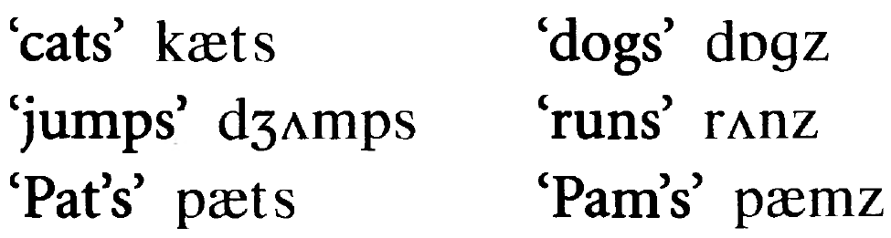
Progressive assimilation of voice with the suffixes s, z;
Ex

Slide 22
The End

Slide 23

بحمد الله

