Slide 1

اسم المقرر
الفكرة و الثقافة الإنجليزية
أ. جمال رفيق محمد
جامعة الملك فيصل
عمادة التعلم الإلكتروني والتعليم عن بعد
1

Slide 2
المحاضرة السادسة
.......................

Slide 3
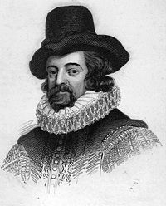
عناصر المحاضرة
Francis Bacon

Slide 4
عناصر المحاضرة
Francis Bacon has been called the father of:
  The scientific method
  The Enlightenment
  Empiricism
  Modern Science
  Inductive Reasoning

Slide 5
عناصر المحاضرة
Biography
Born 22 January 1561 Strand, London, England
Was thought to be home schooled due to poor health
Entered Trinity College at Cambridge at age 12
Met Queen Elizabeth who was impressed with his intelligence
In 1576 he entered Gray's Inn, and in the same year joined the embassy of Sir Amyas Paulet to France, where he remained until his father died in 1579
Obtained political office in 1584, eventually rose to Lord Chancillor, was accused of
Corruption, and stripped of office

Slide 6
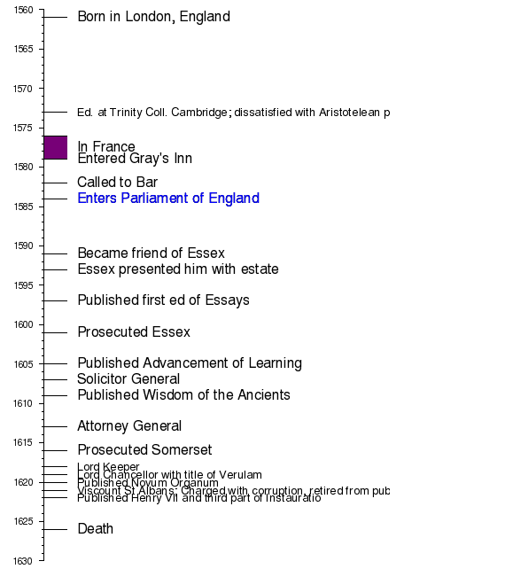
عناصر المحاضرة
Timeline

Slide 7
عناصر المحاضرة
Of Studies
'Studies' have a three-fold purpose: 'delight', 'ornament' & 'ability'. Books may be read
for attaining delight, for being ornamental in discourses, and for achieving ability.
b) 'Studies' must be ratified by experience, just as experiences are trimmed by studies.
c) Clever people do not like studies, for things learnt from books may be inimical to their
interests. Simple men look upon reading books as a very admirable venture, for they
themselves do not find a chance to read books. But only the wise men can make good
use of their knowledge.
d) Books are generally of three types; some are to be 'tasted' i.e. to be read in parts;
some are to be 'swallowed' i.e. to be somehow read through''; some books deserve to
be read in full with enough sincerity and attention.
e) Just as ailments of the body can be cured by physical exercises, ailments/shortcomings
of the mind may be cured by appropriate studies.

Slide 8
عناصر المحاضرة
Of Simulation and Dissimulation
— Tell a lie and find a truth.
Summary: The practice of dissimulation is followed by the weak man,
for the strong minds and hearts have the power to tell the truth.
The man of secret nature never gives a hint of what is in his heart.
The advantage of simulation and dissimulation is that they keep the
opposition guessing and unprepared and so to be easily surprised at
the proper moment. They also help us discover the intentions of the other.
The disadvantage is that they indicate a weakness of the disposition and
one who uses these methods is considered unreliable.

Slide 9
عناصر المحاضرة
Of Parents and Children:
— The joys of parents are secret; and so are their griefs and fears.
— Children increase the cares of life; but they mitigate the remembrance of death.
— Children sweeten labor, but they make misfortune more bitter.
Summary: Children get benefit because of their parents. Parents usually have unequal
favoritism towards their children. They should give them suitable monetary allowance.
They should choose a suitable profession for their child.

Slide 10
عناصر المحاضرة
Of Great Place:
— The rising onto place is laborious and by pains men come to greater pains; and it is
sometimes base and by indignities men come to dignities.
— Death falls heavy upon him who dies too well known to others, but unknown to himself.
— It is a strange desire to seek power and lose liberty; or to seek power over others and
to lose power over a man’s self.
— Men in great place are thrive servants: servants of the sovereign or state; servants
of fame and servants of business.
Summary: Men are servants of the state, their desires for fame and time restriction. Man
should follow the good examples set in the past. There are faults of men in great place such
as delays, corruption etc. We should refuse bribes. One may while rising to a position use
crooked methods and join sides but after reaching a position, one should become neutral.

Slide 11
عناصر المحاضرة
End of Lecture

Slide 12

بحمد الله

