Slide 1

اسم المقرر
الفكرة و الثقافة الإنجليزية
أ. جمال رفيق محمد
جامعة الملك فيصل
عمادة التعلم الإلكتروني والتعليم عن بعد
1

Slide 2
المحاضرة العاشرة
.......................

Slide 3
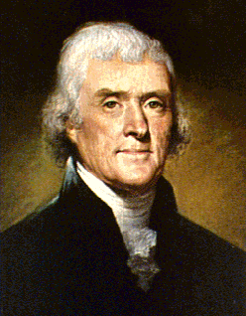
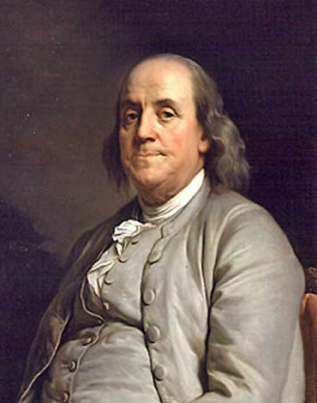
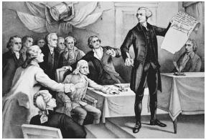
عناصر المحاضرة
The Declaration of Independence

Slide 4
عناصر المحاضرة
Historical Influences
The Magna Carta, written in 1215 in England, was the historical document that had
probably the most influence on the wording of the Declaration of Independence. This
Charter stated that the Law of the Land was the final authority, even above the King.
Thomas Jefferson was heavily influenced by John Locke (Human Understanding)and
Jean-Jacques Rousseau (The Social Contract).

Slide 5
عناصر المحاضرة
The Virginia Declaration of Rights
Only two days after the Second Continental Congress recessed and while Thomas Jefferson
was pondering his task, something unprecedented happened in his home-colony of Virginia.
On June 12th the Virginia House of Burgesses considered and then adopted a document based
on English Common Law, Locke's philosophy of natural law, and the thinking of that day.
Written by George Mason, a wealthy Virginia planter, it became known as The Virginia
Declaration of Rights.

Slide 6
عناصر المحاضرة
Provisions listed in the Virginia Declaration of Rights
All men have inherent rights to life, liberty, and property
All power is vested in the people
Government is established to benefit, not rule the people
Leadership roles should not be hereditary
Legislative and Executive Powers should be separate and distinct
The principles of free elections
Government can not suspend laws without the consent of the people
The right to trial by jury and to confront witnesses
There should be no cruel and unusual punishment
Provisions to eliminate unlawful searches of persons or personal property
Trial by jury is preferable and should be held sacred
"Freedom of the press is one of the great bulwarks of liberty"
A well regulated militia is required to defend a free state
People have a right to a uniform government
Free government is preserved only by adherence to fundamental principles
The freedom to practice religion according to personal reason and conviction

Slide 7
عناصر المحاضرة
"I did not consider it any part of my charge to invent new Ideas, but to place
before mankind the common sense of the subject, in terms so plain and firm
as to command their assent. It (Declaration of Independence) was intended
to be an expression of the American mind." Thomas Jefferson
Thomas Jefferson Writes the first draft of the Declaration of Independence between
June 11 and June 28, 1776. He consulted with Benjamin Franklin and John Adams who
made minor changes, then presented the draft to the Congress.

Slide 8
عناصر المحاضرة
The Text of the Declaration
The first sentence of the Declaration asserts as a matter of Natural law the ability of a people to assume political independence, and acknowledges that the grounds for such independence must be reasonable.
When in the Course of human events, it becomes necessary for one people to dissolve the political bands which have connected them with another, and to assume among the powers of the earth, the separate and equal station to which the Laws of Nature and of Nature's God entitle them, a decent respect to the opinions of mankind requires that they should declare the causes which impel them to the separation.

Slide 9
عناصر المحاضرة
The next section, the famous preamble, includes the ideas and ideals that were principles of the Declaration. It is also an assertion of what is known as the "right of revolution": that is, people have certain rights, and when a government violates these rights, the people have the right to "alter or abolish" that government.
We hold these truths to be self-evident, that all men are created equal, that they are endowed by their Creator with certain unalienable Rights, that among these are Life, Liberty and the pursuit of Happiness. — That to secure these rights, Governments are instituted among Men, deriving their just powers from the consent of the governed, — That whenever any Form of Government becomes destructive of these ends, it is the Right of the People to alter or to abolish it, and to institute new Government, laying its foundation on such principles and organizing its powers in such form, as to them shall seem most likely to effect their Safety and Happiness.

Slide 10
عناصر المحاضرة
The Indictment
The Indictment begins by stating the suffering of the American colonies and the feeling of absolute constraint in forming a new system of government. The Indictment also refers to the numerous and repeated injuries that King George III placed upon the colonies and then go on to include factual information as to the many things that King George III had committed.
The King is accused of twenty seven specific abuses; interfering with colonists' rights to self government and a fair judicial system; instituting legislation that affected colonies without their consent, increasing taxes on colonists; requirement to quarter British soldiers; right to trial by jury; preventing them from trading freely, etc. Also, the King had refused to protect the borders of the colonies thus resulting in the destruction of American life and property.

Slide 11
عناصر المحاضرة
In the final section, the signers assert that there exist conditions under which people must change their government, that the British have produced such conditions, and by necessity the colonies must throw off political ties with the British Crown and become independent states. The conclusion incorporates language from Lee's resolution of independence that had been passed on July 2.
We, therefore, the Representatives of the united States of America, in General Congress, Assembled, appealing to the Supreme Judge of the world for the rectitude of our intentions, do, in the Name, and by Authority of the good People of these Colonies, solemnly publish and declare, That these United Colonies are, and of Right ought to be Free and Independent States; that they are Absolved from all Allegiance to the British Crown, and that all political connection between them and the State of Great Britain, is and ought to be totally dissolved; and that as Free and Independent States, they have full Power to levy War, conclude Peace, contract Alliances, establish Commerce, and to do all other Acts and Things which Independent States may of right do. And for the support of this Declaration, with a firm reliance on the protection of divine Providence, we mutually pledge to each other our Lives, our Fortunes and our sacred Honor.

Slide 12
عناصر المحاضرة
End of Lecture

Slide 13

بحمد الله

