Slide 1

اسم المقرر
الفكرة و الثقافة الإنجليزية
أ. جمال رفيق محمد
جامعة الملك فيصل
عمادة التعلم الإلكتروني والتعليم عن بعد
1

Slide 2
المحاضرة الثامنة
.......................

Slide 3
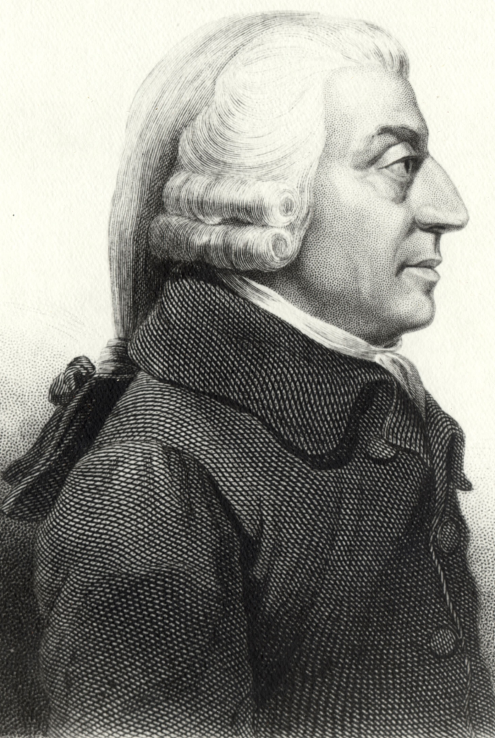
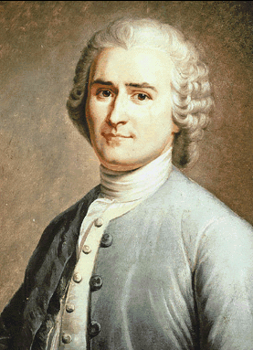
عناصر المحاضرة
Adam Smith
Jean-Jacques Rousseau

Slide 4
عناصر المحاضرة
Adam Smith (5 June 1723 – 17 July 1790):
Leading figure in the Scottish Revolution
Father of modern capitalism
Wrote The Wealth of Nations
Jean-Jacques Rousseau (28 June 1712 – 2 July 1778):
Writings influenced The French Revolution
Writings include Émile; Julie, ou la Nouvelle Héloïse; The Social Contract, Confessions
Supported a direct democracy form of government

Slide 5
عناصر المحاضرة
An Inquiry into the Nature and Causes of the Wealth of Nations
Smith's book is about material well-being. The Wealth of Nations is an influential statement of the case for laissez-faire, the thesis that government should not attempt to control or direct economic activity.

Slide 6
عناصر المحاضرة
Chapter 1
Economic advances are due to increased specialization of labor. The work of various kinds of philosophers, scientists and engineers are examples of this division of labor. More basic than advances in technology is the division of labor which enables technology itself to develop and progress. So specialization is the key to human material well-being.

Slide 7
عناصر المحاضرة
Chapter 2
This chapter opens with the argument that the Division of Labour is not the
consequence of somebodies wisdom, but results in the propensity of humans
to to exchange goods. Smith finds no evidence of any animals in nature (except
for humans) where any bartering goes on. The difference between humans and animals is
that animals can exist independently in the wild, while humans need assistance from
others, but can not expect this assistance out of good will alone. He then states that
we do not get meat from a Butcher because we need the meat, but because the
butcher is looking out for his own self-interest and wants what we have in return.

Slide 8
عناصر المحاضرة
The Social Contract
He claimed that sovereignty belonged to the people and that the government was only
a representative of the sovereign, charged with executing the general will. Although this
is idea is commonplace today, it was shocking to contemporary readers of Rousseau's work.
The Social Contract influenced governments throughout Europe and helped to promote
political reform and revolution. According to Rousseau, the clauses of the Social Contract can
Be reduced to one: The total alienation of the individual in favor of the community.

Slide 9
عناصر المحاضرة
Book 1
Because no man has a natural authority over other men and because force cannot establish right, all legitimate authority must depend upon convention. Rousseau goes on to refute Grotius, who argues that a state can be legitimate even if the people are slaves and the government is their master. Rousseau disputes his claim that the people can alienate their liberty and give themselves to a king. According to Rousseau, no one will give up his liberty without getting something in return.

Slide 10
عناصر المحاضرة
People form societies when the obstacles faced in the state of nature become too
taxing for any one person to overcome. Each person gives up his natural liberty –
the freedom to do anything he desires - in exchange for the greater power of the
entire community. Because everyone gives himself and all of his rights to the
community, the conditions of the social contract are equal for all those involved. The
association of many individuals with the same interests creates a collective body with
its own life and will. This body is called the "state" when it is passive, and the
"sovereign" when it is active.

Slide 11
عناصر المحاضرة
Influence
The works of Adam Smith formed the basis of modern capitalism.
The writings of Rousseau were influential on the founding fathers of the United
States of America as well as the Abolitionist who were fighting to end slavery.

Slide 12
عناصر المحاضرة
End of Lecture

Slide 13

بحمد الله

