Slide 1

اسم المقرر
الفكرة و الثقافة الإنجليزية
أ. جمال رفيق محمد
جامعة الملك فيصل
عمادة التعلم الإلكتروني والتعليم عن بعد
1

Slide 2
المحاضرة السابعة
.......................

Slide 3
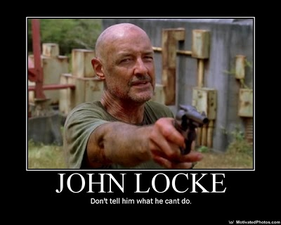
عناصر المحاضرة

Slide 4
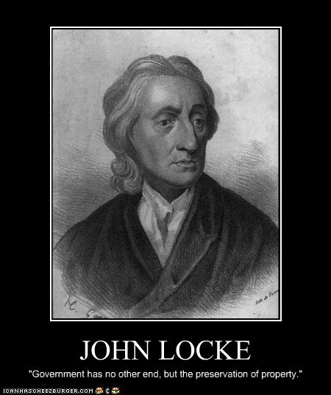
عناصر المحاضرة

Slide 5
عناصر المحاضرة
Widely known as:
The Father of Liberalism
One of the most influential of Enlightenment thinkers
One of the first of the British empiricists, following the tradition of Francis Bacon
His work had a great impact upon:
Social contract theory
The development of epistemology and political philosophy
Voltaire and Rousseau, many Scottish Enlightenment thinkers, as well as the American revolutionaries
Classical republicanism and liberal theory
American Declaration of Independence

Slide 6
عناصر المحاضرة
Biography
Born August 29, 1632 in Somersetshire
Taught at home by his father until he was 14
Studied moral philosophy, chemistry, meteorology and medicine at Oxford
Entered politics in 1667 and became assistant to Lord Ashley, who eventually rose to the position of Lord Chancellor and Earl of Shaftesbury
From 1675 to 1679 he lived in France and worked on his Essay
Left England again in 1683 after the execution of Lord Ashley
Returned to England after the Glorious Revolution and ascension of William and Mary
Retired from public life in 1691 and died in 1704

Slide 7
عناصر المحاضرة
Philosophy
Promoted representative democracy form of government
“Man” is the Animal the “person” is ones self
Championed the separation of Church and State

Slide 8
عناصر المحاضرة
The Essay
First appearing in 1690 with the printed title An Essay Concerning Humane Understanding
Concerns the foundation of human knowledge and understanding
Describes the mind at birth as a blank slate (tabula rasa, although he did not use those
actual words) filled later through experience.
One of the principal sources of empiricism in modern philosophy,
Influenced many enlightenment philosophers, such as David Hume and George Berkeley and
Jean-Jacques Rousseau.

Slide 9
عناصر المحاضرة
Of Perception
Passive, unavoidable
The first step toward knowledge and the only inlet of all the materials in the mind
Cannot occur without awareness.
Often comes attended by some automatic judgment,
Separates animals from lower forms of life.

Slide 10
عناصر المحاضرة
Of Retetion (Memory)
Locke is concerned mostly to tell us which ideas are best remembered
and to name the defects of the faculty.
Locke recognizes that, given his doctrine that all mental
items must be conscious, there is not much room allowed for memory.
For the sake of consistency Locke admits that by "memory" he does not literally
mean a place where ideas are stored, but rather, he refers to a power of the mind
to revive perceptions it once had

Slide 11
عناصر المحاضرة
Of Discernment
-The ability to tell one idea apart form all others
The faculty that determines intelligence, according to Locke.
The stronger this faculty, the stronger one's powers of reasoning.
Discernment makes our ideas clear and determinate, qualities that are revealed as extremely important for knowledge..

Slide 12
عناصر المحاضرة
End of Lecture

Slide 13

بحمد الله

