Slide 1

English Language
Essay
Instructor:
Ammar Sultan Al-Ma’ani
King Faisal University
e- Learning Deanship
& Distance Education
1

Slide 2
^{10th} Lecture

Slide 3
Elements of the Class
Complex Sentences
  With adverb clause
  With adjective clause
  With noun Clasus

Slide 4
Complex Sentences
A complex sentence contains at least one independent clause and one dependent clause.
John cannot set up his typewriter
because the wall has no outlet.
Independent Clause
Subordinating Conjunction
Dependent Clause

Slide 5
Example- Complex Sentence
A complex sentence contains at least one independent clause and one dependent clause.
She will go to school in the city
until she finds a job.
Independent Clause
Subordinating Conjunction
Dependent Clause

Slide 6
Complex Sentences
Use a comma after a dependent clause if it begins the sentence.
When I first moved to the city,
I was afraid to drive the steep and narrow streets.
Subordinating Conjunction
Use a comma if the dependent clause is the first part of the sentence.
Independent Clause

Slide 7

Correct!
Excellent! This sentence reads more smoothly
because it has more sentence structure variety.
Complex Sentence
Simple Sentences
I love living in the city of San Francisco. I have a wonderful view of the entire city from my apartment window. In addition, I can see the Golden Gate Bridge under which many cargo ships pass each day. I also like San Francisco because I can find wonderful restaurants with food from just about every country; however, I don’t like the traffic in the city.
Compound/Complex Sentence

Slide 8

I’m Sorry!
These sentence do not read as smoothly.
These sentences contain no sentence variety.
I love living in the city. I have a wonderful view of the entire city. I have an apartment. I can see the Golden Gate Bridge. I can see many cargo ships pass under the bridge each day. I like the restaurants in San Francisco. I can find wonderful food from just about every country. I don’t like the traffic in the city.
Simple Sentences

Slide 9
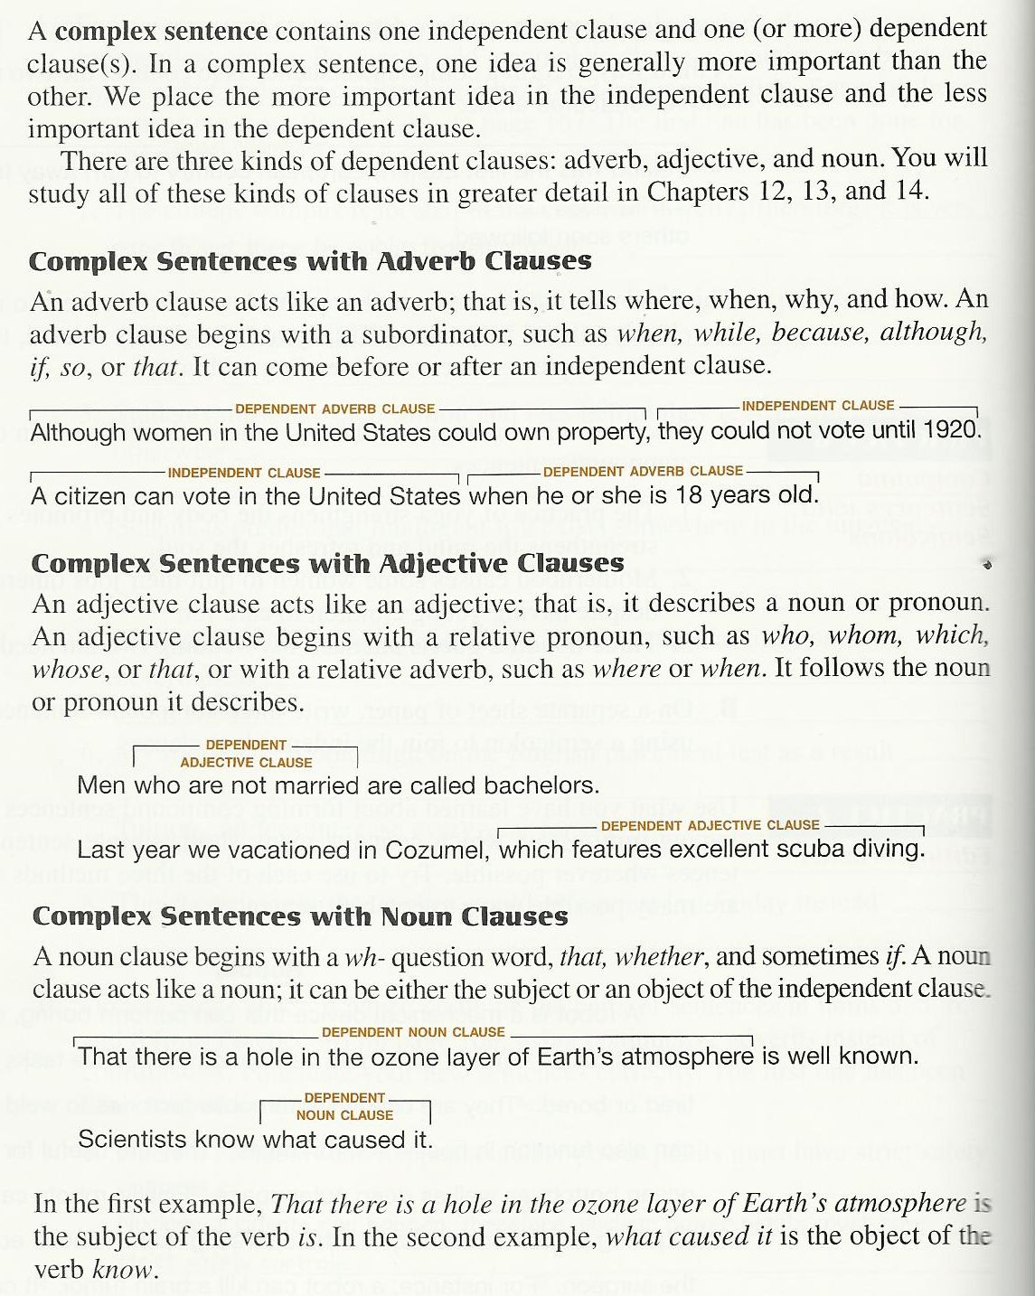

Slide 10
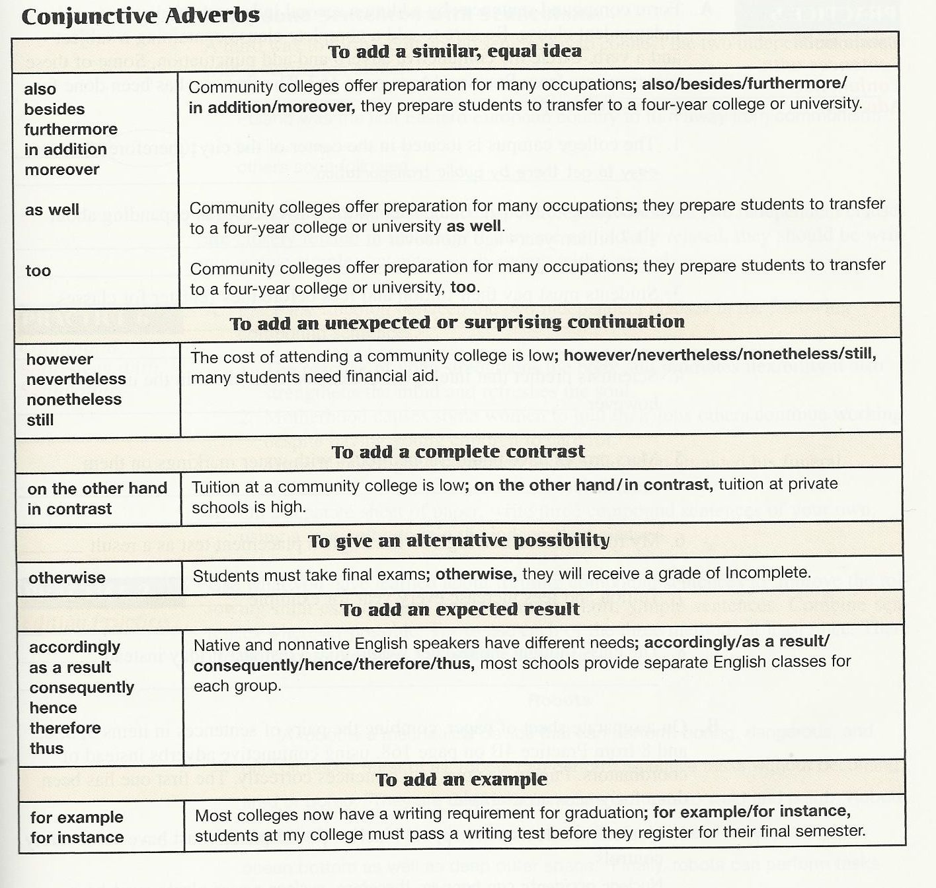

Slide 11
Relationship | Transition
Addition | Moreover Furthermore In addition besides
Contrast | However On the contrary In contrast On the other hand
Result or Effect | Consequently Accordingly Thus Hence Therefore As a result
Reinforcement/Emphasis | Indeed In fact

Slide 12
Relationship | Transition
Exemplification | For example For instance In particular
Time | Meanwhile (at the same time) Subsequently (after) Thereafter (after)
Reinforcement/Emphasis | Indeed In fact
Exemplification | For example For instance In particular

Slide 13
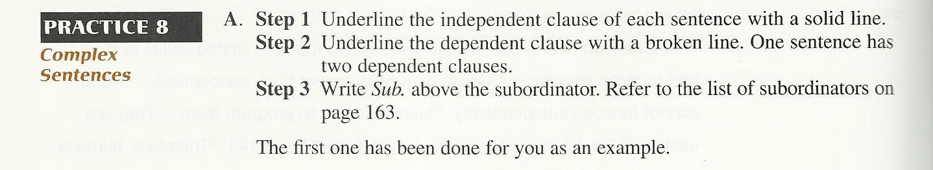
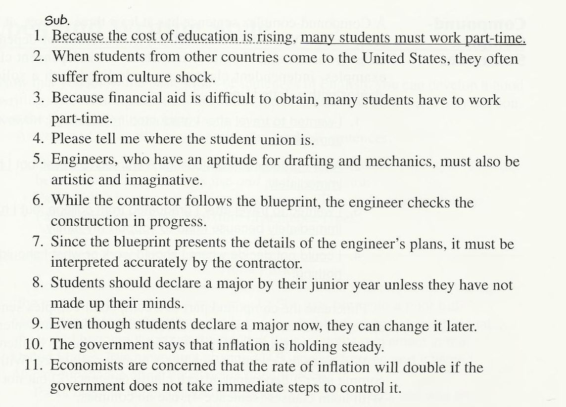

Slide 14
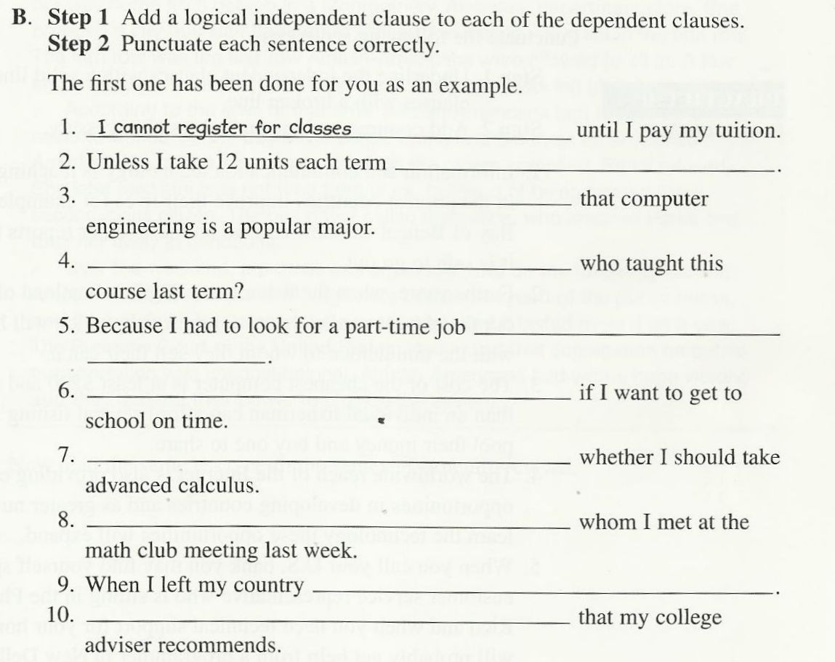

Slide 15
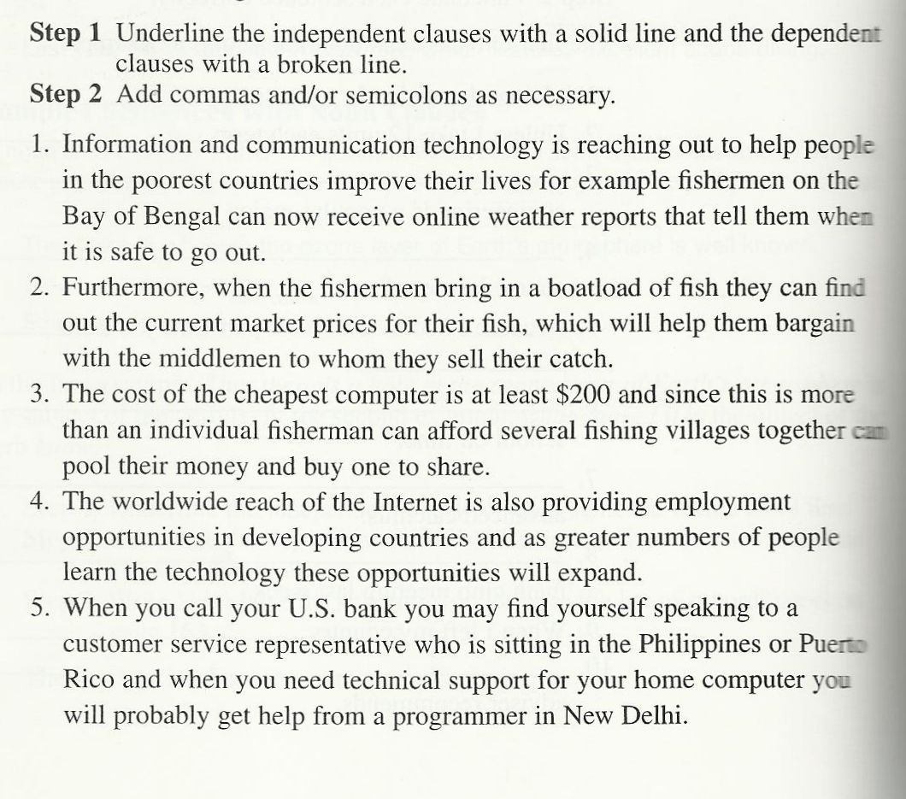

Slide 16

بحمد الله

