Slide 1

English Language
Essay
Instructor:
Ammar Sultan Al-Ma’ani
King Faisal University
e- Learning Deanship
& Distance Education
1

Slide 2
^{9th} Lecture

Slide 3
Elements of the Class
Types of Clause Independent & Dependent
and then
- Types of Sentences

Slide 4
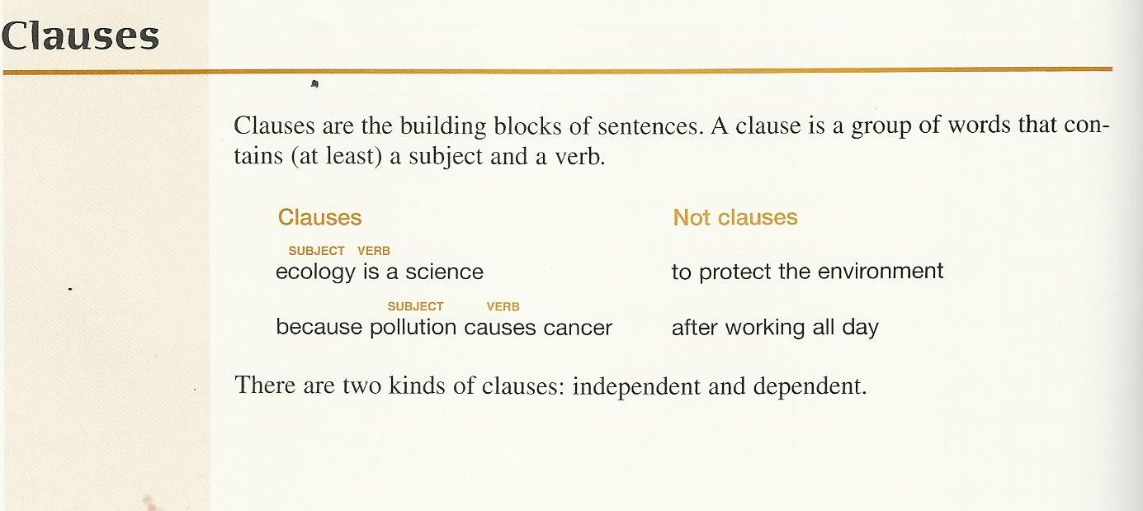

Slide 5
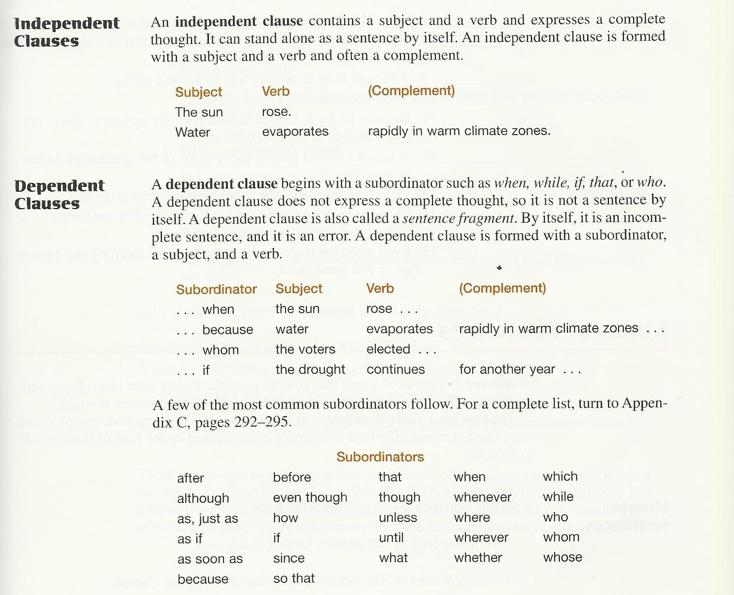

Slide 6

Varying Sentence Structure

Slide 7
Adding Variety to Sentence Structure
To make your writing more interesting, you should try to vary your sentences in terms of length and structure. You can make some of your sentences long and others short. Read the two paragraphs on the next page.

Slide 8
Two Paragraphs
Read the paragraphs below. Choose the
paragraph that is more effective.
I love living in the city. I have a wonderful view of the entire city. I have an apartment. I can see the Golden Gate Bridge. I can see many cargo ships pass under the bridge each day. I like the restaurants in San Francisco. I can find wonderful food from just about every country. I don’t like the traffic in the city.
I love living in the city of San Francisco. I have a wonderful view of the entire city from my apartment window. In addition, I can see the Golden Gate Bridge under which many cargo ships pass each day. I also like San Francisco because I can find wonderful restaurants with food from just about every country; however, I don’t like the traffic in the city.

Slide 9
How do you vary sentence structure?
You will want to use a variety of sentence structures in your writing. There are three types of sentences we will study in this lesson:
- Simple Sentence
- Compound Sentence
- Complex Sentence

Slide 10
The Simple Sentence
A simple sentence has one independent clause (one subject and a verb):
I live in San Francisco.
Subject
Verb

Slide 11
Compound Sentence
A compound sentence contains two independent clauses that are joined together.
She works in the city, but she lives in the suburbs.
Independent Clause
Independent Clause

Slide 12
Compound Sentence
You can make a compound sentence by joining two logically related independent clauses by using…
- a semicolon
- a coordinating conjunction
- a transition
Independent Clause + Coordinator + independent Claus

Slide 13
Using a Semicolon
Independent Clause ; Independent Clause
I love living in the city ; there are so many things to do.
Independent Clause
Independent Clause

Slide 14
Using a Coordinating Conjunction
Independent Clause ,coordinating conjunction Independent Clause
He couldn’t watch the show , so he decided to tape it.
Independent Clause
Independent Clause

Slide 15
Coordinating Conjunctions
Logical Relationship | Coordinating Conjunction
Addition | And
Contrast | But, yet
Choice | Or, nor
Cause | For
Result | So

Slide 16
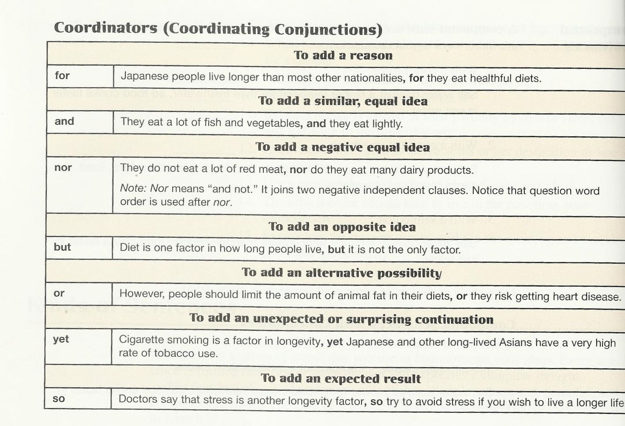

Slide 17
There are 7 coordinators: FANBOYS
Another way to remember these is…
For → F
And → A
Nor → N
But → B
Or → O
Yet → Y
So → S

Slide 18
CAUTION!
Do NOT use a comma every time you use the words and, or, but, nor, for, so, yet. Use a comma only when the coordinating conjunction joins two independent clauses.
Simple Sentence
The necklace was beautiful but expensive.
Independent Clause
No comma- not an independent clause

Slide 19
Using a Transition
Independent Clause ; transition , Independent Clause
I love San Francisco ; however, I hate the traffic.
Independent Clause
Independent Clause

Slide 20
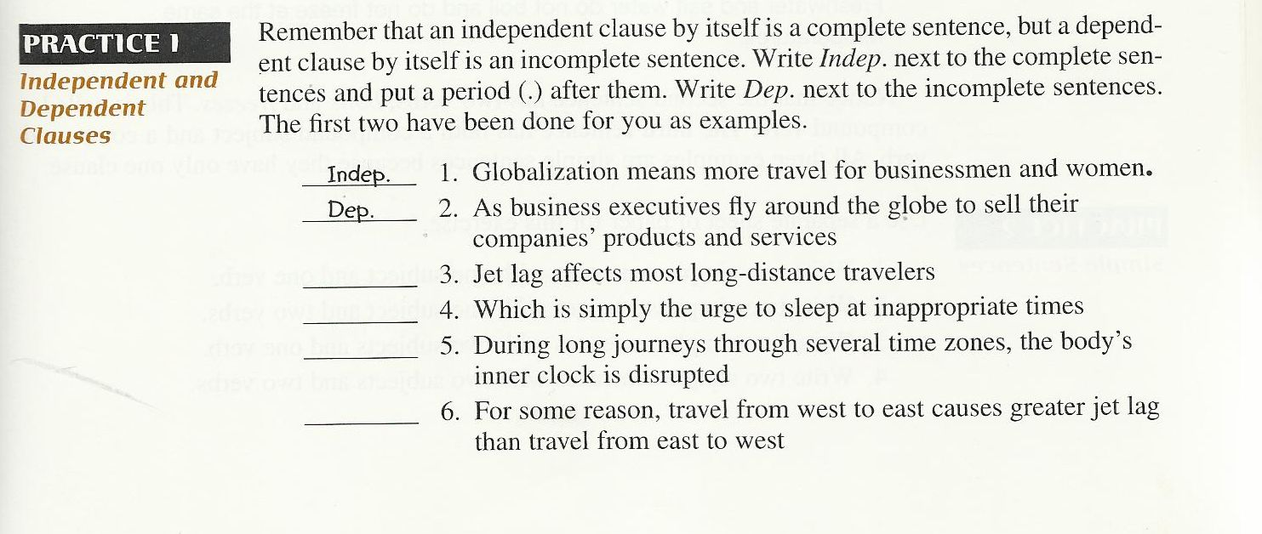
Independent C: 3, 5, 6,
Dependent , 4

Slide 21
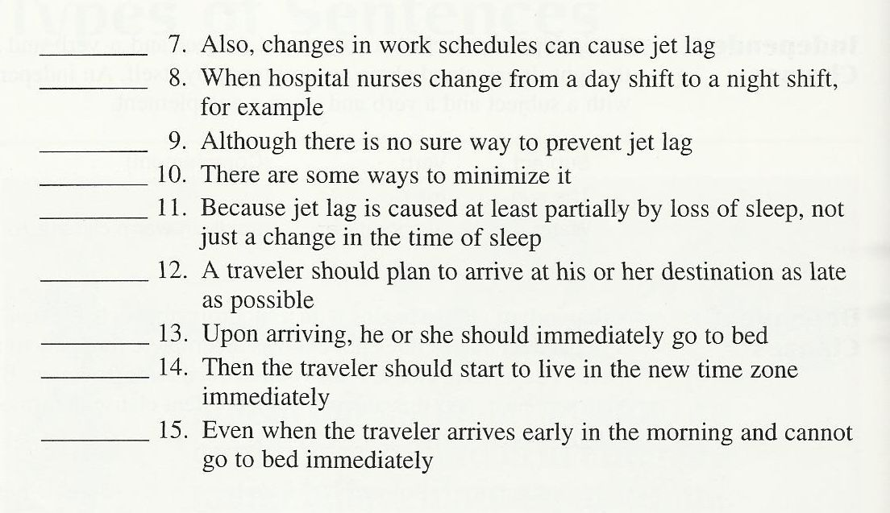

Slide 22
Homework
Practice 4, pages, 167 , 168
Practice 5, page 170

Slide 23

بحمد الله

