Slide 1

English Language
Essay
Instructor:
Ammar Sultan Al-Ma’ani
King Faisal University
e- Learning Deanship
& Distance Education
1

Slide 2
^{8th} Lecture
Comparison and Contrast Essay

Slide 3
Introduction to Academic Writing 2: Comparison and Contrast Essays

Slide 4
What are Comparison and Contrast Essays?
Comparing things is something we do every day when we have to make decisions. For example, you might think of similarities or differences when we are buying a new MP3 player or choosing a place to study English.
You may need to evaluate two sides of an issue you have studied in a class or two proposals for research or projects at your workplace. In these cases, you will need to write an essay or report to discuss your ideas about the topic. This is a comparison and contrast essay.

Slide 5
Comparison/Contrast Essay Organization
Like other types of essays, a comparison and contrast essay must have a clear introduction and conclusion.
The body of the essay can be organized many ways. We will look at two organizational styles.
Point by point organization
Block organization

Slide 6
The Introduction
For both types of organization, the introduction is the same.
Presents the topic or subject that is being compared and contrasted in the topic sentence.
Gives some general information about the topic
Ends with a thesis statement that tells the reader specifically what will be compared and contrasted.

Slide 7
Point by Point Organization
The body paragraphs alternate between similarities and differences.
In a short essay, one body paragraph will explain the similarities between the two subjects and one paragraph will explain the differences.
In a longer essay, one paragraph will explain similarities between one main idea in the two subjects and one paragraph will deal with differences in the same main idea, and so on.

Slide 8
Short Essay Organization
Introduction
Similarities
Differences
Conclusion

Slide 9
Longer Essay Organization
Introduction
Similarity #1
Difference #1
Similarity #2
Difference #2
Conclusion

Slide 10
Block Organization
In block organization, the body paragraphs first present the similarities in the two subjects. Then, in separate paragraphs, the differences are presented.
For the short essay, the organization is similar to Point by Point Organization.
For the longer essay, the body paragraphs first present the similarities as a set then, after a transition, present the differences as a separate set.

Slide 11
Short Essay Organization
Introduction
Similarities
Differences
Conclusion

Slide 12
Long Essay Organization
Introduction
Similarity #1
Similarity #2
Transition
Difference #1
Difference #2
Conclusion

Slide 13
The Conclusion
For both types of comparison and contrast essay, the conclusion is the same.
Restate the topic
Restate or summarize the similarities and differences between the two topics
Give your opinion or feeling about the topic make a prediction, or explain the results

Slide 14
Let’s look at some sample essays

Slide 15
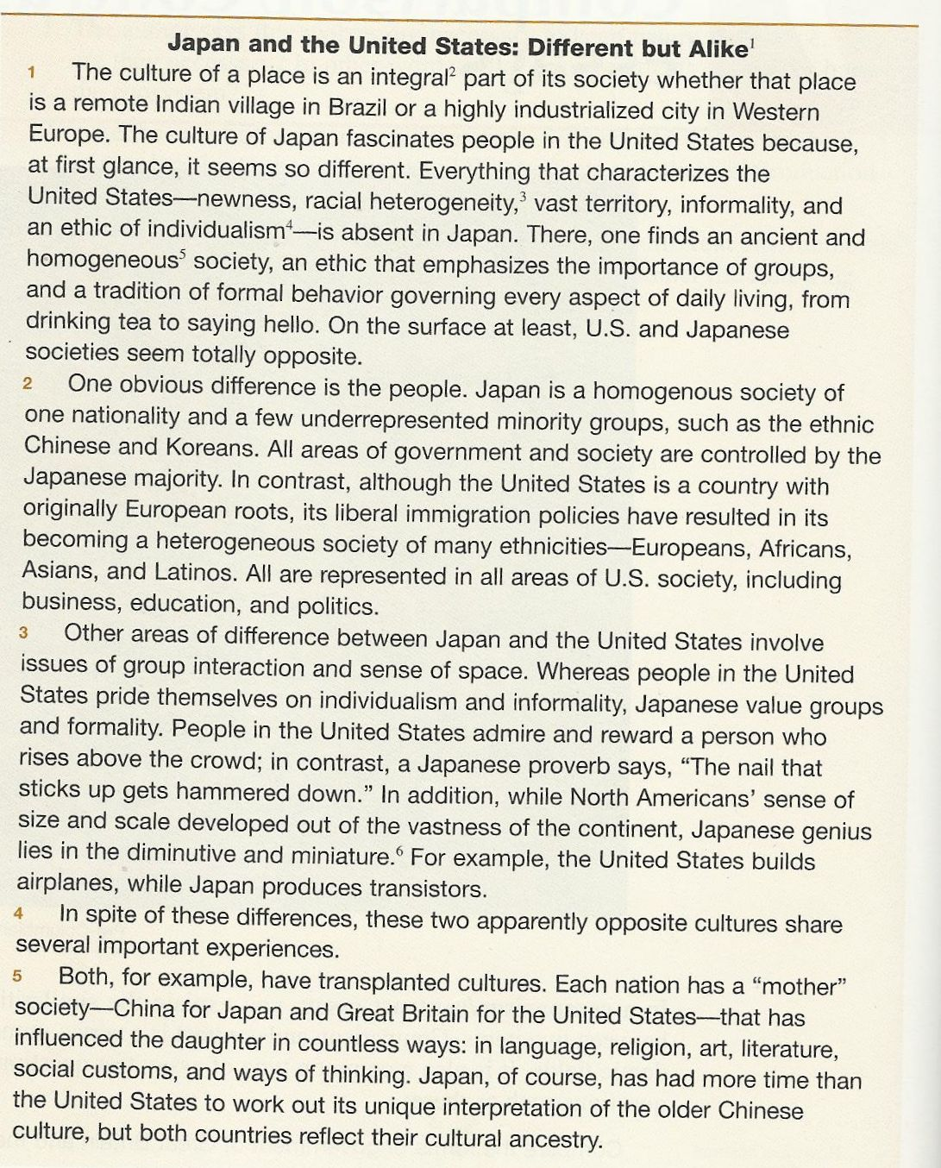

Slide 16
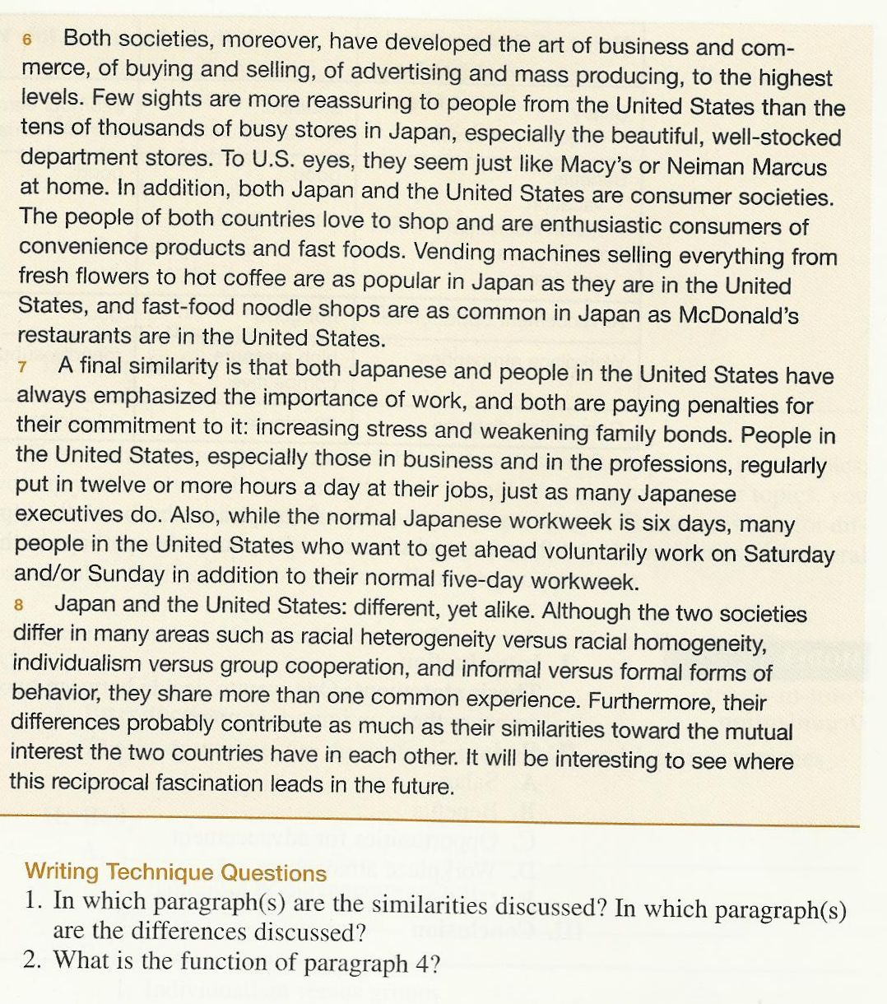
It is a transition paragraph introducing the second half of the essay.
Similarities are discussed in paragraphs 5, 6, and 7.
Differences are discussed in paragraph 2 and 3.

Slide 17
A Short Essay
Point by Point or Block Organization

Slide 18
The Introduction
Introduces the topic and general information
There are two places that have had a profound impact on my life. One of them is New York City, and the other is Quetzaltenango, Guatemala. When you compare them, they seem like dramatically different places, but they have some things in common, and I love them both.
The specific things that will be compared. It also gives the writer’s opinion about the topic

Slide 19
Introduces the similarities with general statements
There are many reasons why New York seems like my home away from home. Both cities are striking and distinctive. For example, each has its own nickname. Everyone knows New York is “the Big Apple.” Quetzaltenango is known as “Xela” (pronounced (shey-la), which is a lot easier to say! Second, both cities have a “Central Park” where people like to go and walk. Although Central Park in Xela is smaller, its tropical flowers and colonial architecture mean it is just as beautiful as New York’s. Furthermore, when you walk around Xela, you find many tourists and people from other countries, just like New York. For me, this means conversations in Xela are just as interesting as conversations in New York.
Examples of similarities between the two cities explain why the writer likes the two cities

Slide 20
Despite their similarities, these cities are different. Life in Xela is more colorful and the pace of life is slower. For this reason, whenever I return to Xela, it is like an escape. When I arrive, the first thing I notice is the color. In New York, many people wear black to be stylish, but in Xela stylish clothing is the rainbow-colored clothing of the indigenous people. And because Xela is smaller, the beautiful green mountains outside the city are always visible. The second thing I notice is the pace of life.
Introduces the differences
Specific examples of the differences

Slide 21
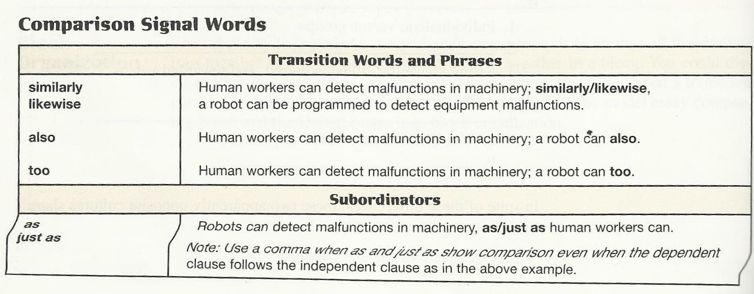

Slide 22
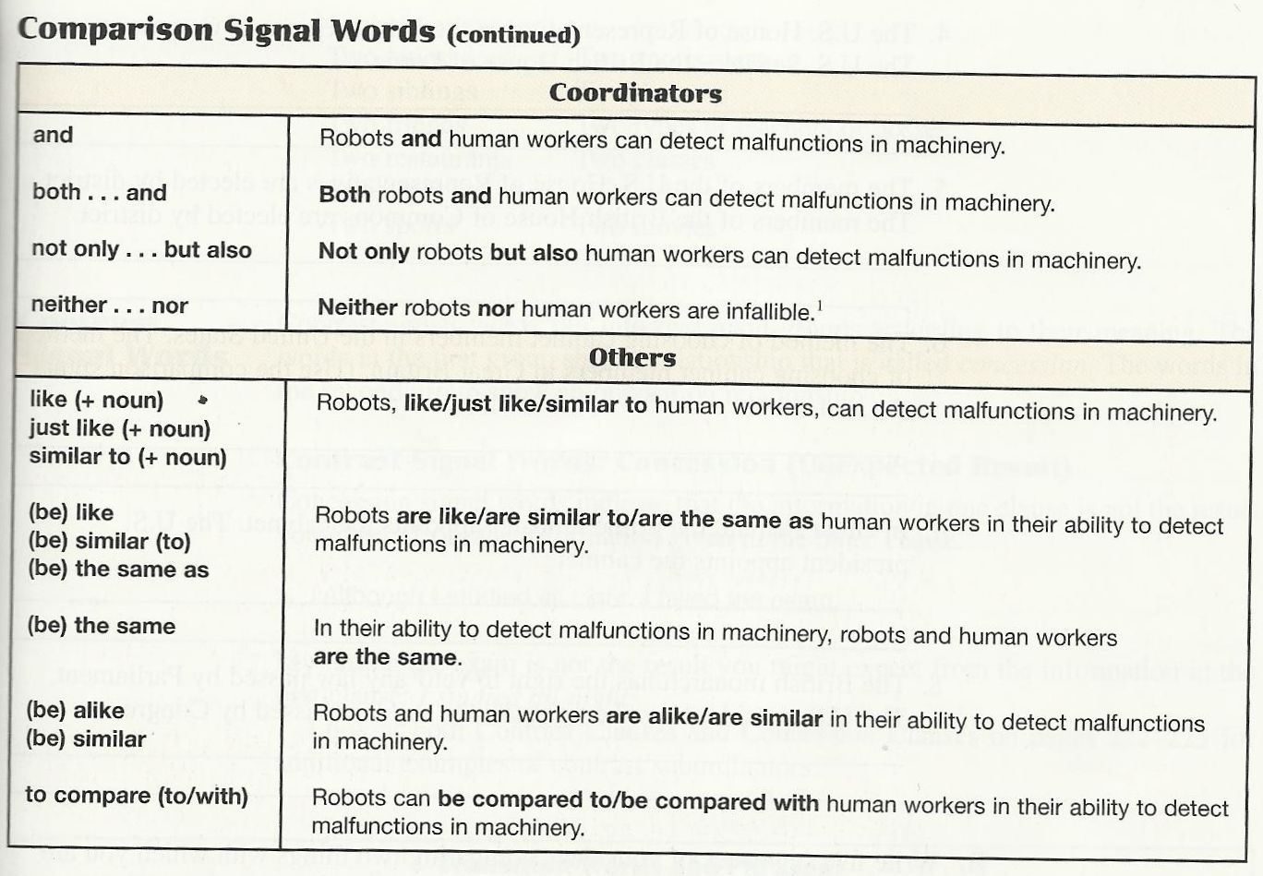

Slide 23
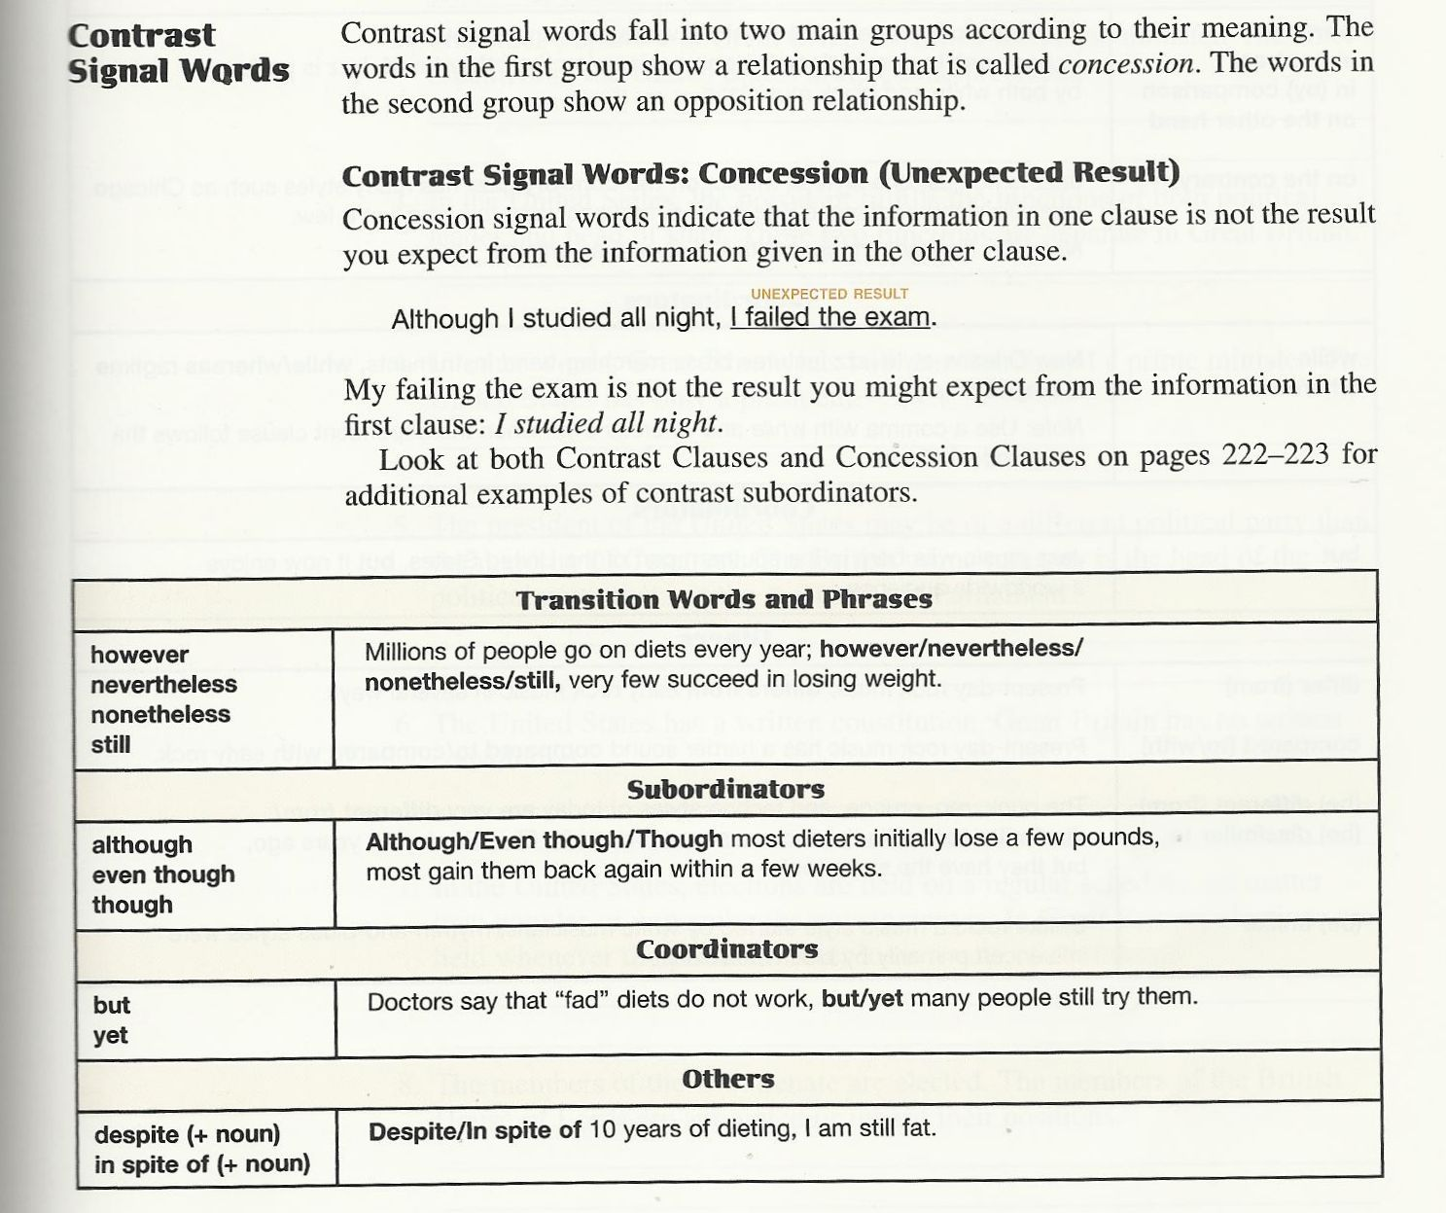

Slide 24
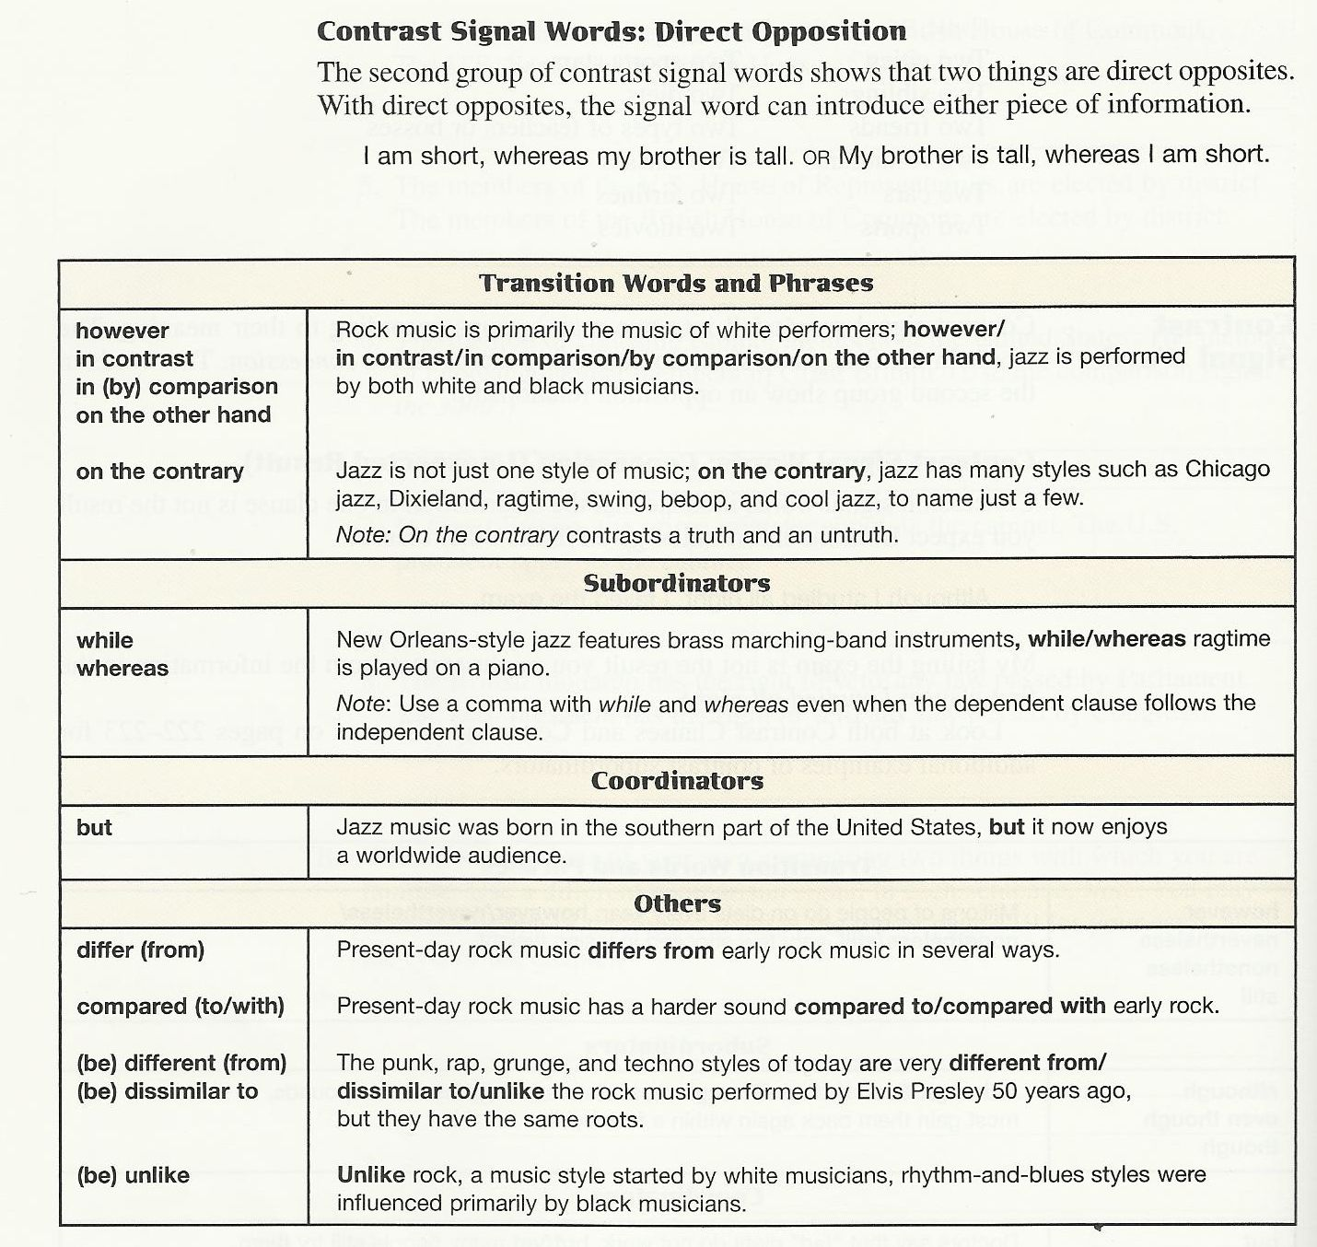

Slide 25
Homework
Practice 2, pages 117-118
Practice 3, page 121

Slide 26

بحمد الله

