Slide 1

اسم المقرر
الفكرة و الثقافة الإنجليزية
أ. جمال رفيق محمد
جامعة الملك فيصل
عمادة التعلم الإلكتروني والتعليم عن بعد
1

Slide 2
المحاضرة الثالثة عشر
.......................

Slide 3
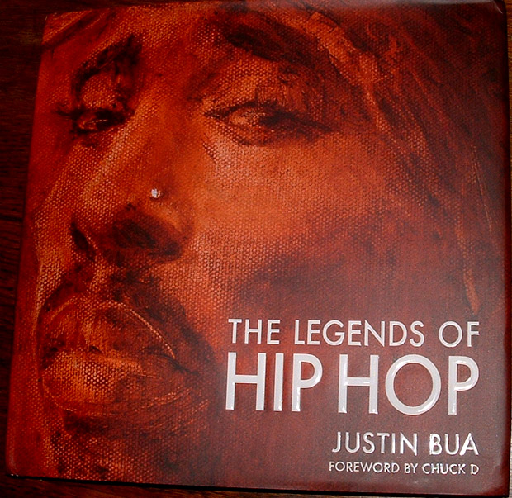
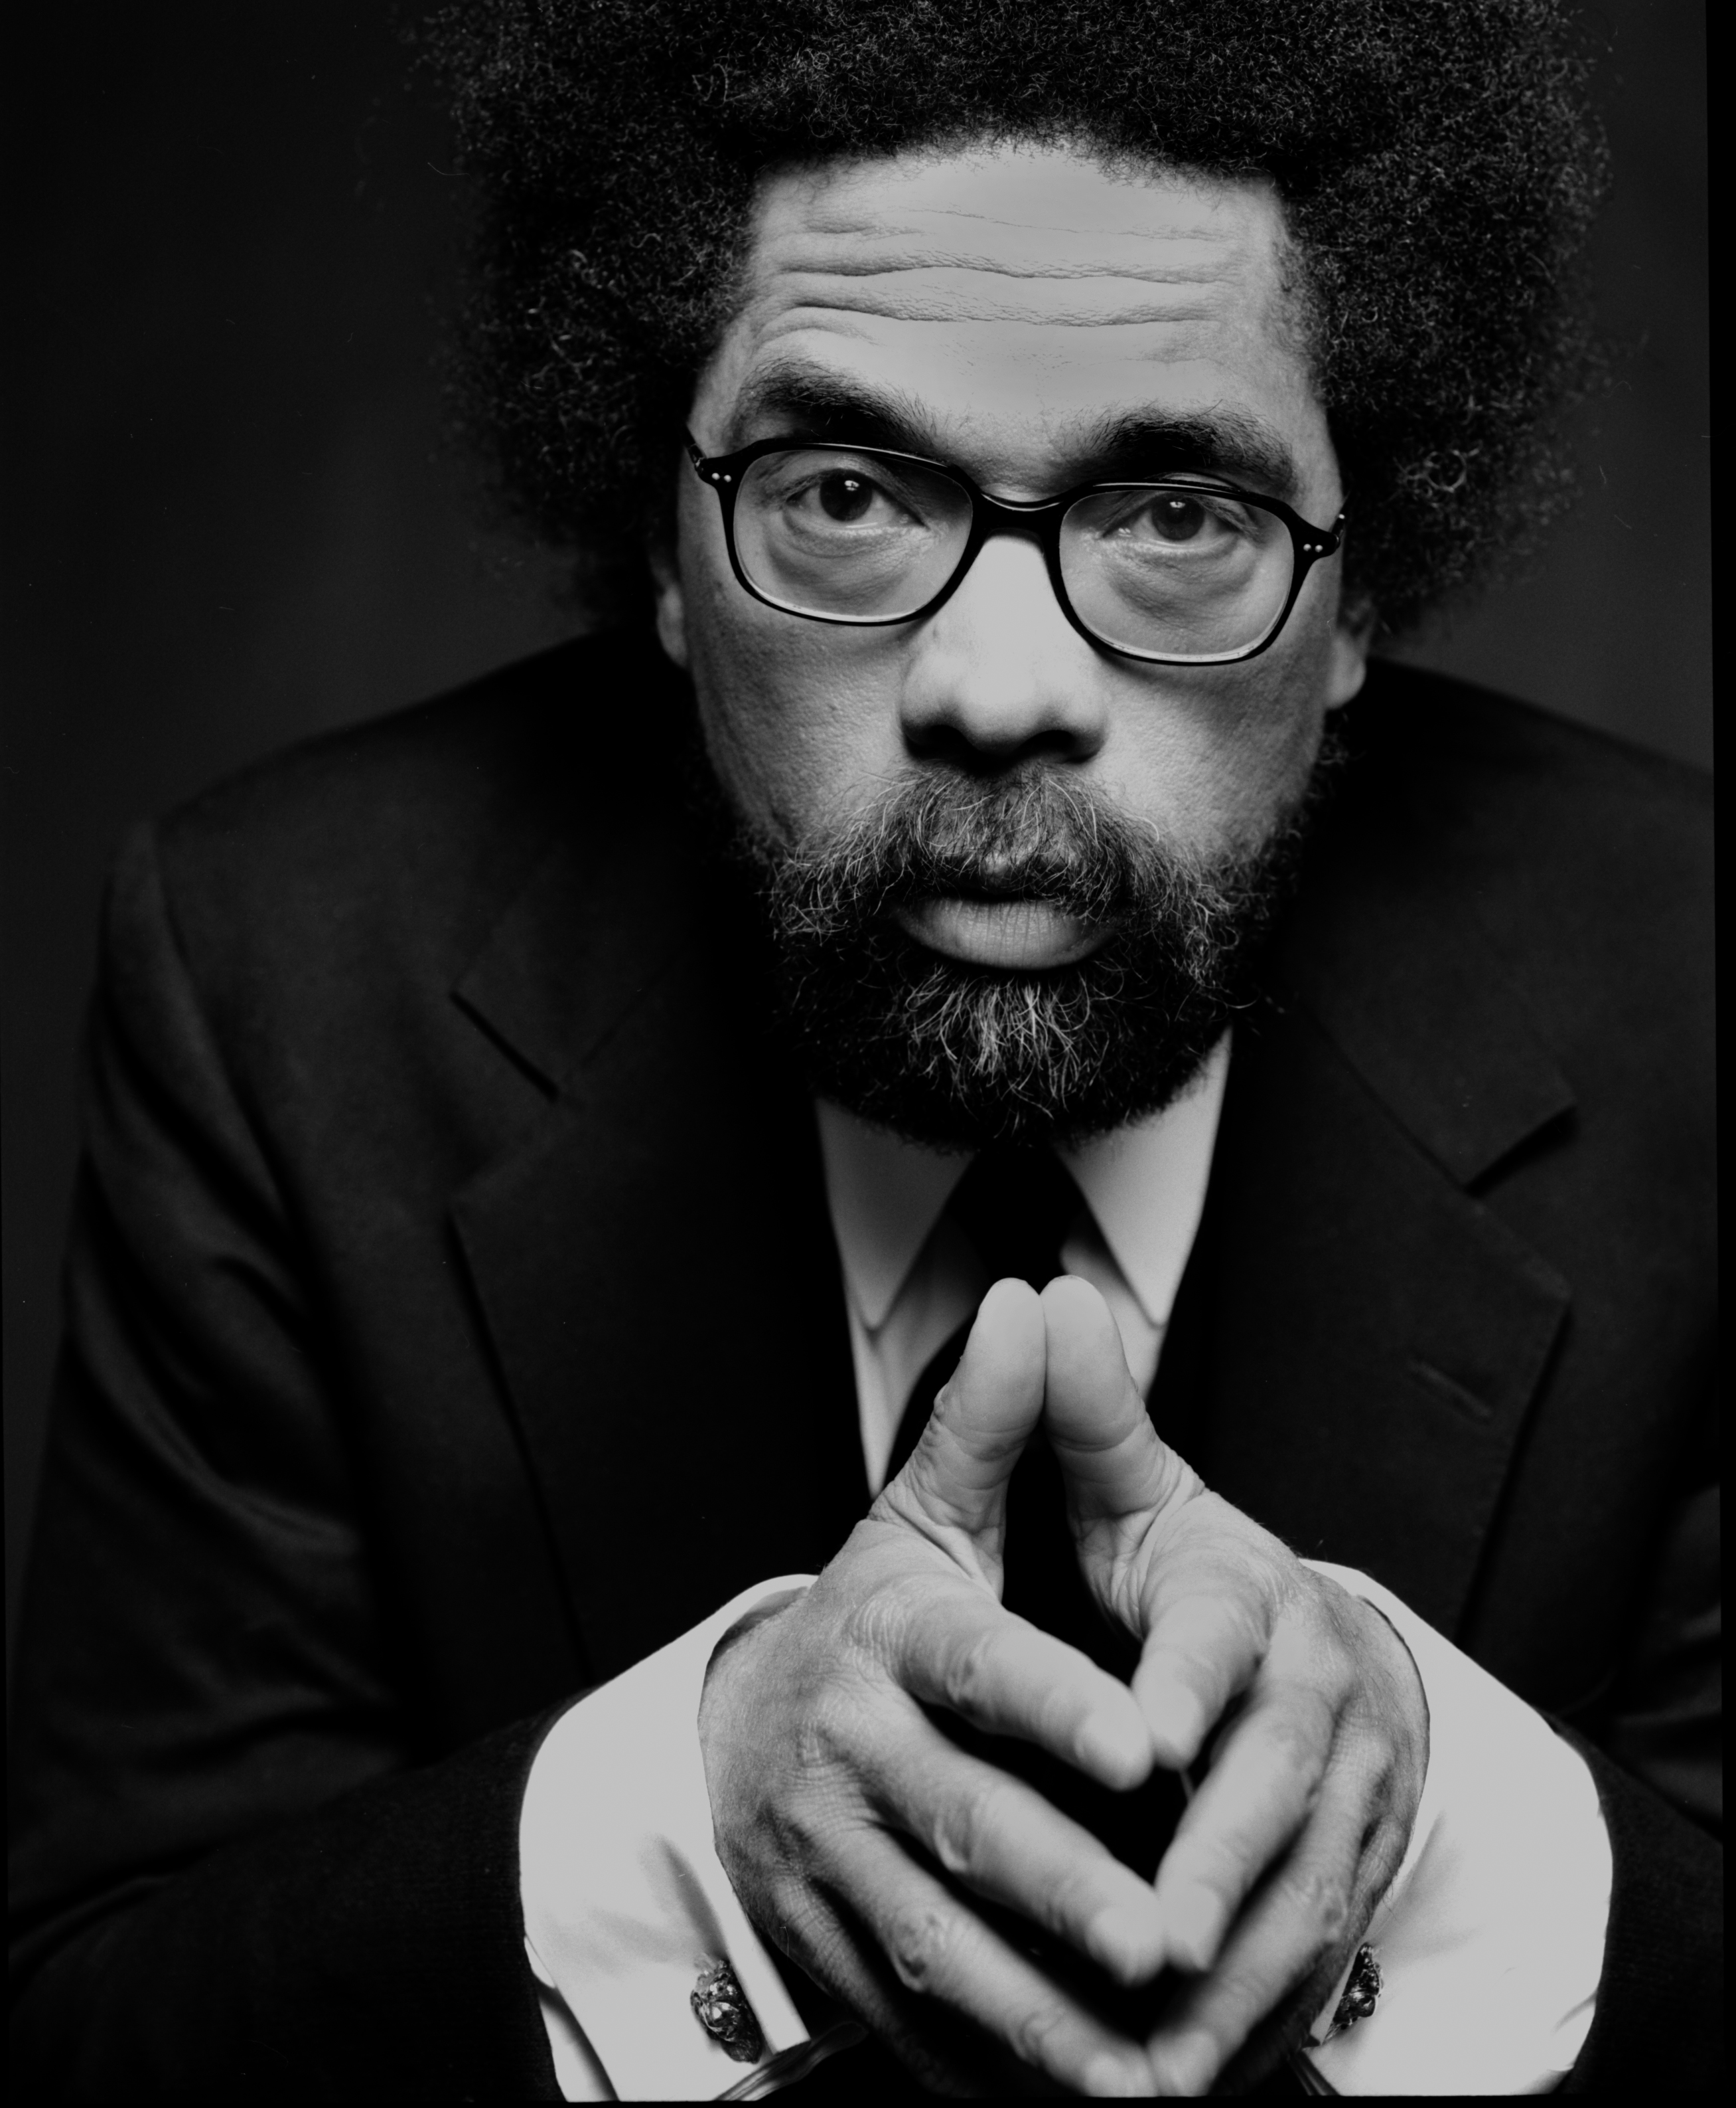
عناصر المحاضرة
African American Vernacular
And
Hip Hop Culture

Slide 4
عناصر المحاضرة
The Development of AAVE
There are two main hypotheses about the origin of AAVE. One is the dialect hypothesis and
the other is the creole hypothesis. The dialect hypothesis is the belief that African slaves,
upon arriving in the United States, picked up English very slowly and learned it incorrectly,
and that these mistakes have been passed down through generations. In other words, AAVE
is just "bad English." The creole hypothesis, however, maintains that modern AAVE is the
result of a creole derived from English and various West African Languages. Slaves, who
spoke many different West African languages, were often thrown together during their passage
to the New World. To be able to communicate in some fashion they developed a pidgin by
applying English and some West African vocabulary to the familiar grammar rules of their
native tongue. This pidgin was passed on to future generations, and as soon as it became
the primary language of it's speakers it is classified as a creole. Over the years AAVE has
gone through the process of decreolization and is beginning to sound more like Standard
English.

Slide 5
عناصر المحاضرة
AAVE grammatical Aspects
Aspect | Example | SE Meaning
Habitual/continuative aspect^{[44]} | He be working Tuesdays. | He works frequently or habitually on Tuesdays.
Intensified continuative (habitual) | He stay working. | He is always working.
Intensified continuative (not habitual)^{[45]} | He steady working. | He keeps on working.
Perfect progressive | He been working. | He has been working.
Irrealis | He finna go to work. | He is about to go to work.ª

Slide 6
عناصر المحاضرة
Ebonics and Pop Culture
During the 1960’s and 1970’s, Ebonics became more widespread in films and music
1970’s blacksploitation movies popularized many aspects of AAVE as “cool”.
Sitcoms also allowed AAVE more mainstream exposure. (Sanford and Son)
The end of the civil rights movement resulted in White America developing a sense of guilt over the treatment of Blacks, which resulted in greater acceptance and a reluctance to criticize black culture.

Slide 7
عناصر المحاضرة
Hip Hop
The 1980s saw the emergence of a new style of music in the poor areas of the inner city, called rap and hip-hop. This developed into its own sub-culture.
Today the influence of hip hop can be seen in films, TV, and mainstream music, and in recent times has expanded globally.
Now, as far away as Jeddah KSA, the influence of hip hop can plainly be seen.

Slide 8
عناصر المحاضرة
End of Lecture

Slide 9

بحمد الله

