Slide 1

English Language
Speaking Skills
Instructor: Ammar Sultan Al-Ma’ani
King Faisal University
e- Learning Deanship
& Distance Education
1

Slide 2
14th Class

Slide 3
The Sound of it: Understanding Intonation in Tag Questions
We often a conversation with a sentence that includes a tag question. We add a “tag” to a sentence, and it becomes a question. Our voices goes up on the tag if we aren’t sure about the answers; it becomes a real question. Our voices goes down on the tag if we already know the answer and are making small talk.
Examples:
You will do it quickly,won't you?
John and Mark aren't English,are they?

Slide 4
Common Expressions in Conversation
Introducing Someone | Responses
- I’d like you to meet… This is… a friend of mine (my brother, sister, etc.) Have you met..? | Nice (Glad, Pleased) to meet you.
Ending a Conversation
Well, I’ve got to run. Good-bye. See you later (Friday, etc.). Have a good day. Have a good weekend | I have to go now, but I’ll see (call) you … It’s been good seeing you (talking to you). Talk to you soon. Keep in touch.
Expressing Thanks | Responses
Thanks. Thank you very much (so much) That was very kind of you, How thoughtful! I appreciate it. I’m very grateful. | You’re welcome. Don’t mention it.
Giving an Apology | Responses
I’m very sorry. Excuse me. Forgive me. It was my fault. | No problem., That’s ok. That’s all right. Don’t worry about it. a

Slide 5
The sound of it: Understanding Reductions
In a normal or fast speech, you will hear “reductions” of some words. For instance, want to may sound like wanna. Learning to understand reductions will help you become a better listener.
Listen to the following examples of reductions form the conversations in this chapter. →

Slide 6
CD 1, TR 12- 13 (A)
Can you hear the difference between the long forms and the short forms? Note: The short forms are not correct in writing.
LONG FORM | REDUCTION | SHORT FORM
Do you have any pets? | You → ya | Do ya have any pets?
What’s your name? | What’s you → watcher | Watcher name?
Does this bus go to Geary Street? | Go to → goda | Does this bus goda Geary Street?
Do you want to see the kitchen? | Want to → wanna | Do you wanna see the kitchen?
You have to have exact change. | Have to → hafta | You hafta have exact change

Slide 7

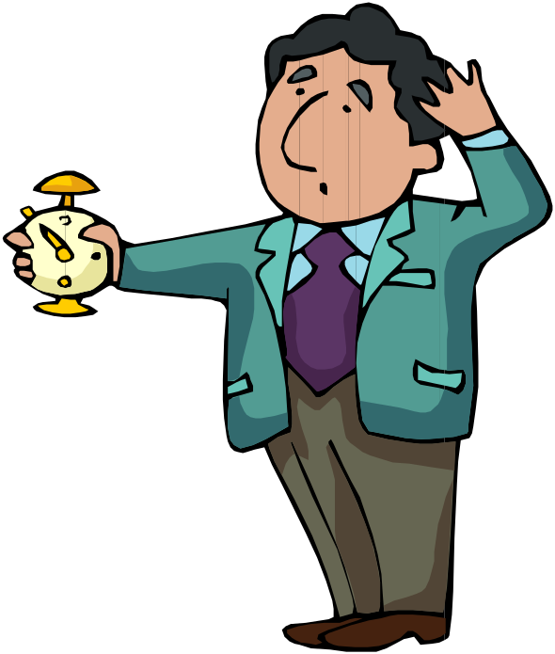
Gerunds as Subjects
A gerund can be the subject of a sentence. It is always singular. Use a third-person singular verb after a gerund.
singular subject
Voting
is an important responsibility.
Choosing
a candidate takes time.

Slide 8
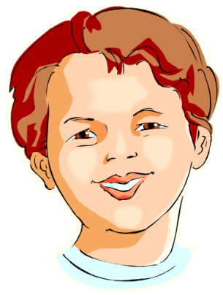
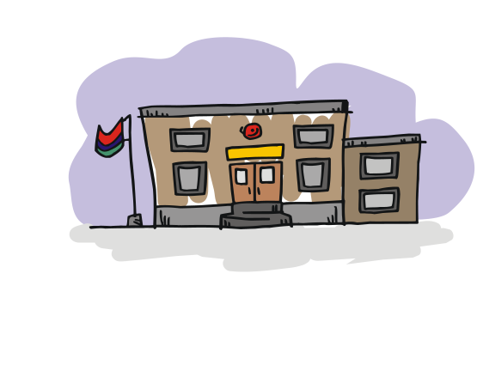
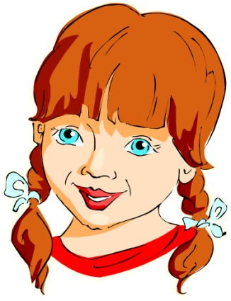
Gerunds as Objects
A gerund can be the object of certain verbs.
object
verb
I suggest improving our schools.
suggest
verb
object
enjoy
I enjoy working for the people.

Slide 9
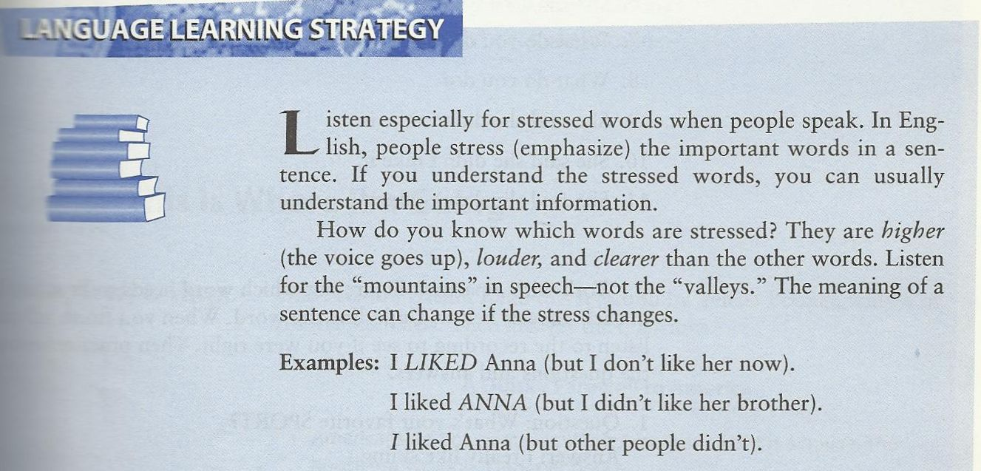
CD 1, TR 20-23

Slide 10
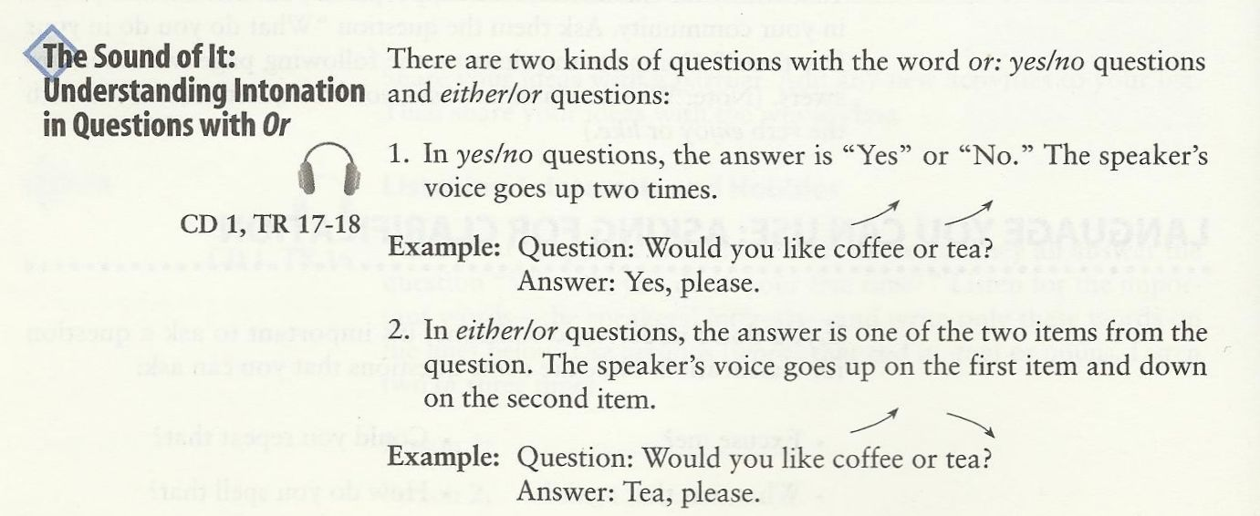

Slide 11
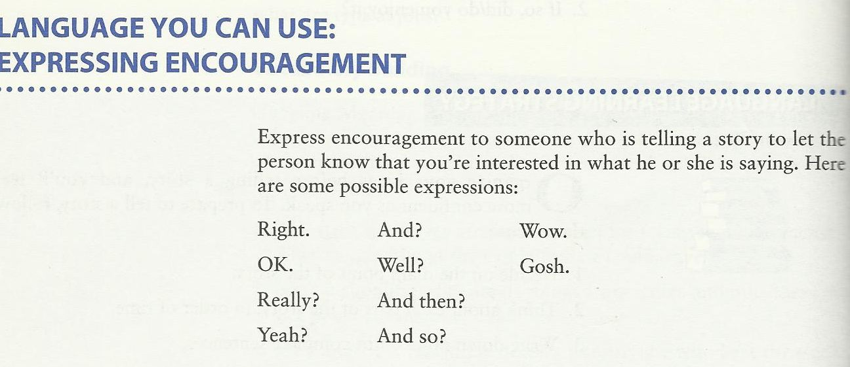

Slide 12
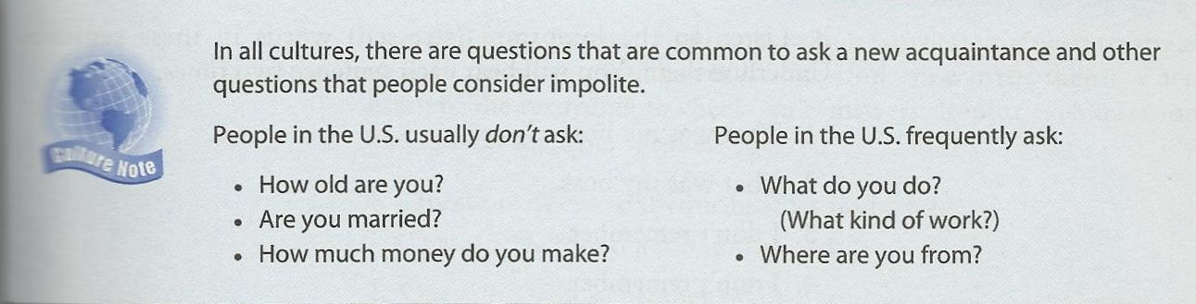

Slide 13
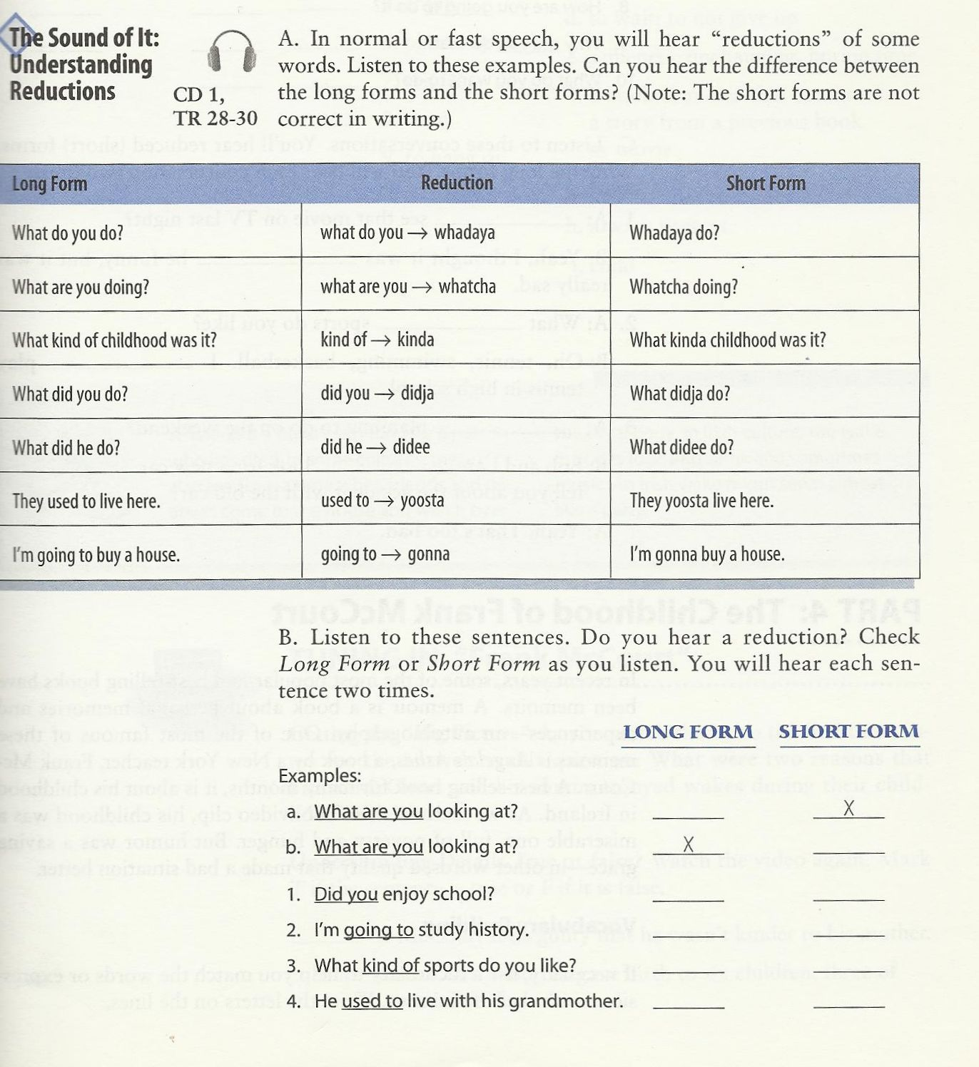

Slide 14
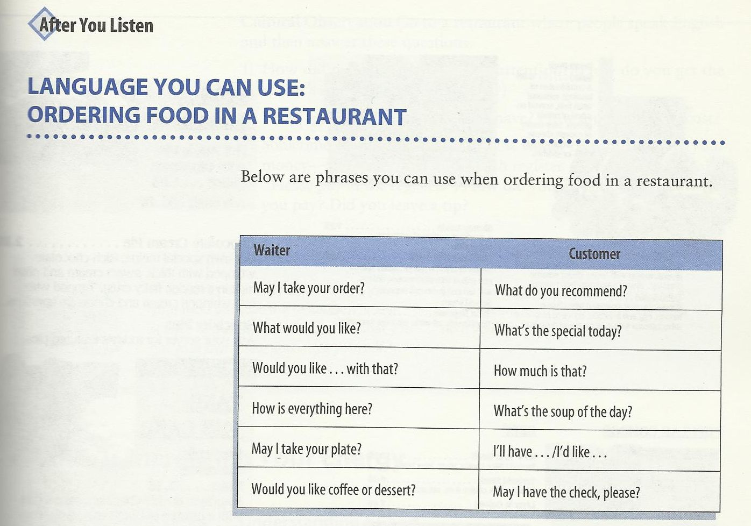

Slide 15
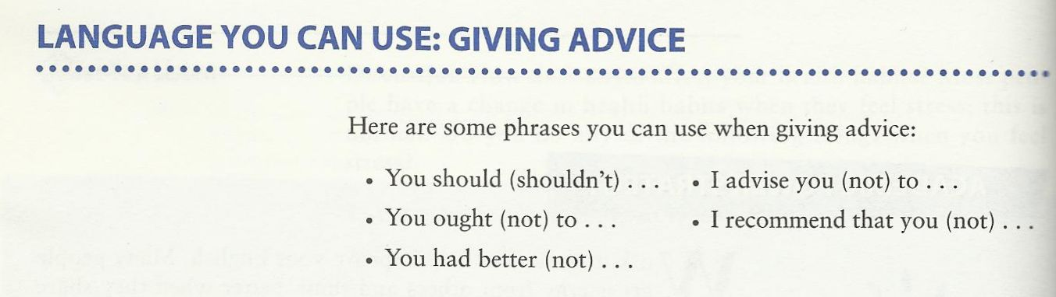

Slide 16
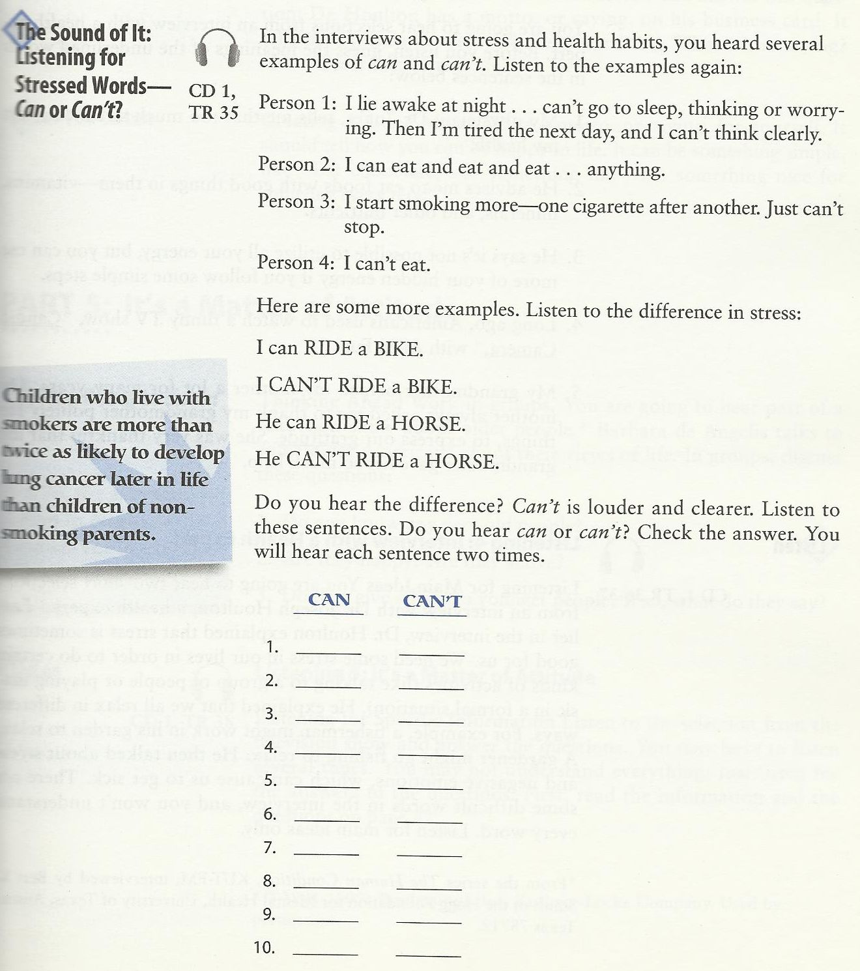

Slide 17
Exercise : Start Short Conversation With Strangers.
at the bus stop?
At the post office
At a wedding
In a supermarket
On a bus
Anywhere
In a museum
It’s hot today, isn’t it?
This line is really slow, isn’t it?
It’s nice to have a chance to celebrate, isn’t it?
These tomatoes look terrible, don’t they?
What country are you from?
Can you lend me some money?
This is a wonderful painting, isn’t it?

Slide 18
Say the Following Correctly.
Unsure of the Answer (Real Questions)
Sure of the Answer (small talk)
The food is awful, isn’t it?
You don’t see any fresh fruit, do you?
There isn’t any yogurt, is there?
The food is awful, isn’t it?
You don’t see any fresh fruit, do you?
There isn’t any yogurt, is there?

Slide 19
Study this situation ☺
Situation : your class colleague is talking about a topic that you are unfamiliar with. You want to ask him or her for clarification. What should you say?
Excuse me, What was that again?
Or
Could you repeat that?
Or
How do you spell that?

Slide 20

What are modals?
Auxiliary verbs
  Can
  Could
  Had better
  a
  Might
  Must
  Ought to
  Shall
  Should
  Will
  Would
How could I teach modals?
Should I teach them?

Slide 21
Showing strong necessity:
Must………I must go to sleep!
Have to……..I have to go to sleep!
Have got to…I have got to go to sleep!

Slide 22
Had better…for a warning!
Use “had better” to give a warning that something bad will happen if the advise is not followed.
You had better study tonight or you might fail the test.
He had better go home now or he will be in trouble!

Slide 23
Use Should to offer advise
Should means…it would be a good idea.
You should eat something you are hungry.
You should read a book and turn off the television.
They should stop being so loud.
We should have a party at the beach.

Slide 24
Could or might are more gentle than should….
You could read a book.
They might like the movie.
We could buy some candy.
I might play basketball.
He could win your blue marble.

Slide 25
Showing strong necessity:
Must………I must go to sleep!
Have to……..I have to go to sleep!
Have got to…I have got to go to sleep!

Slide 26
Had better…for a warning!
Use “had better” to give a warning that something bad will happen if the advise is not followed.
You had better study tonight or you might fail the test.
He had better go home now or he will be in trouble!

Slide 27
Use Should to offer advise
Should means…it would be a good idea.
You should eat something you are hungry.
You should read a book and turn off the television.
They should stop being so loud.
We should have a party at the beach.

Slide 28
Could or might are more gentle than should….
You could read a book.
They might like the movie.
We could buy some candy.
I might play basketball.
He could win your blue marble.

Slide 29
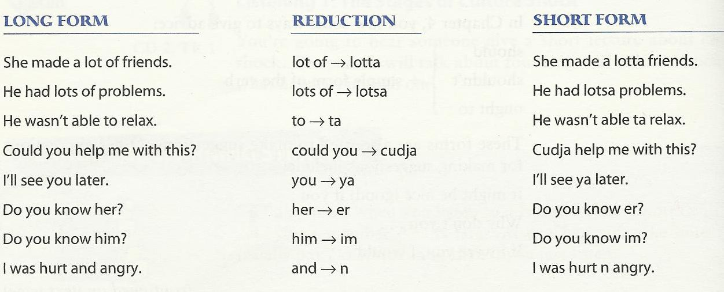
The Sound of It: Understanding Reductions

Slide 30
What are participles?
A participle is a form of a verb that functions as an adjective.

Slide 31
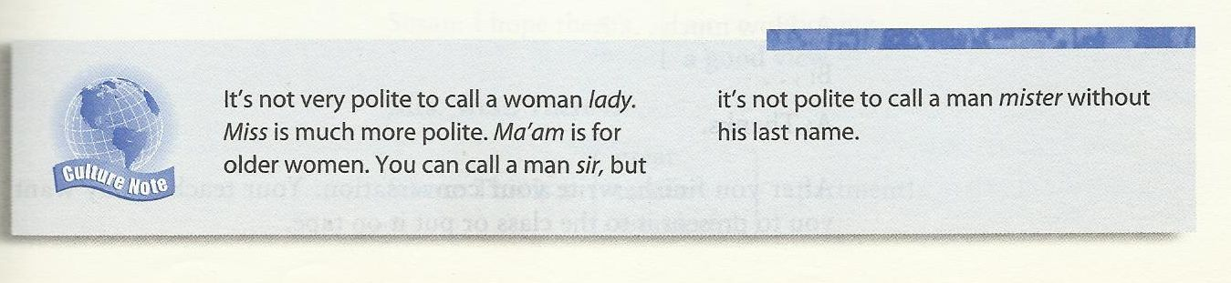

Slide 32
Getting Meaning from Context
Definition
A definition gives the meaning of words. The writer may use words, phrases, or statements to define something. The writer will use key words, or signal words to identify a definition so you need to look for them. See examples of key words below.
Key words is/are means/mean
is/are called what this means is
is/are known as consist of
is/are defined as refer to
is/are described as may be seen as
e.g.
Someone who explores and studies caves is known as a spelunker.
an unfamiliar word = spelunker
signal words = is known as
definition = someone who explores and studies caves

Slide 33
2. Restatement
The writer may use other words, phrases, or sentences to provide the meaning of difficult words. We call this restatement; the writer describes it again or in a different way. Signal words for restatement are in the “Key words box” below.
e.g.
The surface of Africa consists mainly of plateaus, or large flat areas, although these occur at different levels.
an unfamiliar word = plateaus
signal word = or
meaning = large flat areas
or
that is to say
in other words
i.e. or that is

Slide 34
3. Punctuation marks
Punctuation is used to describe the meaning of unfamiliar words. The writer will write unfamiliar words and then use punctuation, words, phrases, or sentences to explain the meaning of the new words. Such punctuation is in the “Key words box” below.
e.g. Full-color pictures are printed using only black and three colors: yellow, cyan (a light blue) and magenta (a light purple).
an unfamiliar word = cyan and magenta
signal punctuation = ( )
meaning : cyan = a light blue and magenta = a light purple
The use of computers to handle text, or word processing, was foreseen in the 1950s.
an unfamiliar word = handle text
signal punctuation = , ,
meaning : handle text = word processing
, commas
, , appositive
( ) parentheses
? ? dashes
; semicolon
: colon

Slide 35
4. Examples
help us to understand the meaning of new words. See key words or signal words used for
showing examples in the “Key words box”.
e.g.Use navigation buttons, such as, the “Next” button, the “Previous” button, the “Menu” button, and the “Exit” button, to go back and forth or jump to other topics while you are using your English software.
unfamiliar words = navigation buttons
signal word = such as
meaning = buttons on computer program that are used for turn on pages
such as
like
for example, …
for instance
is / are

Slide 36
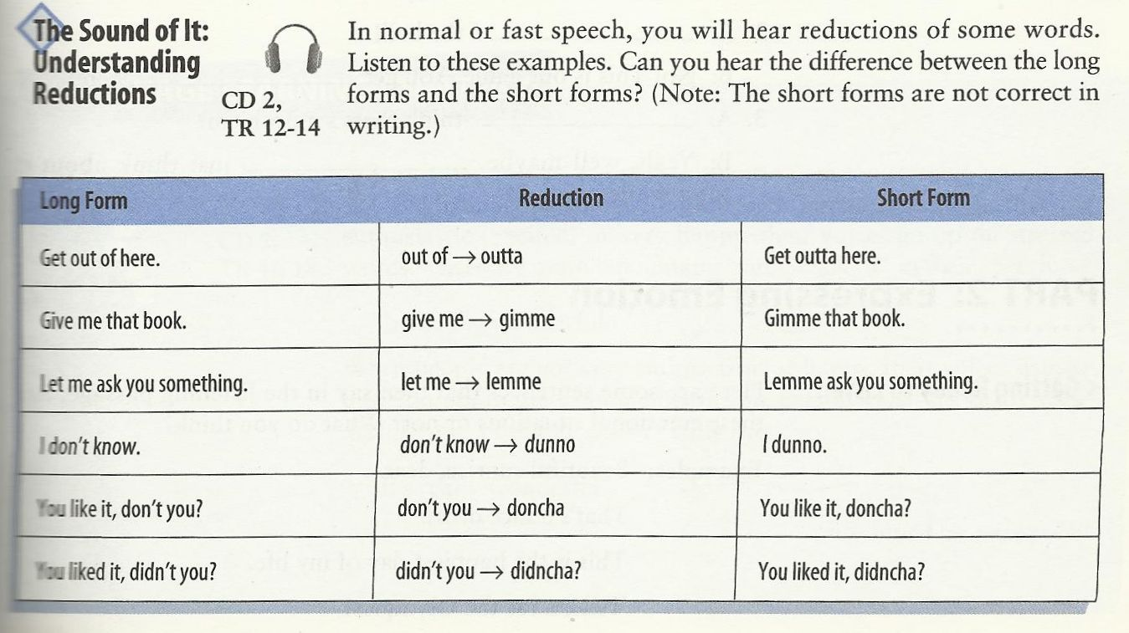

Slide 37
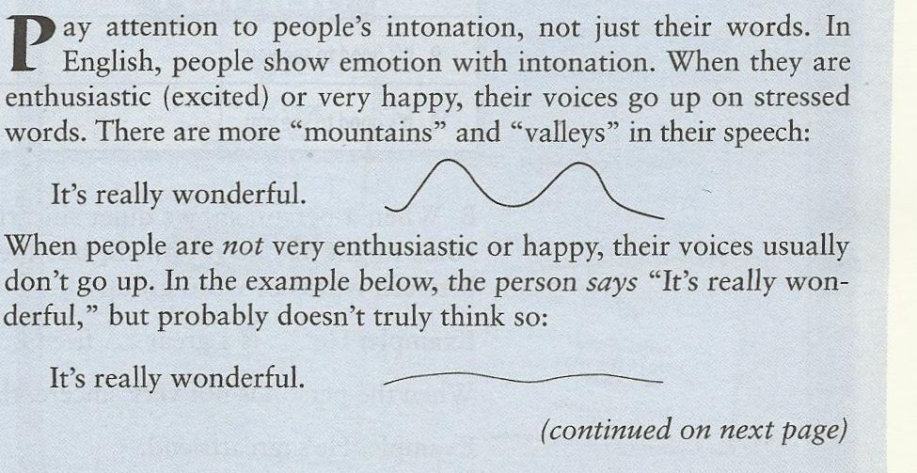

Slide 38
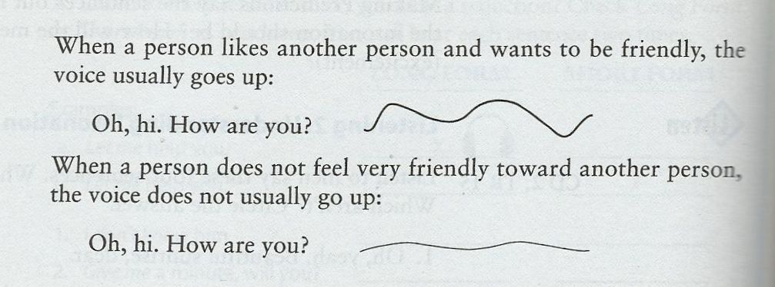

Slide 39
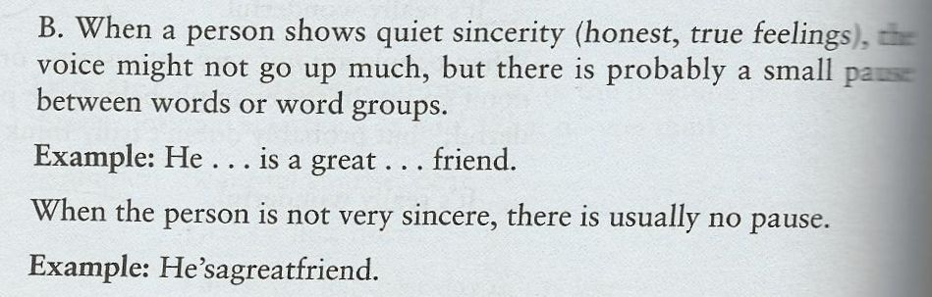

Slide 40
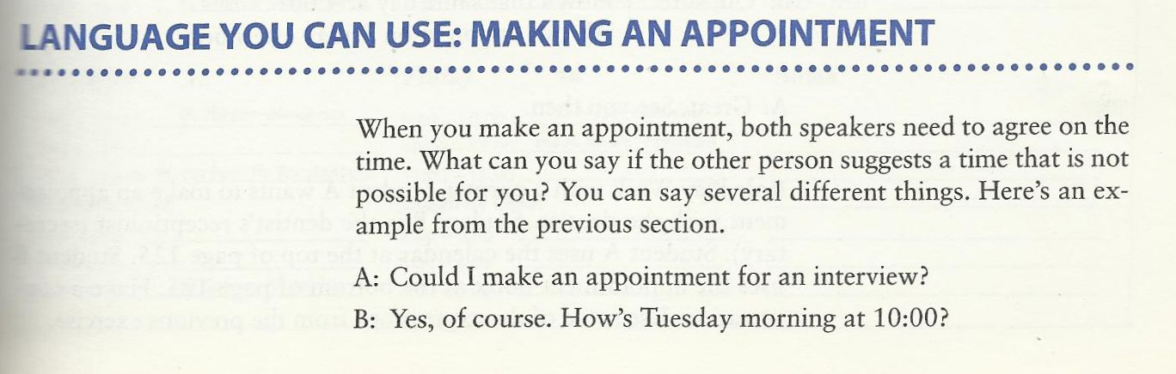

Slide 41
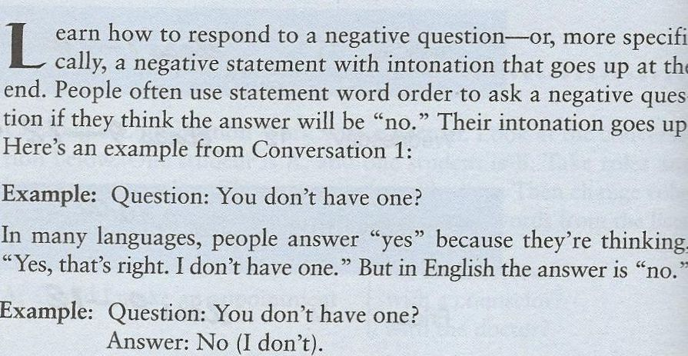

Slide 42
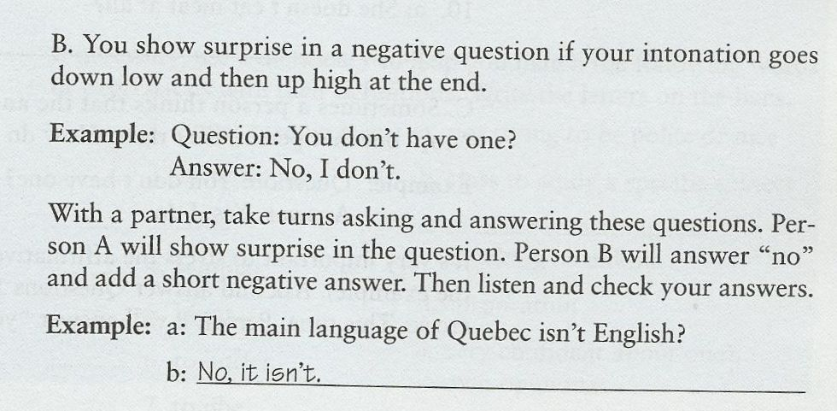

Slide 43
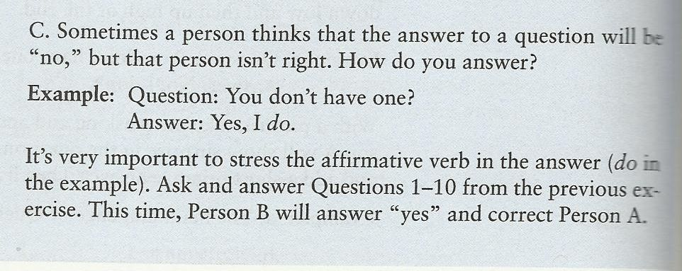

Slide 44
Most Frequent Prefixes and Suffixes
Word Beginnings and Endings
You Can Really Use

Slide 45
B. Now decide for each word that has a suffix what part of speech the word is (eg. noun (n), verb (v) , adverb (adv), adjective (adj) ). Insert the correct form - n, v, adv or adj into the spaces. programmer (for) performing a computer analyst organizational action maximize efficiency printer preferable printing (device) quiteness microcomputer compiler programmable greatly shipment computerize division independence (a way of...)storing Spooling turning (...your office....) (big...) savings developer (...are) producing increasingly sophisticated application a growing global ...(market)

Slide 46
Summary comparison
comparative
superlative
long
long
er
long
est
funny
funn
ier
funn
iest
modern
more
modern
most
modern
good
better
best

Slide 47
Expressing Agreement or Disagreement for Constructive Dialogue

Slide 48
Participating constructively in controversial discussions is not easy.
It’s challenging to figure out how to say what you want to say without sounding harsh, offending someone, or creating bad feelings. Most of us have never been taught how to express agreement or disagreement in a positive way. In fact, often, we learn early on that it is best not to disagree with others.

Slide 49
Discussions about complex topics can happen at three different levels, which are described below. Although we might label these levels in different ways, the goal in academic environments (and in good stimulating dialogue anywhere), should be the type of dialogue described in Level 3.

Slide 50
Level 3 (Dialogue)
The goal is primarily to try and understand where each person is coming from and what makes them think the way they do
People spend as much effort on really listening and probing to understand others as they do trying to explain what they think and why they think that way.

Slide 51
Level 2 (Discussion)
The goal is primarily to get to “say your piece”.
People are more interested in getting a chance to speak than listening to other’s perspectives and trying to understand where they are coming from.

Slide 52
Level 1 (Debate)
The goal is to prove that you’re right and the other person is wrong
Things are presented as very black and white/ right or wrong

Slide 53

بحمد الله

