Slide 1

English Language
Essay
Instructor:
Ammar Sultan Al-Ma’ani
King Faisal University
e- Learning Deanship
& Distance Education
1

Slide 2
^{6th} Class
Process Essay

Slide 3
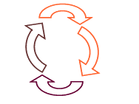
Elements of the Lecture
Process Essay (Practice)
Cause and Effect Essay

Slide 4
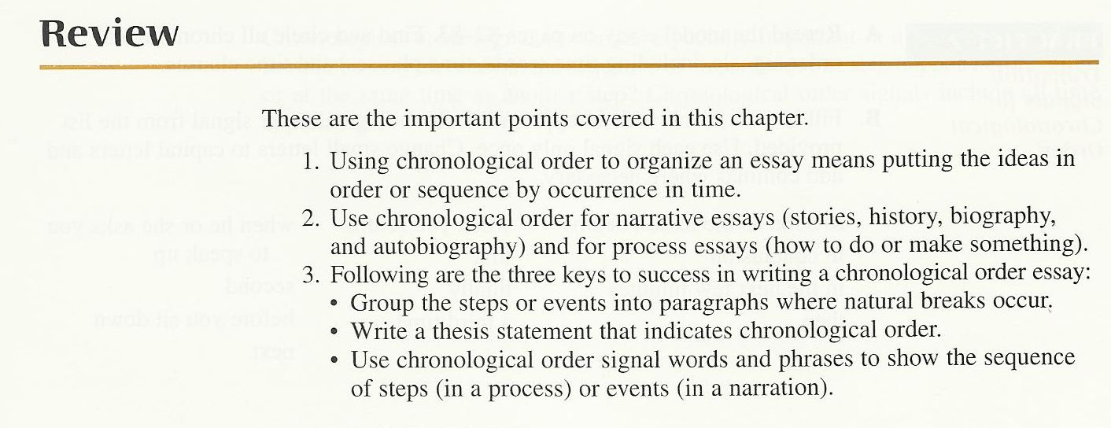

Slide 5
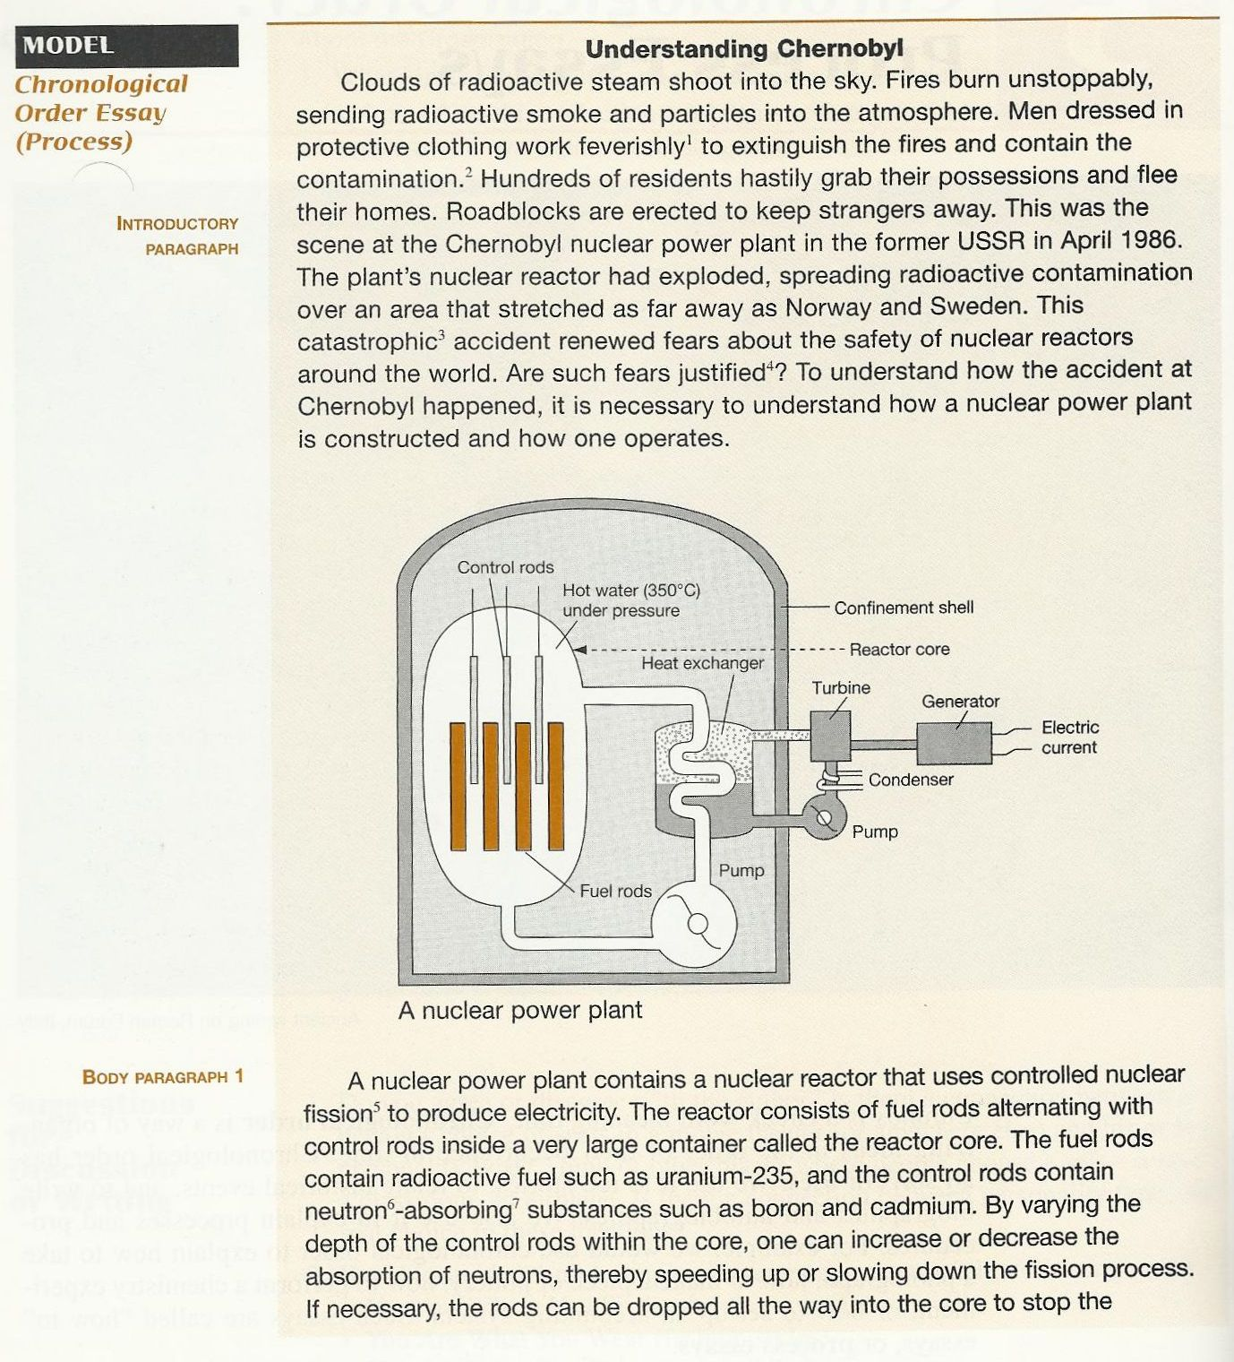
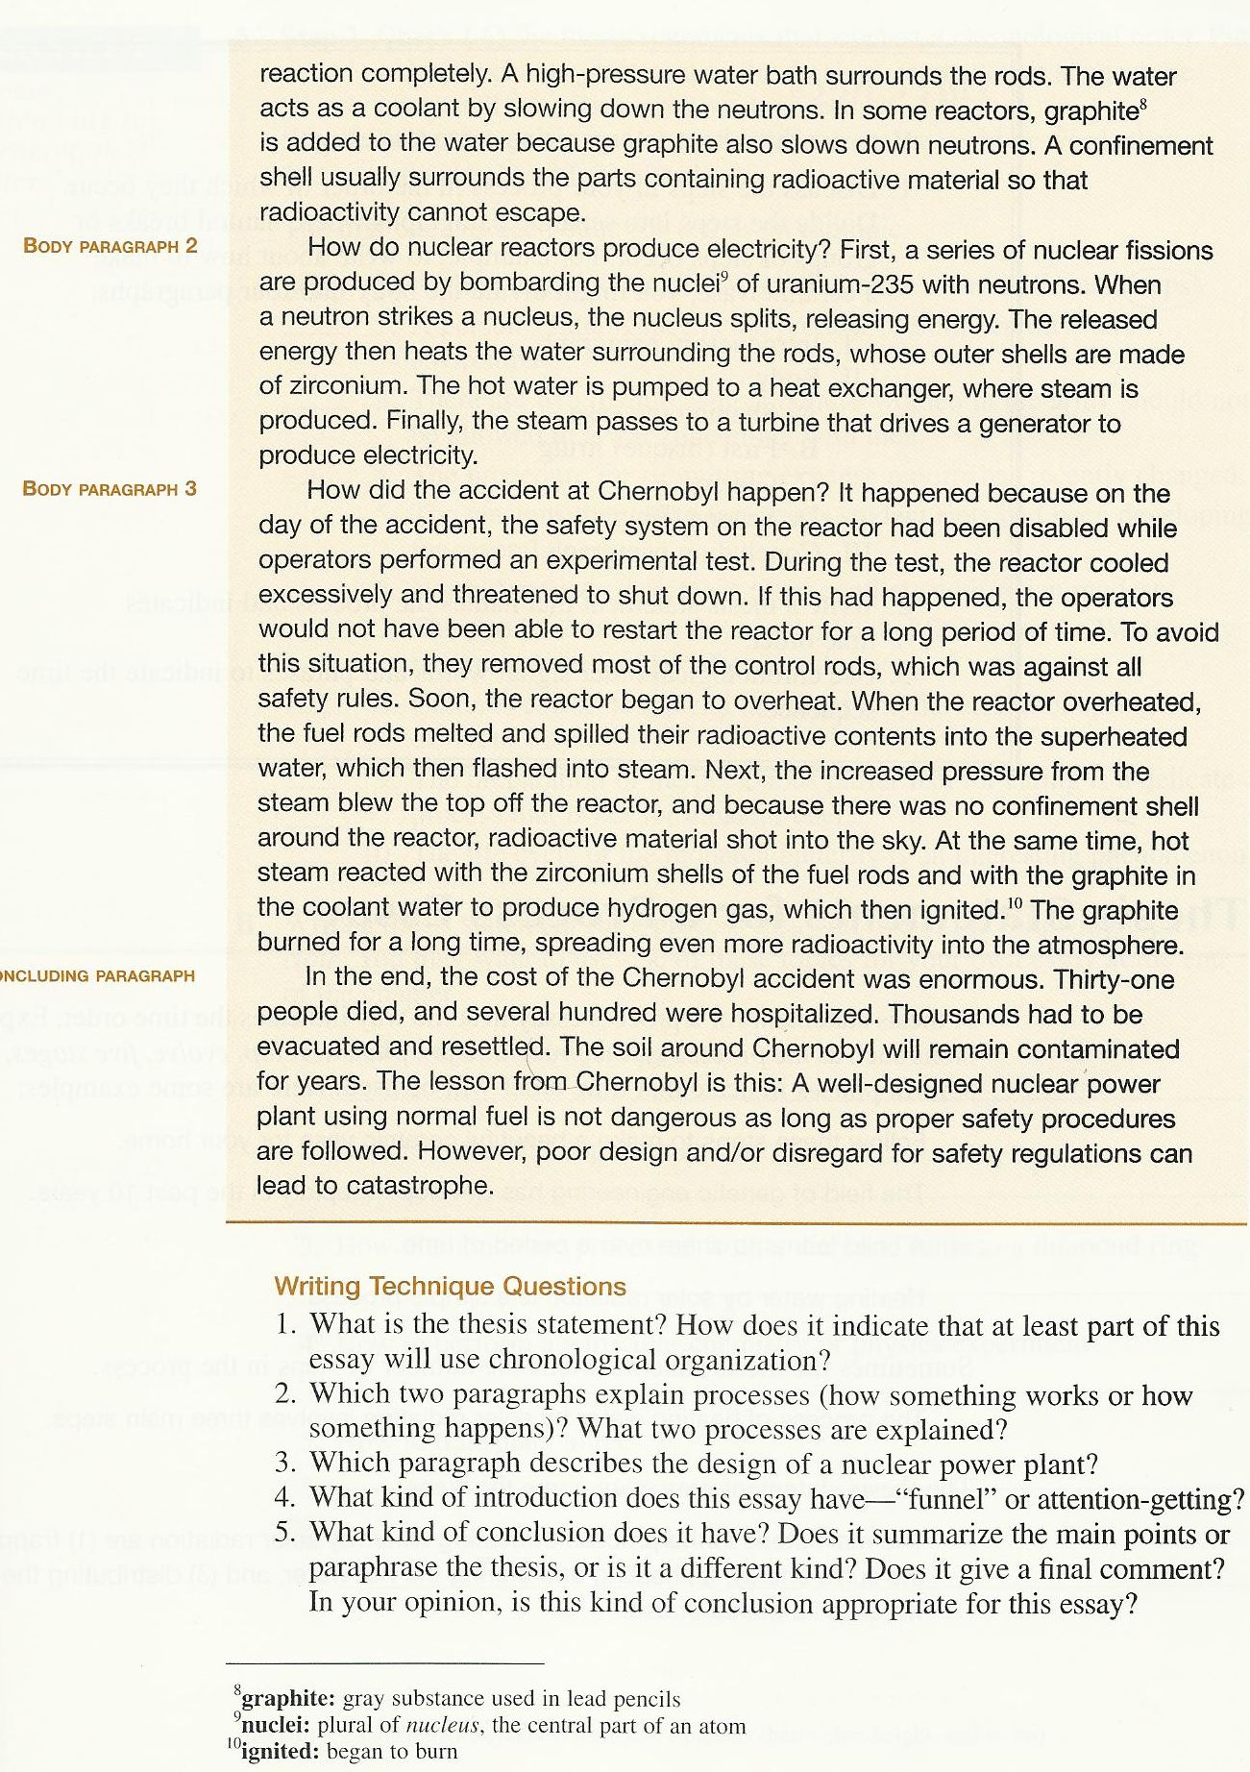
2. Body par 2 explains how nuclear reactors produce electricity. Body Par 3 explains how the Chernobyl accident happened.
3. Body Par 1 explains the design of a nuclear power plant.
4. It has an attention-getting introduction
5. It is a different kind (neither a summary nor a paraphrase). It gives a final comment that a well-deigned nuclear power plant is safe as long as safety procedures are followed.
Thesis Statement: “To understand how the accident at Chernobyl happened…. One operates.” it indicates chronological order by indicating that the essay will explain (1) how the accident happened and (2) how a nuclear is constructed and how one operates.

Slide 6
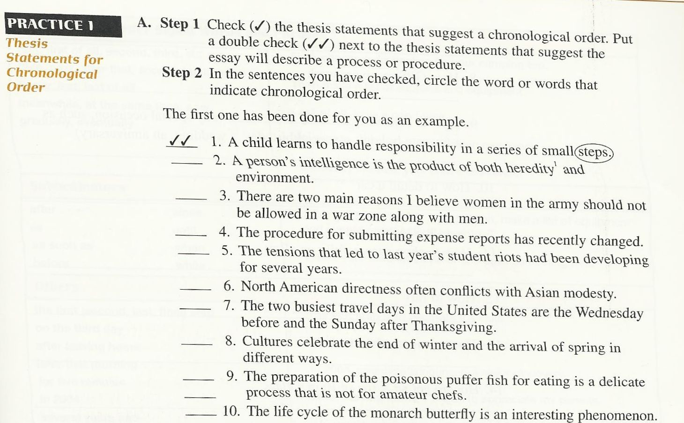
Single Check – Sentence 5. (“had been developing for several years”)
Double Check-4- (“Procedures”)
Single Check – 10- (“Life Cycle”)
Double Circle – 9 – ( Process)

Slide 7
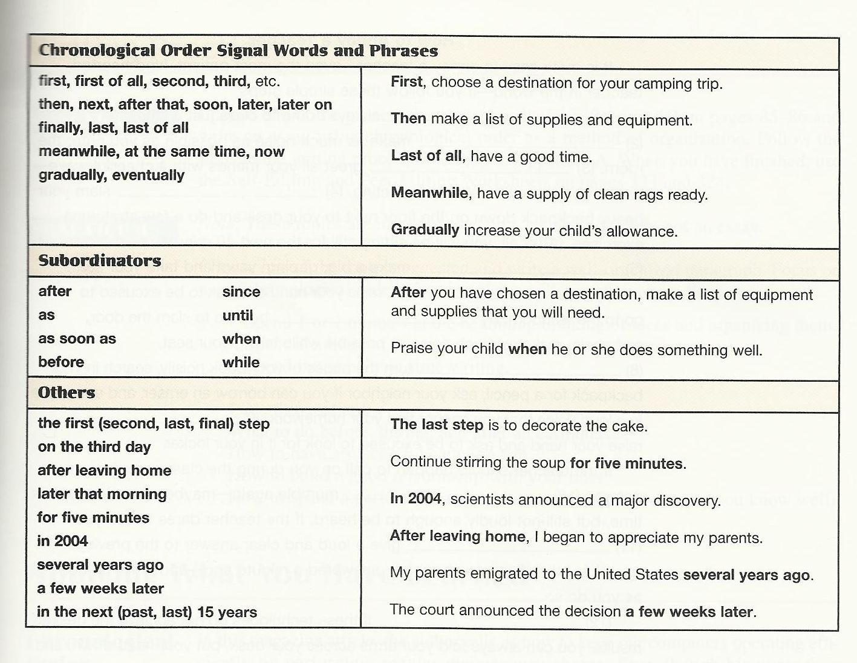

Slide 8
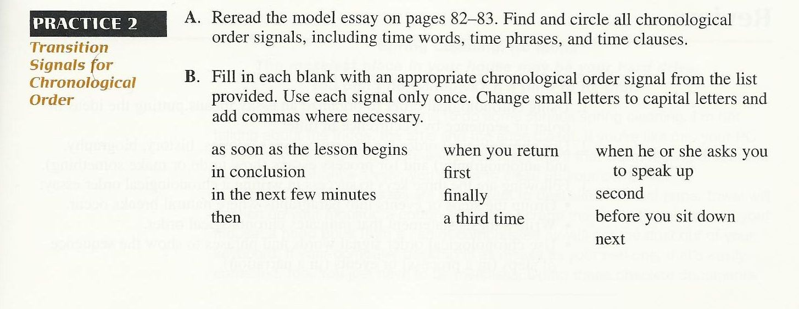

Well, Introduction Body has time period “in April 1986”
☺ Do the Rest By Yourself!!
First
Second
Next
Before you sit down
Finally
As soon as the lesson begins
When you return,
In the next few minutes
Then
10. When he or she asks you speak up
A third time,
In conclusion

Slide 9
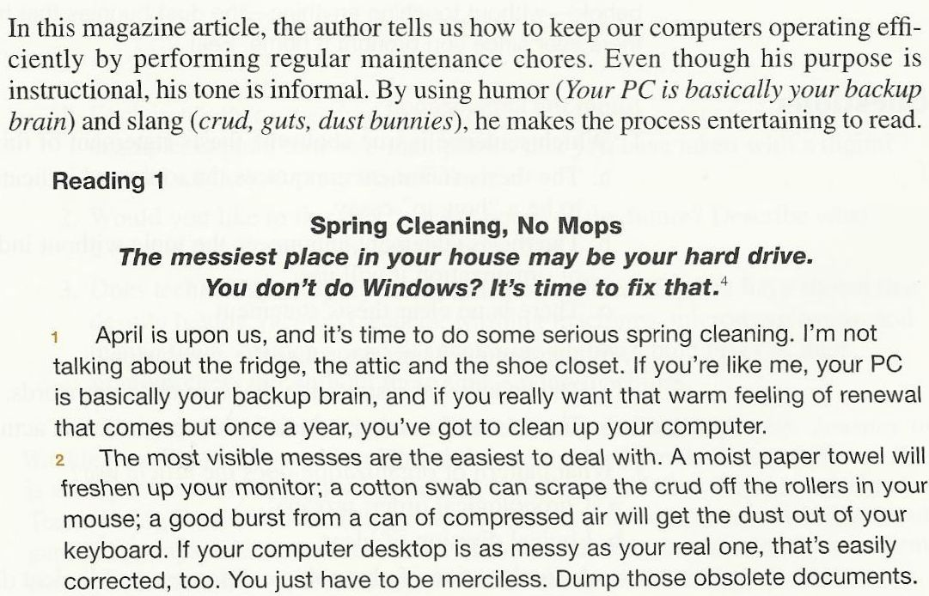
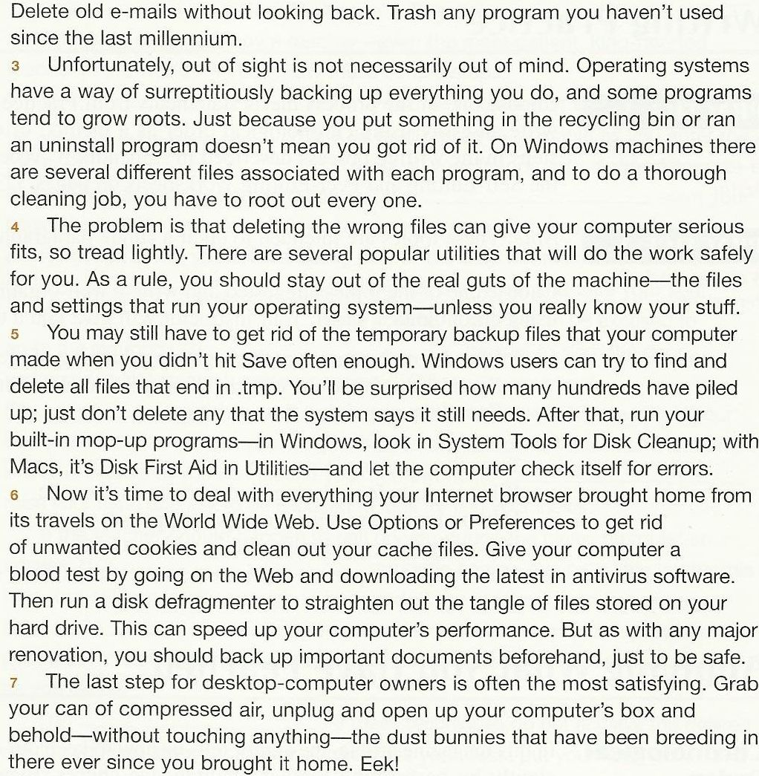


Slide 10
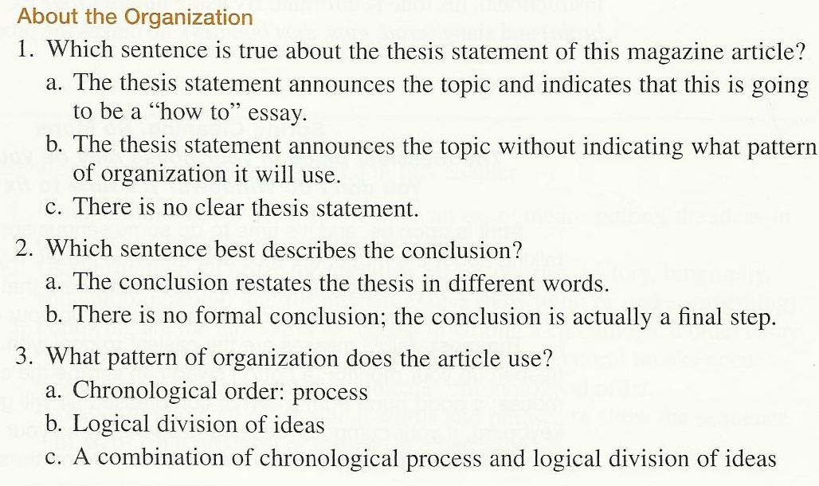
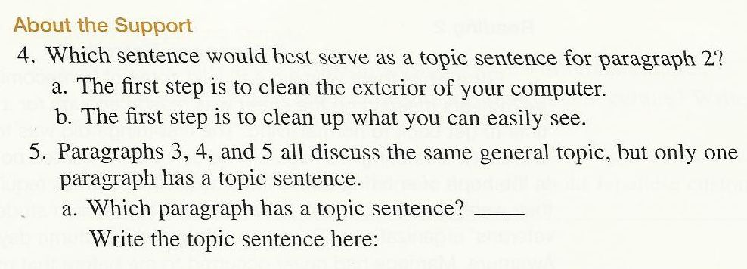
c
c
c
5. a. Paragraph 5 has a topic sentence. You may still have to get ride of the temporary backup files that your computer made when you didn’t his SAVE often enough.
c

Slide 11
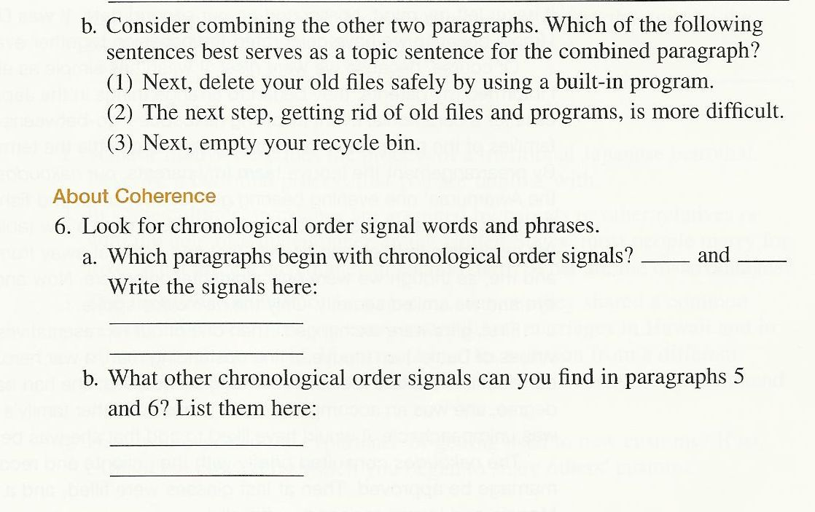
d
6. a. Paragraphs 6 and 7 begin with chronological transition signals: “Now’ and “The last step.”
b. After that and then.
Note: Read the other reading page 92.

Slide 12

Cause and Effect Essay
Let’s Play this icon and listen carefully.

Slide 13

What is a cause? What is an effect?
Cause and effect depend on each other. You can’t have one without the other. A plane crashed. That is the effect. What are the possible causes? Was it a mechanical or human error? Was it due to the weather? Was it a terrorist action? Obviously there are many possible causes.

Slide 14

How to write a cause and effect essay.
Step one:
Select a significant topic, for example, a social phenomenon or a social trend.
Examples:
Social phenomena:
Teenage rebellion
Teenage violence
Domestic abuse
Environmental crisis
Pollution
Social trends:
Increasing number of teenage pregnancies
Increases in computer science majors.

Slide 15

Step two
Decide whether you want to examine the cause or effect or both.

Slide 16

Step three
Examine each cause and effect thoroughly, using sufficient evidence to prove your points.

Slide 17

The patterns of cause and effect essays are the following
Cause-to-Effect Pattern
Introduction, Thesis
Effect 1
Effect 2
Effect 3
Conclusion
Effect-to-Cause Pattern
Introduction, Thesis
Cause 1
Cause 2
Cause 3
Conclusion

Slide 18

Guideline for Writing Cause and Effect Essays
Introduction
  Lead-in: Introduce the topic
  Transition: Present popular assumption of the cause or the effect concerning the topic
  Thesis Statement: Present your speculation about the causes or effects of the topic (at least three cause or effects)

Slide 19
Body
Body Paragraph 1
1. Topic Sentence: Present the first cause or the first effect.
2. Supporting Details: Explain and provide examples.
3. Closing Remarks: Link the examples back to the topic sentence.
Body Paragraph 2
1. Topic Sentence: Present the second cause or the second effect.
2. Supporting Details: Explain and provide examples.
3. Closing Remarks: Link the examples back to the topic sentence.
Body Paragraph 3
1. Topic Sentence: Present the third cause or the third effect.
2. Supporting Details: Explain and provide examples.
3. Closing Remarks: Link the examples back to the topic sentence.

Slide 20

Conclusion
1. Restate the thesis statement.
2. Offer a solution or share insight.

Slide 21

بحمد الله

