Slide 1

English Language
Speaking Skills
Instructor: Ammar Sultan Al-Ma’ani
King Faisal University
e- Learning Deanship
& Distance Education
1

Slide 2
^{6th} Class
Reviewing the Main Speaking Skills

Slide 3
Exercise : Start Short Conversation With Strangers.
at the bus stop?
At the post office
At a wedding
In a supermarket
On a bus
Anywhere
In a museum
It’s hot today, isn’t it?
This line is really slow, isn’t it?
It’s nice to have a chance to celebrate, isn’t it?
These tomatoes look terrible, don’t they?
What country are you from?
Can you lend me some money?
This is a wonderful painting, isn’t it?

Slide 4
Say the Following Correctly.
Unsure of the Answer (Real Questions)
Sure of the Answer (small talk)
The food is awful, isn’t it?
You don’t see any fresh fruit, do you?
There isn’t any yogurt, is there?
The food is awful, isn’t it?
You don’t see any fresh fruit, do you?
There isn’t any yogurt, is there?

Slide 5
Introduce Someone
Response
-I’d like you to meet…
This is… a friend of mine (my brother, sister, etc.)
Have you met..?
Nice (Glad, Pleased) to meet you

Slide 6
End a Conversation now.
Well, I’ve got to run.
Good-bye.
See you later (Friday, etc.).
Have a good day. Have a good weekend

Slide 7
Expressing Thanks
Response
Thanks.
Thank you very much (so much)
That was very kind of you,
How thoughtful!
I appreciate it. I’m very grateful.
You’re welcome.
Don’t mention it.

Slide 8
Giving an Apology
Responses
I’m very sorry.
Excuse me.
Forgive me.
It was my fault.
No problem.,
That’s ok. That’s all right.
Don’t worry about it. a

Slide 9
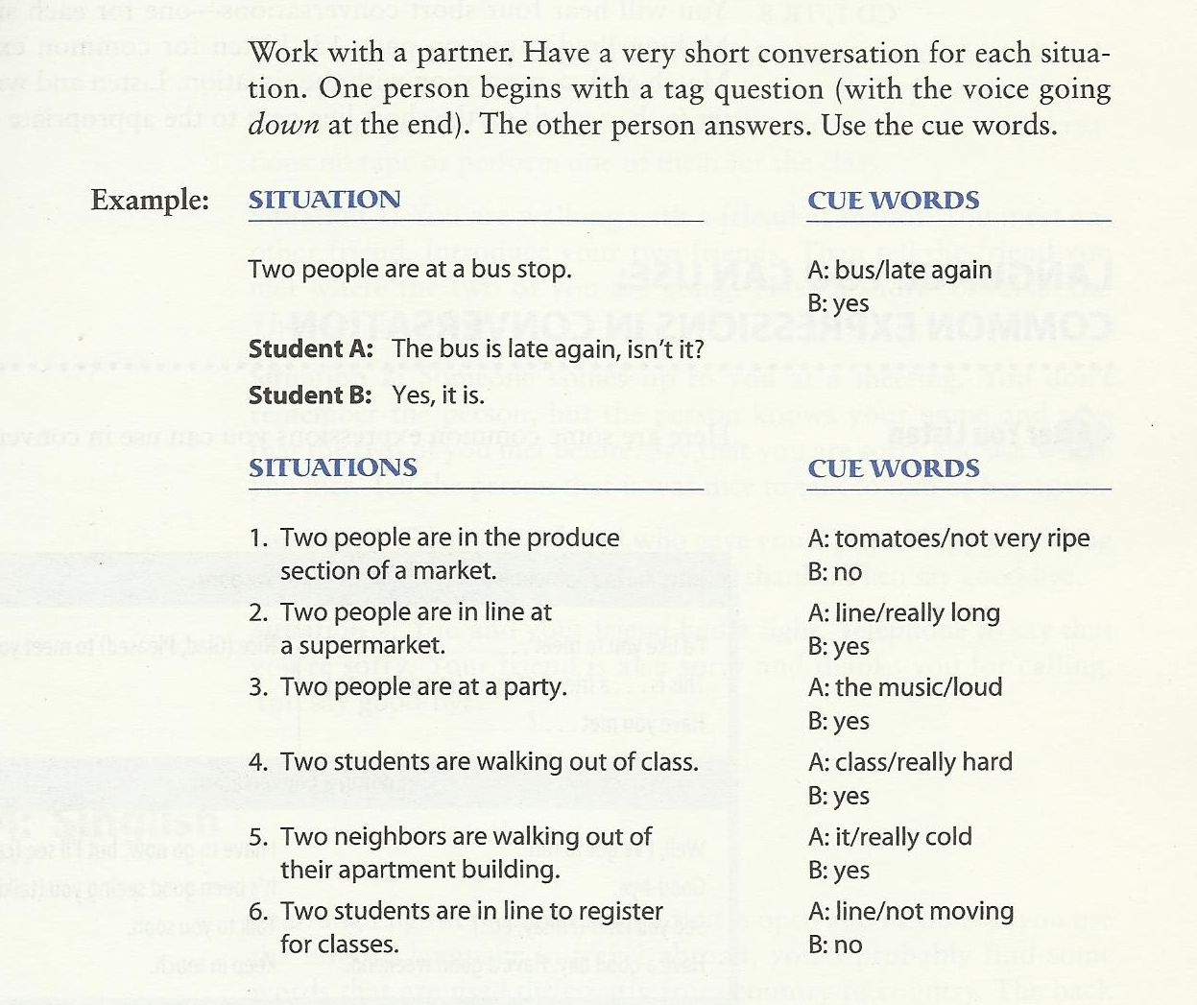

Slide 10
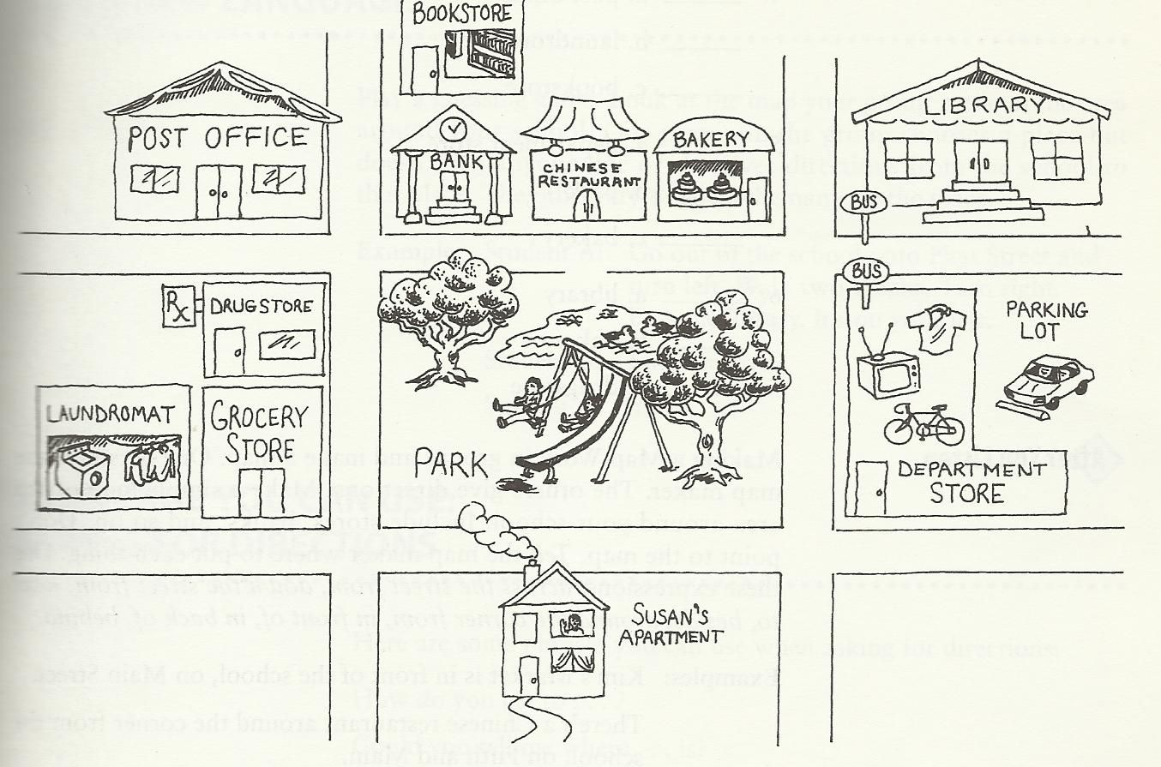
How can I get to
Could you tell me where … is?
Is….. Far from here?
I’m looking for ….
In what direction is …?
The post office is across the street from the bank.
The bakery is down the street from the post office.
The Laundromat is next to (beside) the grocery store.
The drugstore is around the corner from the laundermat

Slide 11
Creating a Conversation
Work with a partner. Student A wants to take the bus. Student B is a bus driver. Have a conversation. Follow this model.
A: Excuse me. Does this bus go to …?
B: No, … you need bus number …..
A: where do I get ….?
B:…..
A: How much …..?
B:…..
A: Thanks.
B:……

Slide 12
Reduction
Long Form
REDUCTION
SHORT FORM
Do you have any pets?
What’s your name?
Does this bus go to Geary Street?
Do you want to see the kitchen?
You have to have exact change.
You → ya
Do ya have any pets?
What’s you → watcher
Watcher name?
Go to → goda
Does this bus goda Geary Street?
Want to → wanna
Do you wanna see the kitchen?
Have to → hafta
You hafta have exact change

Slide 13
Study this situation ☺
Situation : your class colleague is talking about a topic that you are unfamiliar with. You want to ask him or her for clarification. What should you say?
Excuse me, What was that again?
Or
Could you repeat that?
Or
How do you spell that?

Slide 14
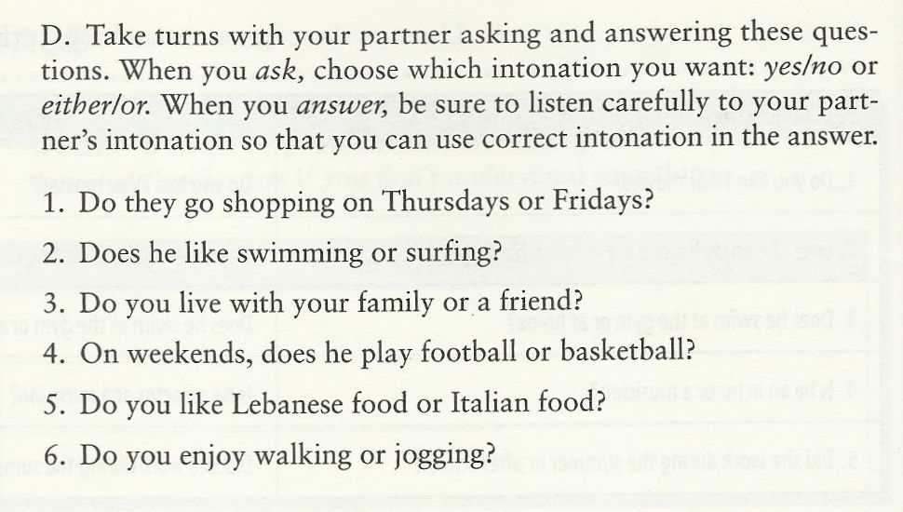
Remember: In yes, No questions, the answer is “yes” or “no” The speaker’s voice goes up two times.
Also Remember: in either/or questions, the answer is one of the two items from the question. The speaker’s voice goes up on the first item and down on the second item.

Slide 15
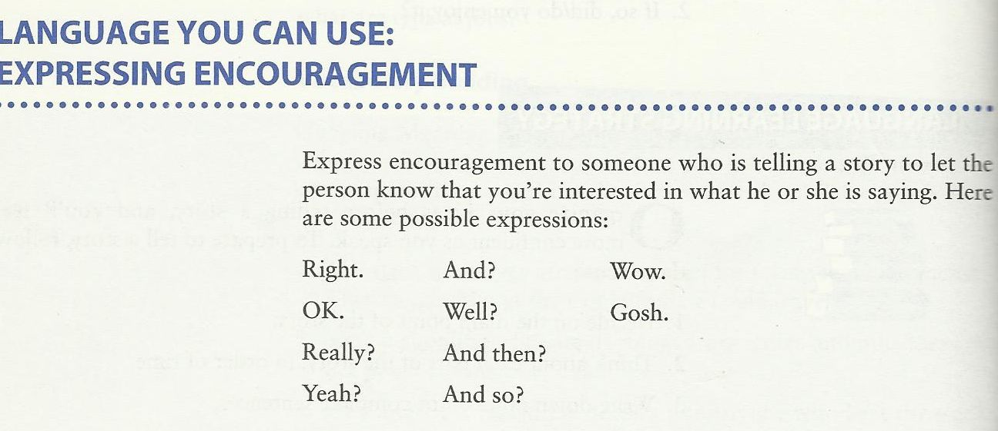
Study this situation
Situation: one of your colleagues has got average grade in his/her first exam. However, he/she is looking for a higher grade. Your role is to encourage him/her. What should you say.

Slide 16
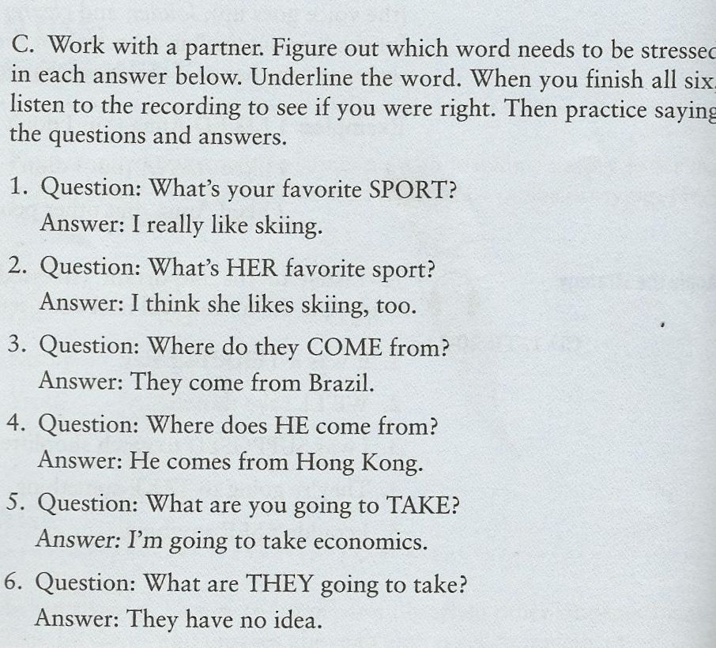
Stressed Words

Slide 17
Long Form
Short Form, Reduction
What do you do – whadaya
whadaya do?
What are you – whatcha
whatcha doing?
Kind of – kinda
  What kinda childhood was it?
Did you – didja
what didja do?
Did he- didee
what didee do?
Used to –yoosta
They Yoosta live here.
Going to – gonna
I’m gonna buy a house
What do you do?
What are you doing?
What kind of childhood was it?
What did you do?
What did he do?
They used to live here.
I’m going to buy a house.

Slide 18
Study this Situation
Situation: your professor is asking you a question about your future plans. “What’s your future plane?” he is saying. What should you say?
I am going to go to Georgetown University. I have already got an admission.
I will pursue my higher education. But I don’t know where yet.

Slide 19
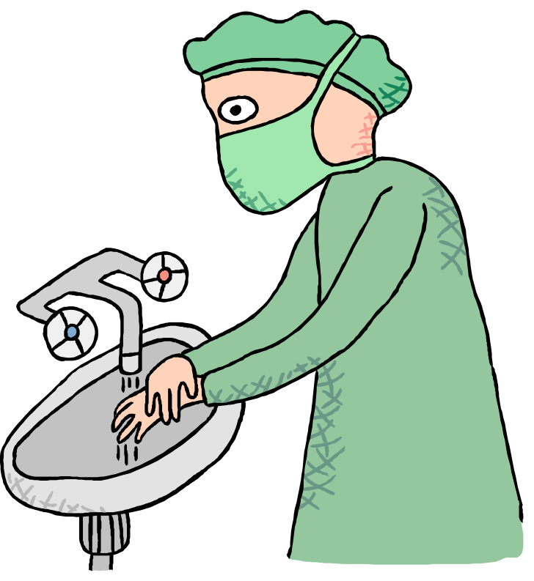

Give Advice:
We should wash our hands with liquid soap.

Slide 20
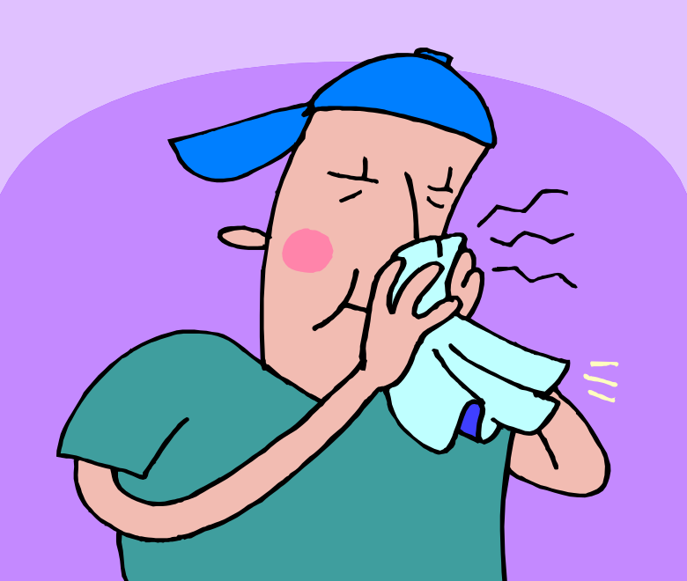
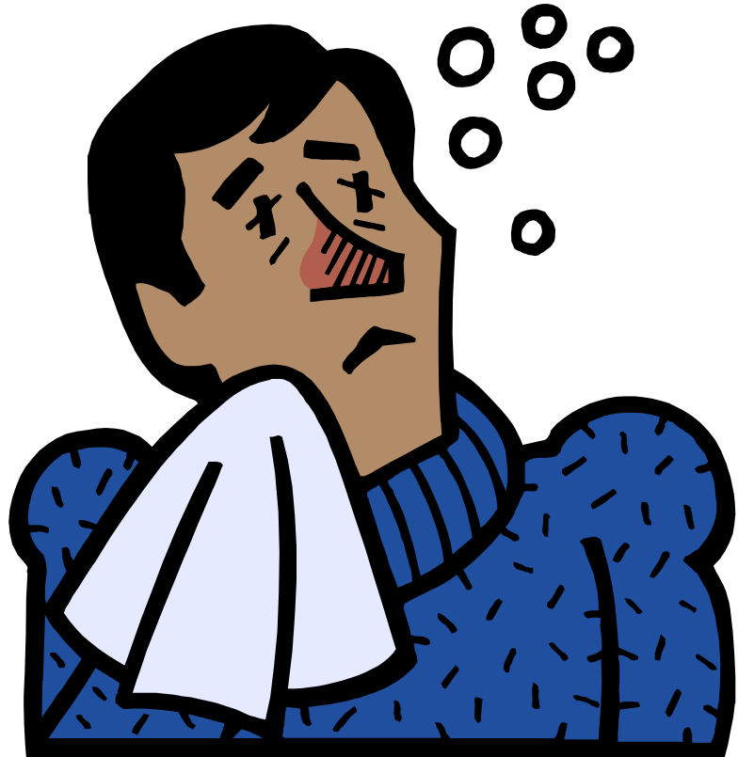
We should prevent disease.

Slide 21

We shouldn't litter.

Slide 22
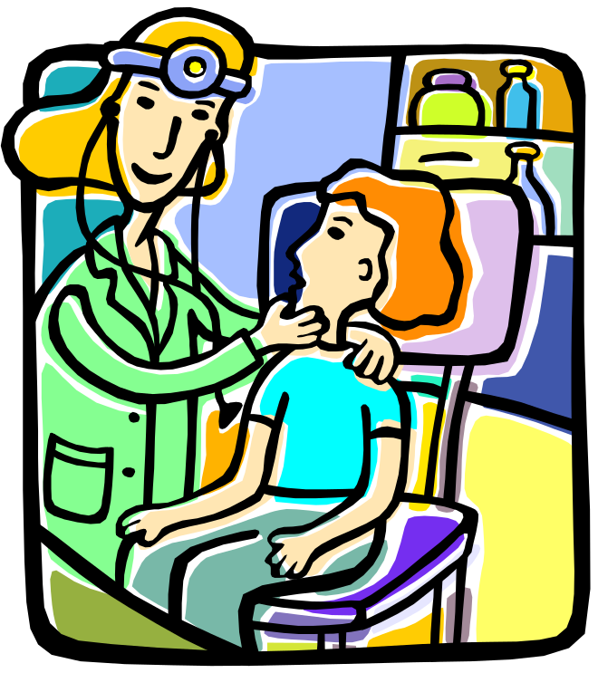
We should see a doctor promptly if we feel unwell.

Slide 23
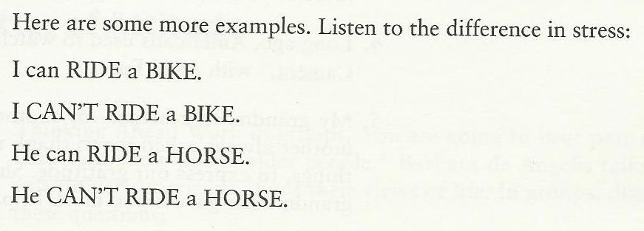

Slide 24

بحمد الله

