Slide 1

English Language
Speaking Skills
Instructor: Ammar Sultan Al-Ma’ani
King Faisal University
e- Learning Deanship
& Distance Education
1

Slide 2
^{7th} Class

Slide 3
Elements of the Lecture
Remember Giving advice.
Using Modals.
Understanding more reductions.
Participles.

Slide 4
Remember! Giving Advice
Should
Shouldn’t + Simple form of the verb
Ought to
These expressions are used to give advice and make suggestions. Other expressions to make suggestions are:
- It might be nice (good) if you…
- Why don’t you …
- If I were you I would …

Slide 5
It’s more polite to use expressions for making suggestion than to use an imperative. Notice this contrast:
Get out and take an art class. (less polite)
You should get out and take an art class. (more polite)
Let’s see more about Using of Modals… → → → → →

Slide 6

What are modals?
Auxiliary verbs
  Can
  Could
  Had better
  a
  Might
  Must
  Ought to
  Shall
  Should
  Will
  Would
How could I teach modals?
Should I teach them?

Slide 7
Why do we use modals?
We use modals to talk about obligations, suggestions, advise and expectations!

Slide 8

There are two kinds of modals:
What? Would you explain this please?
Simple modals : for the present and future
Perfect modals: to show necessity in the past tense.

Slide 9
Simple modals: Present and future
Modal + base form
Examples:
  We should invite your friend to my party.
  We could buy some soda if you have money.
  You might want to call your mom and tell her you are at a friend’s house.

Slide 10
Perfect modals: past
Modal + have + past participle
Examples:
  You should have called me last night.
  Mary should have done her homework this week.
  We should not have made a big mess here.

Slide 11
Showing strong necessity:
Must………I must go to sleep!
Have to……..I have to go to sleep!
Have got to…I have got to go to sleep!

Slide 12
Had better…for a warning!
Use “had better” to give a warning that something bad will happen if the advise is not followed.
You had better study tonight or you might fail the test.
He had better go home now or he will be in trouble!

Slide 13
Use Should to offer advise
Should means…it would be a good idea.
You should eat something you are hungry.
You should read a book and turn off the television.
They should stop being so loud.
We should have a party at the beach.

Slide 14
Could or might are more gentle than should….
You could read a book.
They might like the movie.
We could buy some candy.
I might play basketball.
He could win your blue marble.

Slide 15
Practicing modals:
Do class surveys:
Who might want to play basketball at recess?
Who should be the student of the week?
When should we go to doctor?
Don’t forget to model the appropriate responses!

Slide 16
Sentence pairs:
He must be here | because I see his jacket on his chair.
I should buy a present | because it is Julie’s birthday.
You could call me tonight | since you will be at home.
They should come to my house | to play Nintendo.
He could win a prize | if he turns in his lottery ticket.

Slide 17
Conversation cards: Small group discussions
Why should the school day be shorter? | Name three things you should not do in class. | What could you do to be a good friend?
What would you do if you won a million dollars? | If you could meet one famous person, who would it be? | What might happen if pigs could fly?

Slide 18

Yippee! My students could be successful using modals

Slide 19
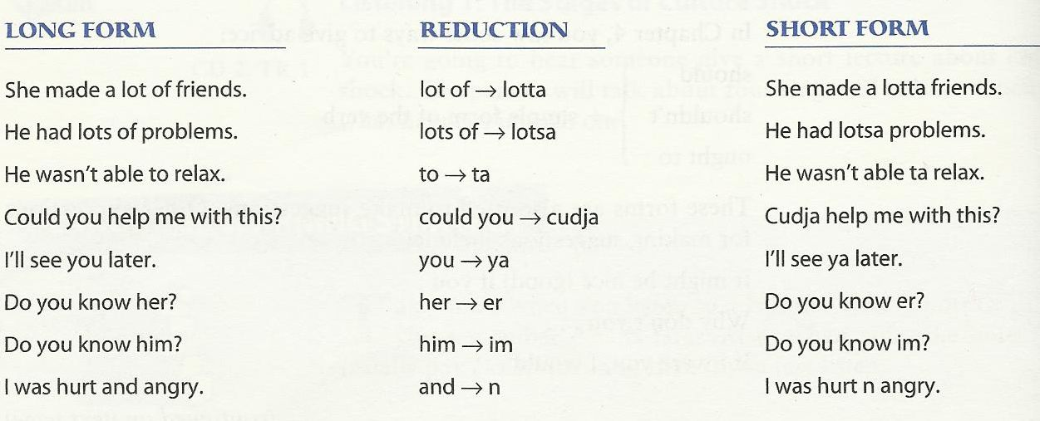
The Sound of It: Understanding Reductions

Slide 20
What are participles?
A participle is a form of a verb that functions as an adjective.

Slide 21
-ing Participles
What are participles?
What are participles?
End with -ing
Infinitive | past | Present Participle | Past Participle
bore | bored | boring | bored
interest | interested | interesting | interested

Slide 22
-ed Participles
What are participles?
End with -ed
Infinitive | past | Present Participle | Past Participle
bore | bored | boring | bored
interest | interested | interesting | interested

Slide 23
Participles used as adjectives
Present participles are usually active
Examples :
1a. The boring teacher talked for hours.
1b. The bored students fell asleep.
Past participles are usually passive
2a. I read an interesting magazine yesterday.
2b. The magazine receives a lot of support from interested
readers.

Slide 24
More examples:
3a. It was an exciting concert.
3b. The excited fans screamed during the concert.
4a. Many young people experience troubling situations.
4b. The Samaritan Befrienders Hong Kong receives calls
from troubled young people.

Slide 25
DON’T CONFUSE PARTICIPLES AND VERBS!
Participles AREN’T preceded by helping verbs.
E.g.
The sputtering sedan wrenched down the boulevard. (participle)
The sedan was sputtering down the boulevard. (verb)

Slide 26

بحمد الله

