Slide 1

Course Title:
The Modern Novel
Instructor:
Dr Abdulgawad Elnady
Associate Professor of Literature, Department of English,
King Faisal University.
King Faisal University
Deanship of E-Learning
1

Slide 2
Fourth Lecture

Slide 3
Quick Revision
One major feature of modernism is the dissatisfaction with the world of politics and the attempt to escape from it through invention of some forms like fables and journeys.
This process is a revival of some older forms. So we can say: history repeats itself. Robinson Crusoe is an 18th century novel that used the trope of the journey. It is used again William Golding (Lord of the Flies) and George Orwell (Animal Farm).

Slide 4
Quick Revision Animal Farm is a Fable:
We talked about the fact that Animal Farm is a fable which is a short tale to teach a moral lesson, often with animals or inanimate objects as characters.
We also talked about the fable and the allegory, saying that the fable entirely uses animal characters while allegory uses both as in our novel.
To repeat, Animal Farm is an allegory that uses some of the features of the fable.

Slide 5
The Wolf and the Lamb
We also studied together a story (written in the form of a fable) called The Wolf and the Lamb so we can understand our novel.
Notice: this fable (The Wolf and the Lamb) is part of our course.
It is not just a tale that we read for entertainment only.
It will help us a lot in understanding how Animal Farm operates on many levels.

Slide 6
Some Thoughts on The Wolf and the Lamb
How many accusations are there in The Wolf and the Lamb?
How many replies are there in The Wolf and the Lamb?
The wolf represents (tyrants- animals- people-policemen) in real life.
The lamb represents (tyrants- animals- people-policemen) in real life.

Slide 7
Some Thoughts on The Wolf and the Lamb
The author of “The Wolf and the Lamb” is anonymous which means:
He is from Russia
His name is hard to pronounce
He is unknown
His name is known to the police

Slide 8
Some Thoughts on The Wolf and the Lamb
The story of the Wolf and the Lamb helps us to know how tyrants deal with
Lambs
Sheep
Wolves
Real people

Slide 9
Some Thoughts on The Wolf and the Lamb
The story of the Wolf and the Lamb is …………..as it does not have human beingS as characters:
a fable
An allegory
A novella
A metaphor

Slide 10
Some Thoughts on The Wolf and the Lamb
The story of the Wolf and the Lamb has strong connections with Animal Farm because:
both of them use animal characters for the criticism of governments
Both of them have sheep as characters
Both of them are written in English
Both of them belong to the genre of poetry

Slide 11
Some Thoughts on The Wolf and the Lamb
Does the story of the Wolf and the Lamb and Animal Farm talk directly about governments?
Yes
No
This is not clear from the texts
They talk about different matters not about governments

Slide 12
Connections between “The Wolf and the Lamb” and Animal Farm
Do writers of both works seem to be in harmony with the world around them? Of course not. They express their utter dissatisfaction with the world around them, and this is a feature of modernism.
Are writers of both works optimistic? They are quite pessimistic as they regard dictatorship as the main reason behind injustice and inequality in the modern world.

Slide 13
Further Thoughts on the Connections between both works
Is the form of Animal Farm traditional like the novels of the 19th century? It is innovative. It makes use once again of forms that were used at the start of the novel in a new way.
Has the writer been able to fully express himself through this form or has he just chosen a new form only? The form has enabled him to fully express himself without colliding with political systems or regimes.

Slide 14
What Animal Farm Talks About
Animal Farm by George Orwell was first published in 1945 as a political allegory of the Russian Revolution, particularly directed at Stalin's Russia.
There was a dictatorial regime in Russia before the 1917 revolution. Everybody hated the Czar of Russia (represented in the novel as Mr Jones) for his oppression of Russians and for the injustice, inequality, and prejudice with which he treated his countrymen. The revolution of 1917 overthrew him. But

Slide 15
What Animal Farm Talks About
But the revolution will fail to apply the same principles that it was originally meant to uphold. In other words, the people (in the novel: the animals) who took part in the revolution against injustice and inequality will not be able to maintain all these values.
Stalin’s Russia which was in control of the country after the revolution could not achieve those noble values for a long time. This is what Orwell has been disappointed with.

Slide 16
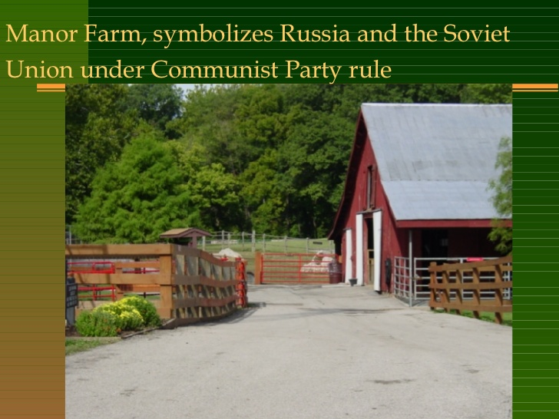
Manor Farm here represents Russia and any other country before the revolution: one person ruling over everyone and treating them badly.

Slide 17
Mr. Jones, of the Manor Farm, had locked the hen-houses for the night, but was too drunk to remember to shut the pop-holes. With the ring of light from his lantern dancing from side to side, he lurched across the yard, kicked off his boots at the back door, drew himself a last glass of beer from the barrel in the scullery, and made his way up to bed, where Mrs. Jones was already snoring.
Sum up the character of Mr Jones. What does he remind you of?

Slide 18
As soon as the light in the bedroom went out there was a stirring and a fluttering all through the farm buildings. Word had gone round during the day that old Major, the prize Middle White boar, had had a strange dream on the previous night and wished to communicate it to the other animals. It had been agreed that they should all meet in the big barn as soon as Mr. Jones was safely out of the way. Old Major (so he was always called, though the name under which he had been exhibited was Willingdon Beauty) was so highly regarded on the farm that everyone was quite ready to lose an hour's sleep in order to hear what he had to say.

Slide 19
At one end of the big barn, on a sort of raised platform, Major was already ensconced on his bed of straw, under a lantern which hung from a beam. He was twelve years old and had lately grown rather stout, but he was still a majestic-looking pig, with a wise and benevolent appearance in spite of the fact that his tushes had never been cut. Before long the other animals began to arrive and make themselves comfortable after their different fashions.
Question: Old Major represents….. In real life.

Slide 20

بحمد الله

