Slide 1

Course Title:
The Modern Novel
Instructor:
Dr Abdulgawad Elnady
Associate Professor of Literature, Department of English,
King Faisal University.
King Faisal University
Deanship of E-Learning
1

Slide 2
Seventh
Lecture

Slide 3
We studied the relationship between the novel and the real history of Russia before and after the 1917 in Russia.
Almost all characters in the novel match real figures of the history of Russia in the first half of the century.
We agreed that the novel attacks the failure of the revolution due to the return back to injustice and inequality and to lack of freedom.

Slide 4

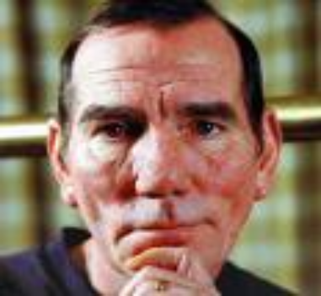
Characters in ANIMAL FARM and who they represent
Mr. Jones
The owner of Manor Farm. He forces the animals to work and doesn’t take good care of them. He has a good life but doesn’t share his good fortune with the animals, and they feel mistreated.
Czar Nicholas
The king of Russia, from a dynasty 300 years in the making. He lived well while Russian peasants starved. Married to Alexandra, several children.
=

Slide 5
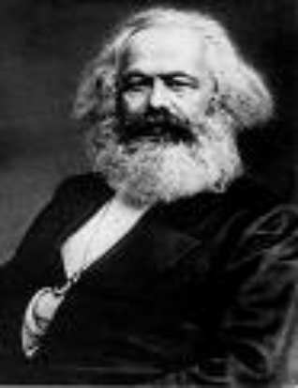
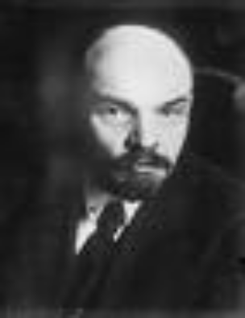
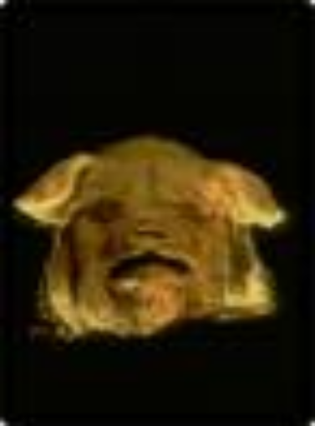
Karl Marx/Vladmir Lenin
These two men came up with the theory of Communism and inspired others to pursue the Revolution.
Old Major
The oldest pig on the farm, he has a dream and comes up with the idea of an animal revolution against man.
=

Slide 6
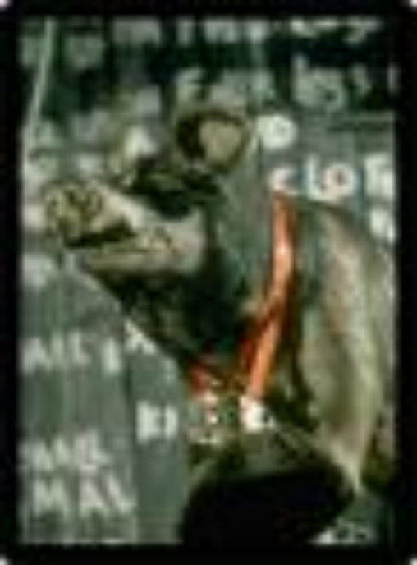
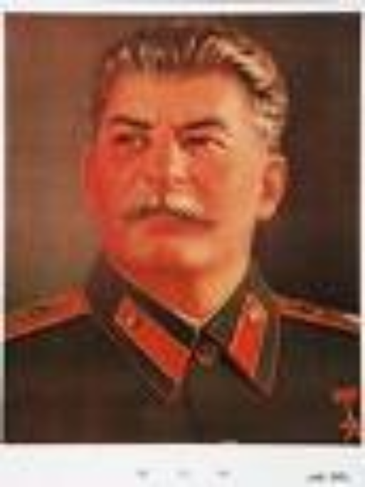
Josef Stalin
Stalin had a power struggle with Leon Trotsky for the direction Russia (or the Soviet Union) would take after the Revolution
Napoleon
A pig who fights with Snowball for control of the farm. He says he wants good conditions for all, but is really greedy.
=

Slide 7
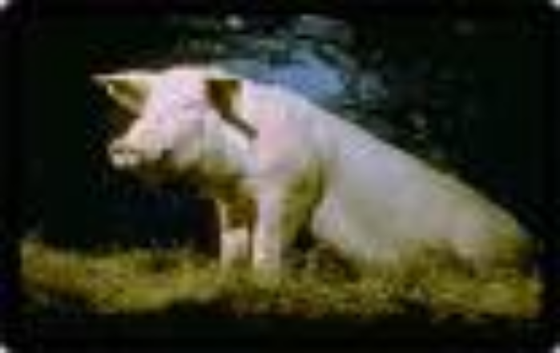
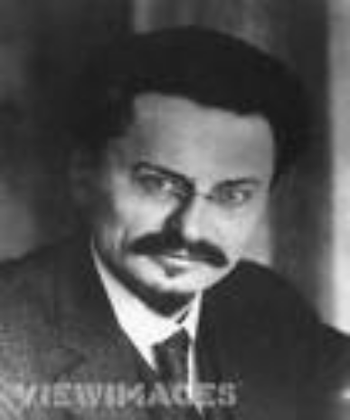
Leon Trotsky
One of the revolutionary leaders who favored Socialism over Communism. He wanted better conditions and education for the common man, and was exiled to Mexico by Stalin.
Snowball
An intellectual pig who wants good conditions and education for all the animals. He is betrayed by Napoleon and exiled from the farm.
=

Slide 8
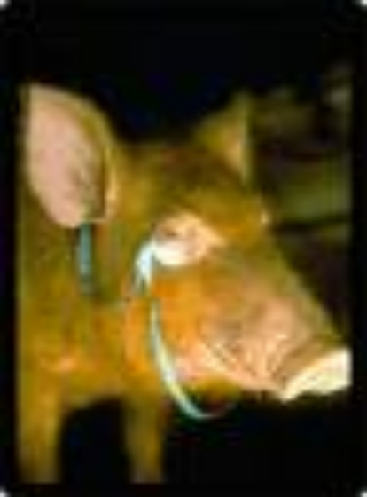
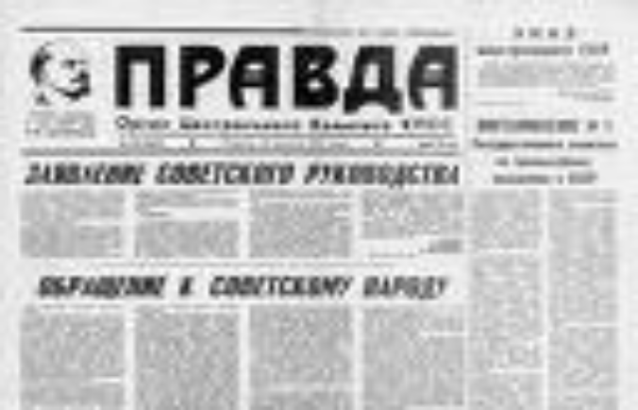
Pravda
A state-run newspaper that was used by Stalin to control news, information and propaganda.
Squealer
A pig who acts as Napoleon’s “mouthpiece” and he lies to cover up the crimes Napoleon commits.
=

Slide 9
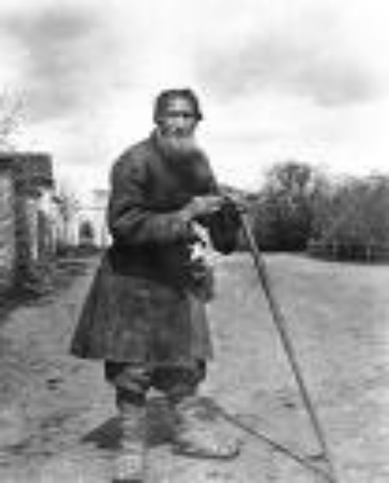
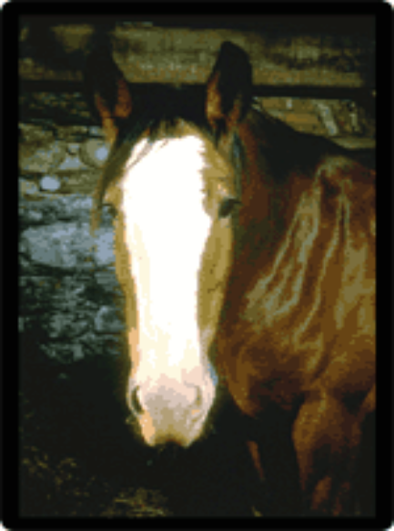
Russian workers
The “proletariat”, or common workers, made Stalin’s Soviet regime work. They did not benefit from their hard work.
Boxer
A horse whose motto was “I will work harder” and “Napoleon is always right.”
=

Slide 10
Pigs: they represent the Communist party
Dogs (puppies): they represent the KGB secret police
Moses the Raven: represents Orwell’s idea that religion is used to keep people confused
Sheep: they represent people who are blind followers and who don’t think for themselves.
Other humans: represent different countries that had dealings with the Soviet Union (Hitler’s Germany, Churchill’s England, etc.)

Slide 11
Czarist supporters
Some Russians remained loyal to the Czar. They are called ‘czarists’ and they had usually benefited from the Czar’s lavish lifestyle.
Mollie
A white horse who loves the ribbons and sugar the humans gave her. She misses the old days.

Slide 12
Old Major Again
"I have little more to say. I merely repeat, remember always your duty of enmity towards Man and all his ways. Whatever goes upon two legs is an enemy. Whatever goes upon four legs, or has wings, is a friend. And remember also that in fighting against Man, we must not come to resemble him. Even when you have conquered him, do not adopt his vices.
Repetition, clarity of thought, generalization, negation, issuing orders

Slide 13
No animal must ever live in a house, or sleep in a bed, or wear clothes, or drink alcohol, or smoke tobacco, or touch money, or engage in trade. All the habits of Man are evil. And, above all, no animal must ever tyrannise over his own kind. Weak or strong, clever or simple, we are all brothers. No animal must ever kill any other animal. All animals are equal.
Generalization

Slide 14
The Song
Beasts of England, beasts of Ireland,
Beasts of every land and clime,
Hearken to my joyful tidings
Of the golden future time.
Soon or late the day is coming,
Tyrant Man shall be o'erthrown,
And the fruitful fields of England
Shall be trod by beasts alone.
Using songs

Slide 15
The Song
It is full of enthusiasm.
It is full of melody so it can be memorized well by all animals/people even those who know nothing about culture or education
It has a direct clear relationship with what Old Major plans for in future.
It is stirring.

Slide 16
The start and end of the Song
Beasts of England, beasts of Ireland,
Beasts of every land and clime,
Hearken to my joyful tidings
Of the golden future time.
Beasts of England, beasts of Ireland,
Beasts of every land and clime,
Hearken well and spread my tidings
Of the golden future time.
What is the difference between the first and last stanzas of the song? Isn’t it very intelligent of Old Major to make those changes while repeating certain ideas?

Slide 17
Direct Effect of the Song
The singing of this song threw the animals into the wildest excitement. Almost before Major had reached the end, they had begun singing it for themselves. Even the stupidest of them had already picked up the tune and a few of the words, and as for the clever ones, such as the pigs and dogs, they had the entire song by heart within a few minutes. And then, after a few preliminary tries, the whole farm burst out into 'Beasts of England' in tremendous unison. The cows lowed it, the dogs whined it, the sheep bleated it, the horses whinnied it, the ducks quacked it.

Slide 18
Direct Effect of the Speech
To address people and touch their hearts, Old Major has been so eloquent.
He has changed his tone
He has repeated certain phrases for further effects
He has addressed some animals by name
He has used songs that are relevant to his topic
He has asked questions
He has used negations
He has used endearing terms like comrades
and brothers
Very powerful effect

Slide 19
Direct Effect of the Speech
After the song has had all this effect upon all animals, Mr Jones wakes up at the sound. What happens?
Will animals rise to action directly?
Unfortunately, the uproar awoke Mr. Jones, who sprang out of bed, making
sure that there was a fox in the yard. He seized the gun which always stood in a corner of his bedroom, and let fly a charge of number 6 shot into the darkness. The pellets buried themselves in the wall of the barn and the meeting broke up hurriedly. Everyone fled to his own sleeping-place. The birds jumped on to their perches, the animals settled down in the straw, and the whole farm was asleep in a moment.
What do you understand by this unexpected reaction?

Slide 20
Direct Effect of the Speech
What do you understand by this unexpected reaction?
we understand that the writer is so realistic. This passive reaction has only been expected as animals are not used yet to expressing themselves.
They need training and some more time and courage in order to put Old Major’s words into effect.
In any case, there is a strong sense of verisimilitude in the novel.

Slide 21
Direct Effect of the Speech
Question
When Mr Jones awakes after the song,
animals rebel directly against him
Animals remain in their places without saying anything
All animals are afraid and go back to their places

Slide 22
Remember
verisimilitude means:
Reality as it can be
Not reality as it is

Slide 23

بحمد الله

