Slide 1

Translating Text Types
Yahya M. Rabab’ah
MA, English/Arabic Translation
جامعة الملك فيصل
عمادة التعلم الإلكتروني والتعليم عن بعد
كلية الآداب
1

Slide 2
Live 4

Slide 3
1. Communication is the main purpose of…………………………………..
food
languages
industry
old languages only
2. Arabic language speakers can …………………….. Arabic texts.
say
understand
write
all mentioned above

Slide 4
3. According to Newmark, the dynamics of translation are the……………………….that pull the translation activity on opposite directions.
opposing forces
the translators
the players
the cultures
4. The general term of "Translation" can refer to (the product) that means:
the text that had been translated.
the act of producing translation.
the written texts waiting for translation
the general subject field.

Slide 5
5. Complete the definition:
Richard Brislin defines translation as: Translation is the general term referring to the transfer of thoughts and ideas………………………………………………, whether the languages are in written or oral form; whether the languages have established orthographies or do not have such standardization or whether one or both languages is based on signs, as with sign languages of the deaf.
from one language (source) to another (target)
to written stories
to written texts
to images and pictures only

Slide 6
6. The text which is a translation of the ST is the…………….
target Text (TT)
text which needs translation of the ST
language in which the ST is written.
language into which the ST is translated.
7. The (ST) is the……………
spoken language only.
culture of the source language
language into which the ST is translated.
text requiring translation.

Slide 7
8. A ……………….is an example of a literary text.
bank leaflet
verse from the Holy Quran
official speech
short story
9. An example of a technical text is a………….…….
short story
poem
certain text talking about a certain disease
novel

Slide 8
10. The (SL) is the:
source culture
language in which the ST is written
target language
target culture
11. ………………………….views the text as the level at which communication is achieved and at which equivalence must be sought.
Fargal
Katharina Reiss
Dickins
Mason

Slide 9
12. Hatim and Mason classified instructional texts into two types: …………..……………..
rhetorical and technical.
philosophical and technical.
instruction without option, and instruction with option.
audiomedial and vocative.
13. According to Newmark," Few texts are purely from the same text type, most include all three functions, ………………………………………………"
with no emphasis on one of the three.
without depending on any of the three
with an emphasis on one of the three
with an emphasis on all the three

Slide 10
14. An example of an empirical genre is:
a poem
a formal speech
a scientific report
a pure mathematics text

Slide 11
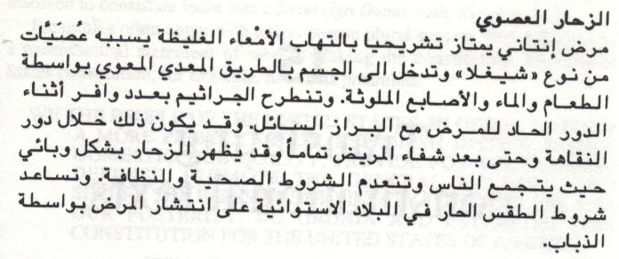
15. Read the following text then answer the question that follows.
According to Dickins, this text belongs to……………………. text type.
literary
philosophical
persuasive
technical

Slide 12

بحمد الله

