Slide 1

Applied linguistics
Dr. Abdulaziz Alturki
جامعة الملك فيصل
عمادة التعلم الإلكتروني والتعليم عن بعد
1

Slide 2
Lecture 6
Applied linguistics

Slide 3
The acquisition of language.
Language acquisition is fascinating (e.g. first language (L1) acquisition is effortless)
Language acquisition is not possible without:
1- a biologically based predisposition (readiness) to acquire language. In other words, people need to be biologically ready to acquire language.
2- experience with language in the environment.

Slide 4
A biological predisposition for language
This is called the ‘nativist model of language acquisition’.
All biologically based systems require ‘environmental input’ to stimulate development. (e.g. eyes, muscles)
In language acquisition, brains provide this predisposition.

Slide 5
Experience with language in the environment
- No input ? no acquisition

Slide 6
But input without ‘something’ to process it is not sufficient for acquisition.
- Here came the idea of the ‘Language acquisition device’ LAD (Chomsky , 1965)
- It includes:
1- Universal Grammar.
2- Acquisition strategies.

Slide 7
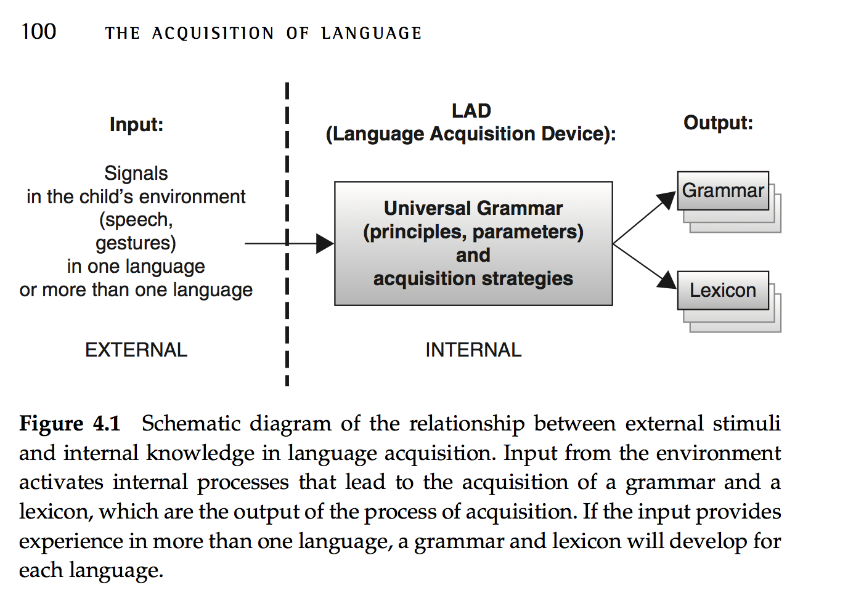

Slide 8
Acquisition strategies determine what will be the most salient and easily acquired aspects of language (e.g. sensitivity to regularities such as prefixes, infixes, and suffixes(
For instance, past tense -ed is regular =
1- Walk + ed = walked
2- Go + ed = goed* (temporary)

Slide 9
Characteristics of the language in the environment
The primary purpose of the child’s linguistic environment is to provide information about the language the child is acquiring (i.e. positive evidence).
Who are the providers of positive evidence?
Parents, care-takers, siblings, and other people who interact with the child.

Slide 10
Should we ‘teach’ children language?
USA vs. some Brazilian tribes (linguistic exogamy) -unlike endogamy-
Some children are rarely talked to.
Children end up acquiring language

Slide 11
1-We don’t need to “teach” children language.
2-Care givers need to provide linguistic input to their children.
3-Information must be conveyed in an interactive setting.
Rewarding for imitation, altering the way of speaking & error correction are not necessary to guarantee successful language acquisition.

Slide 12
To be continued

Slide 13
Questions ?

Slide 14

بحمد الله

