Slide 1

Applied linguistics
Dr. Abdulaziz Alturki
جامعة الملك فيصل
عمادة التعلم الإلكتروني والتعليم عن بعد
1

Slide 2
Lecture 7
Applied linguistics

Slide 3
Let’s look at the language production of a child.

Slide 4
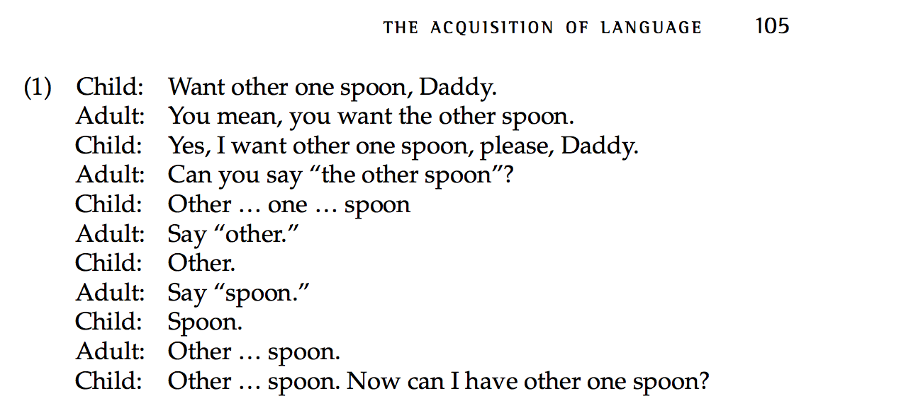
Braine (1971)

Slide 5
Children mostly hear ‘positive evidence’ or input and rarely hear ‘negative evidence’ or ungrammatical language.
E.g. word order is acquired at 14 months (before 2-word sentences = before receiving any feedback on it)

Slide 6
Developmental stages
There are universal milestones or steps (i.e all children acquire languages at similar rates).
What is the first stage ?

Slide 7
Pre-birth to 12 months
Pre-birth sensitivity to language.
Hearing begins to develop around 18 weeks of gestation. (4 months)
By the third trimester, the fetus responds to auditory stimulation.
38 weeks old fetuses have a preference for their own mothers’ voice over that of a stranger. (8.8 months)

Slide 8
After birth, children recognise their mother language as distinct from other languages.

Slide 9
1st six months
Coos, gurgles.

Slide 10
2nd six months
Babbling (e.g. single syllables –CV).
The consonant is usually a stop sound. Vowel is /a/
The vocalisations have sentence-like intonation.

Slide 11
12-24 months
First word -12-18 months (one-word-stage).
This is also called a ‘holophrastic period’ (e.g. milk - I want milk - the cat is drinking milk..etc.).
Underextension vs. overextension.
(e.g. flower X rose vs. dog= cat).

Slide 12
Underextension is a case in which the child will acquire a word for a particular thing and fail to extend it to other subjects in the same category (e.g. the child knows that a rose is flower but can’t use it with other flowers).

Slide 13
Overextension is when the child will extend a word incorrectly to other similar things (e.g. the child knows the word dog but s/he uses it to describe other animals such as cats or horses)

Slide 14
When the child’s vocabulary reaches about 50 words, the child starts putting words together and s/he starts learning new words quickly.
6-year old children roughly know 8000-14000 words.
Average of 4-8 new words everyday.

Slide 15
Preschool years
-Children show knowledge of L1 word-order.
-Sentences start to lengthen.
-Mean length of utterances (MLU). (free & bound morphemes in a language sample/ the number of utterances.
There is high correlation between MLU and age.

Slide 16
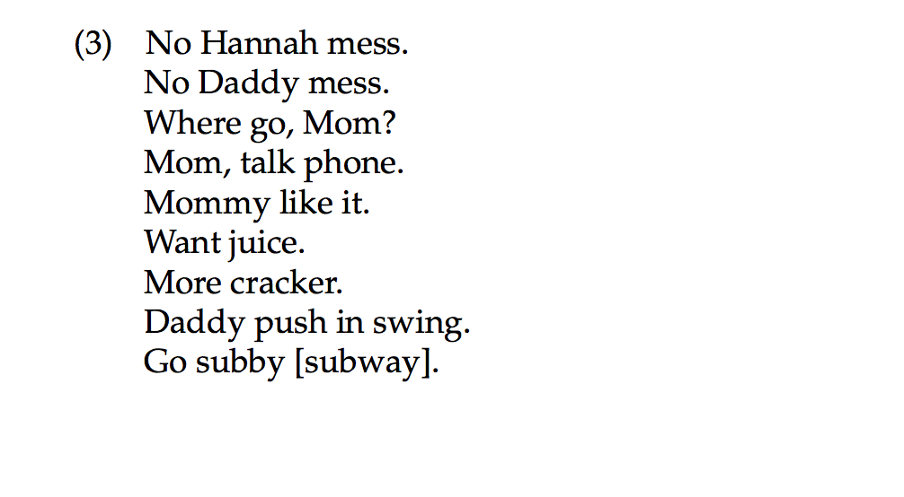
Hanna (23 month old girl)

Slide 17
What can you notice ?
1-No bound morphemes or tense markers on verbs or plural markers.
2-No subjects

Slide 18
Third year
Sentences gradually lengthen, bound morphemes and function word emerge.
Morphemes emerge gradually in a similar order (e.g. -ing present progressive - Kitty sleeping)
Past tense mistakes (e.g. ‘goed’ indicate overgeneralization)

Slide 19
At age 3
Complex sentences are produced (with variation).
-I want Mommy do it.
-I see you sit down.
-Watch me draw circles
Children begin producing relative clauses spontaneously around the age of 3-4

Slide 20
Age 5-6
In general, there is a considerable period between the time a child first uses a form and consistent use of it (e.g. past tense).
At around 5-6, language become more systematic

Slide 21
7,8 & 9 year olds start to use derivational morphemes (e.g. -ness, -ful and –ment).

Slide 22
Discourse ability & metalinguistic awareness develop as children grow older.

Slide 23
Questions ?

Slide 24

بحمد الله

