Slide 1

Applied linguistics
Dr. Abdulaziz Alturki
جامعة الملك فيصل
عمادة التعلم الإلكتروني والتعليم عن بعد
1

Slide 2
Lecture 9
Applied linguistics

Slide 3
Sometimes you may wish to do a detailed analysis of a huge language sample.
For instance, to find out the most frequent words in a language sample.

Slide 4
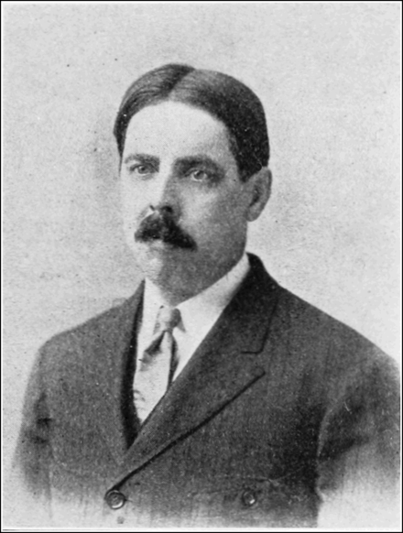
Pre/post computer era
Edward Thorndike 1921
4.5 million words corpus
most frequent 30000 words

Slide 5
Corpus linguistics
Definition ?

Slide 6
CL is “the study of language based on examples of ‘real life’ language use” …… McEnry & Wilson (2001)
1 Corpus, 2 corpora

Slide 7


Slide 8
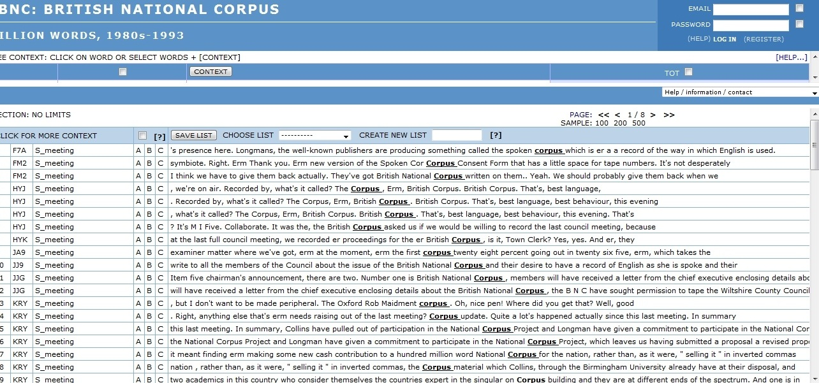

Slide 9
Corpora
The British national corpus (BNC)
The Corpus of Contemporary American English (COCA)
The Longman learners’ corpus (learner language)

Slide 10
Categories
Criteria | Type
User | Native vs. learner
Content | monitor vs. sample
Language | mono vs. mulitlingual
Source | original vs. translation
Time | synchronic vs. diachronic
Remark | plain vs. annotated

Slide 11
Uses & functions
1- Computing: e.g. natural language processing
2- Linguistics: e.g. the study of linguistic competence or performance as revealed in naturally occurring data (descriptive grammar or Critical Discourse Analysis).
3- Language teaching: e.g. ESP.

Slide 12
CL and CDA
CDA = How is X represented in Y source ?
  (e.g. Saudi Women in Fox news)
  Agent vs. theme

Slide 13
Uses of CL in CDA ?
  1- Collocations (e.g. look for collocations of Saudi/muslim/women…etc)
  2- Concordance patterns: a list of all of the occurrences of a particular search term in a corpus, presented within the context that they occur in.
  3- Keywords patterns: lexical items that show marked frequency in one text compared to another.

Slide 14
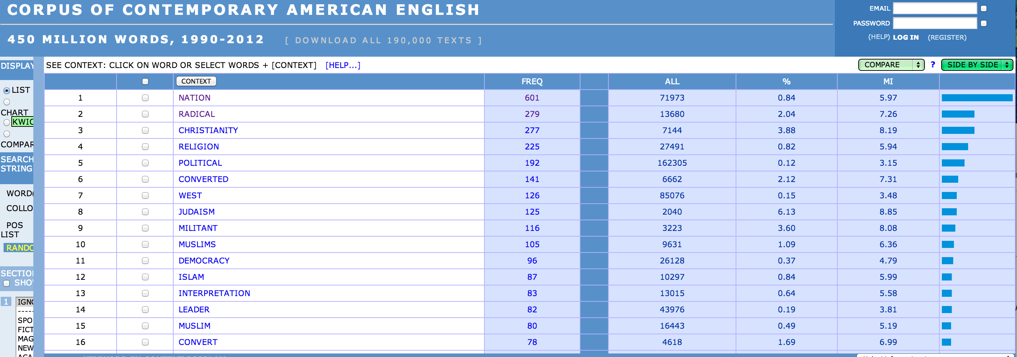
Collocations of ‘ISLAM’ in COCA

Slide 15
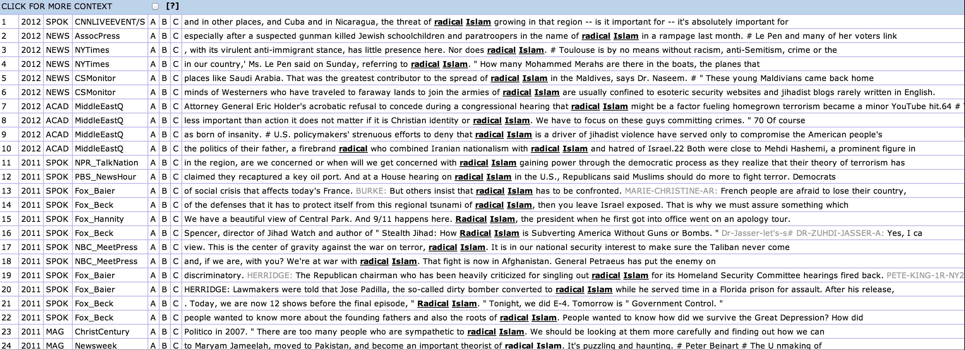
Concordance lines of ‘Radical Islam’

Slide 16
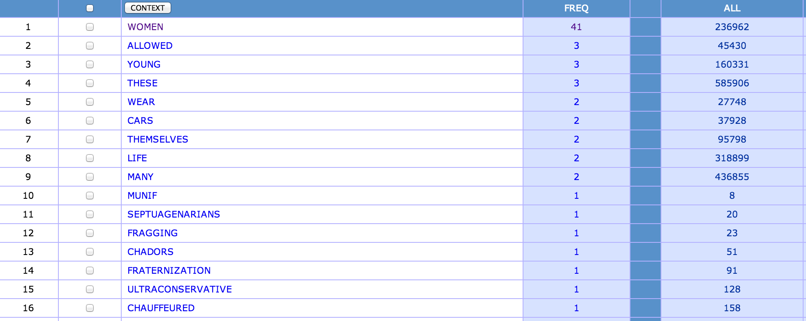
Keywords of ‘Saudi women’

Slide 17
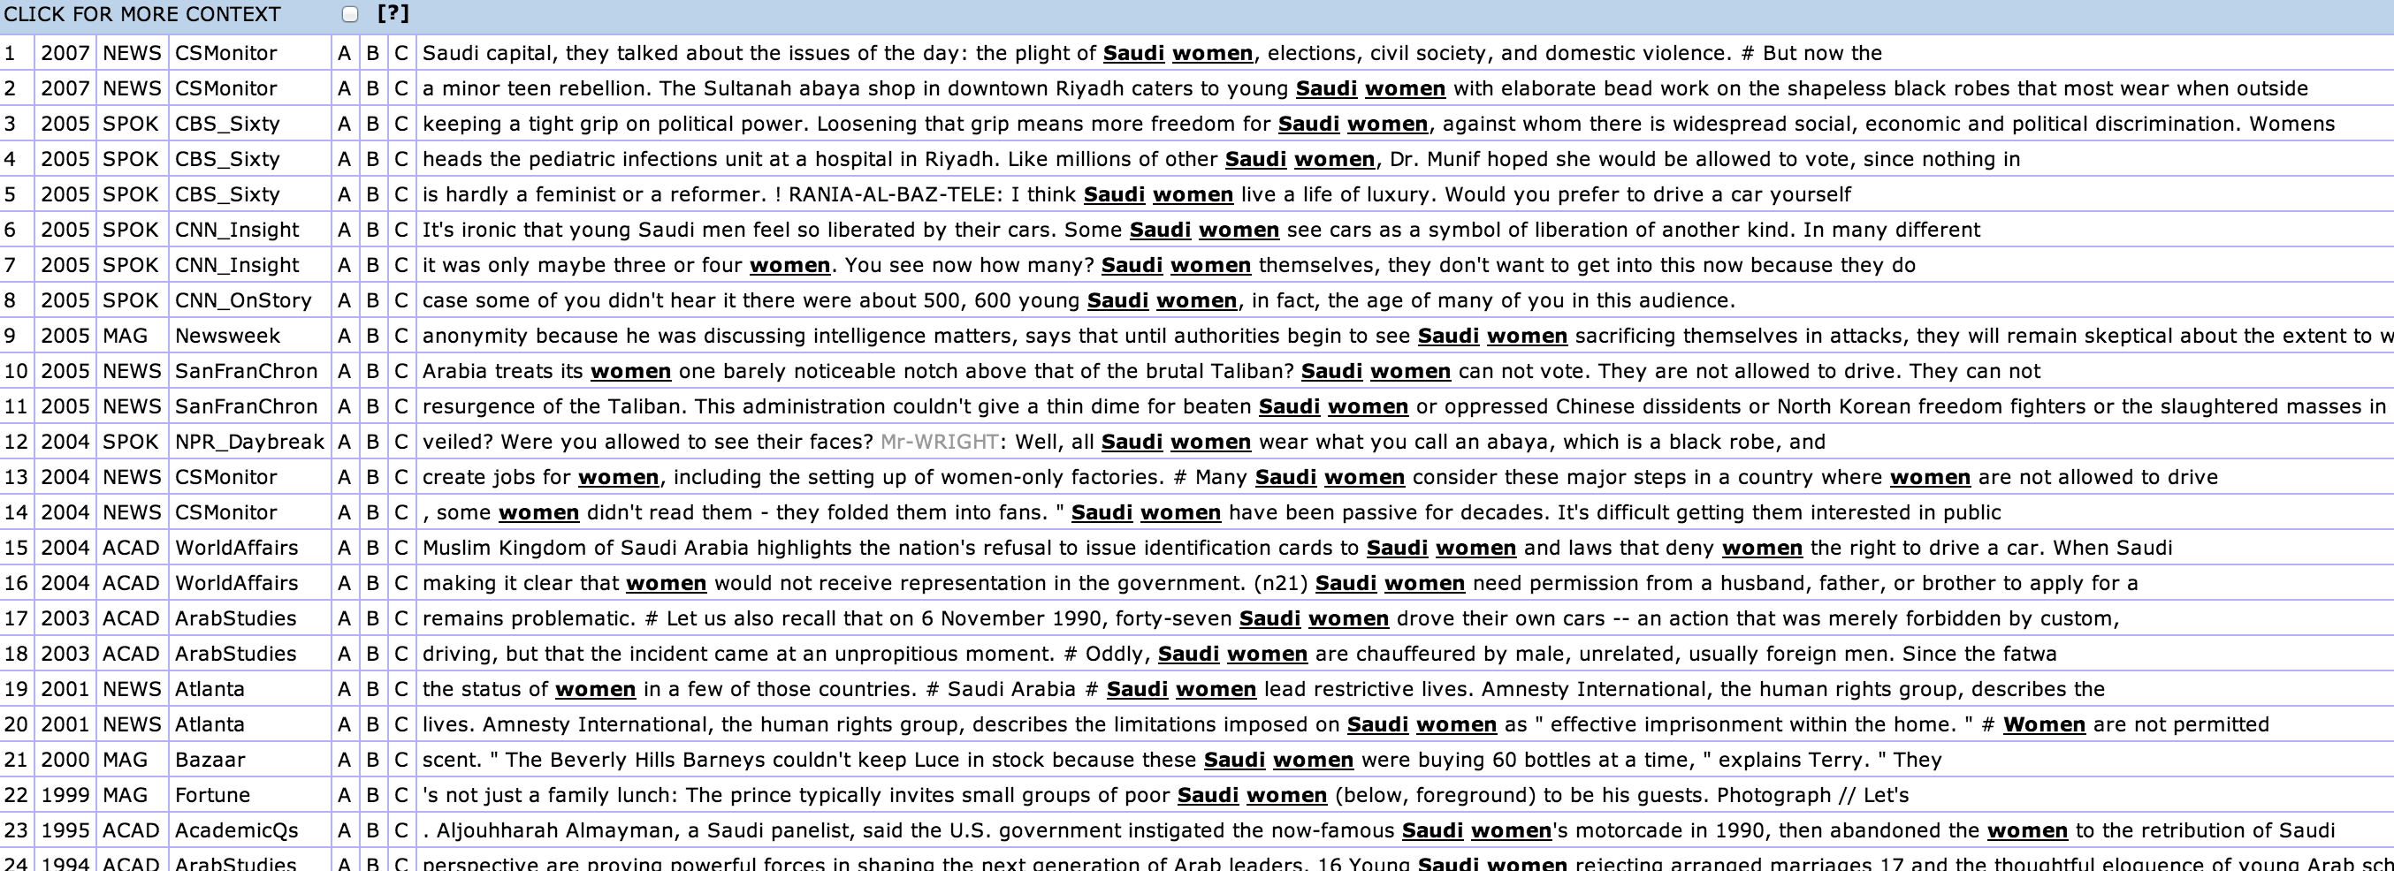

Slide 18
CL & ELT
Barlow (2002) says there are many uses of CL in in ELT:
  -Syllabus design
  -Materials development
  -Classroom activities

Slide 19
Uses of CL in language learning
L2 learners and central/typical uses of a word.
CL & grammar/spelling checkers
Collocation checking
phrase finding - writing classes
Covers different topics
Dictionaries vs. corpora

Slide 20
Thank you !

Slide 21

بحمد الله

