Slide 1

Translating Text Types
Yahya M. Rabab’ah
MA, English/Arabic Translation
جامعة الملك فيصل
عمادة التعلم الإلكتروني والتعليم عن بعد
كلية الآداب
1

Slide 2
Live 3

Slide 3
Communication is the main purpose of…………………………………..
food
languages
industry
old languages only
Arabic language speakers can …………………….. Arabic texts.
say
understand
write
all mentioned above
Any language system has its own ……………………………
features and norms
norms only
features only
Chinese system

Slide 4
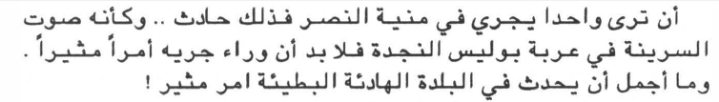
Read the text below then answer the question that follows:
This text is taken from a ………………….
a) poem
b) short story
c) a sermon
d) a brochure

Slide 5
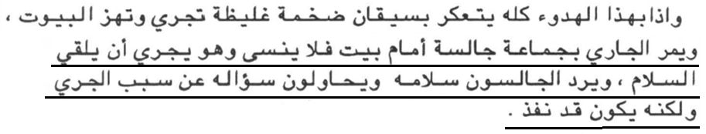
Read the text below then choose the best translation for the underlined sentences:
a) My neighbor passes a group of people and says hello and they reply back asking why but he had gone.
b) As the runner passed a group of men sitting in front of a house, he did not forget to run and greet them. The men returned his greeting, and tried to ask him why he was running; but by that time he had shot past.
c) The runner passes a group of people and says hello and they reply back asking why but he had gone.
d) As the neighbor passed a group of men sitting in front of a house, he did not forget to run and greet them. The men returned his greeting, and tried to ask him why he was running; but by that time he had gone through.

Slide 6
Read the following line of poetry then choose the best translation:
Let the days do everything
Let the days do what they will and with good cheer face fate's decree
Let the days do whatever they want and make yourself happy with the judiciary system
Let the days make it and let yourself accept the judge

Slide 7
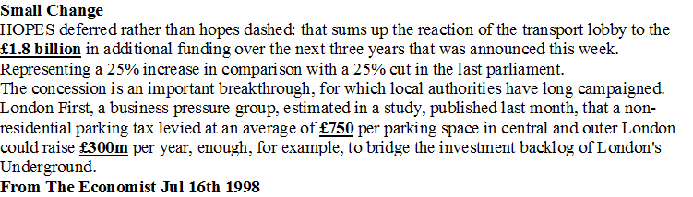
Read the following text and answer the following question
The suitable strategy of translating the underlined digits is to:
translate them according to the exchange rate at that time of publishing the article which is Jul 16th 1998
translate them directly with no change
don't translate them at all
omit them from translation

Slide 8
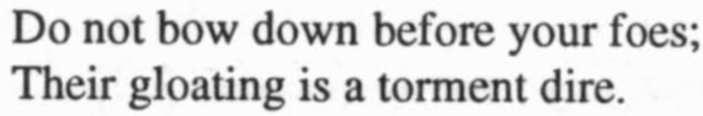
The following translation is for the following line of poetry:

Slide 9
Read the following text then answer the question that follows:
ألقى خادم الحرمين الشريفين الملك عبدالله بن عبدالعزيز آل سعود كلمة بمناسبة حلول عيد الفطر المبارك.
The best translation for the given sentence above is:
The King threw a speech on the Ead occasion.
The King of Saudi Arabia said a speech.
The Custodian of the Two Holy Mosques delivered a speech on the occasion of the blessed Eid Al-Fitr.
The Custodian of the Two Holy Mosques said a speech about Eid Al-Fitr.

Slide 10

The best translation for the following text is:
  This is a cause of Shigella.
  Shigella type is dangerous.
  They are from Shigella.
  It is caused by bacilli of genus Shigella.

Slide 11
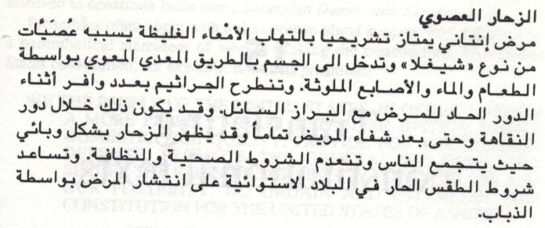
Read the following text then answer the question that follows.
According to Dickins, this text belongs to……………………. text type.
literary
philosophical
persuasive
technical

Slide 12

The best way of conveying the meaning of the underlined verse of (Surat Al-Ikhlas) is:
Lord is one
Say (O Muhammad صلى الله عليه وسلم): "He is Allâh, (the) One
Qul Huwa Allahu Ahad
Say Allhu Ahad

Slide 13

بحمد الله

