Slide 1

Translating Text Types
Yahya M. Rabab’ah
MA, English/Arabic Translation
جامعة الملك فيصل
عمادة التعلم الإلكتروني والتعليم عن بعد
كلية الآداب
1

Slide 2
Lecture 7
Practical Translation 1

Slide 3
Practical 1
In light of the theoretical background outlined before, discuss the strategic decisions that you have to take before starting detailed translation of the following text then translate it into English:

Slide 4
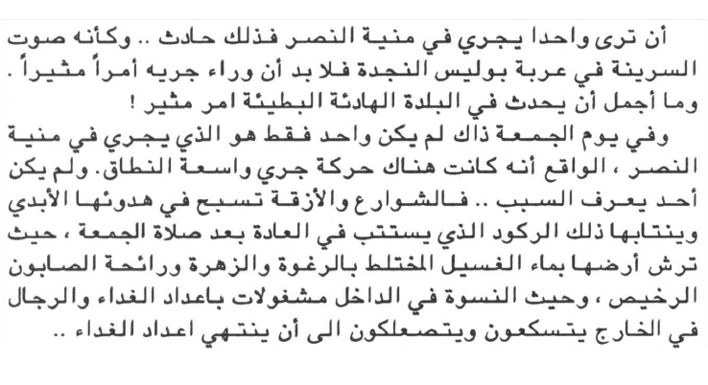

Slide 5
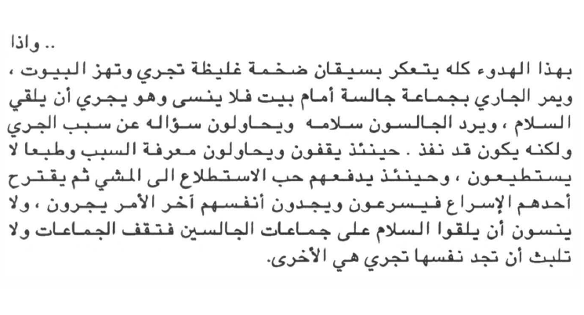

Slide 6
According to scholars we referred to before what sort of text is this?
Basil Hatim & Ian Mason (1990): argumentative, expositive and instruction-based.
Peter Newmark(1988) : Expressive, Informative, Vocative.
Katharina Reiss(1970s) : Informative, Expressive , Operative, Audiomedial.
James Dickins,Sandor Hervey and Ian Higgins (2002) :
Literary, Religious Philosophical, Empirical, Persuasive

Slide 7
Before you begin translating any text, you need to ask yourself the following important questions:
What is the message content of this particular ST?
This part of text is taken from a short story which mainly aims at entertainment and humor.
What are its salient linguistic features?
There are various kinds of word-play, metaphors of water, narrative, repetition
What genre does it belong to and what audience is it aimed at?
Literary genre
What are the functions and intended audience of my translation?
entertainment and humor / general audience: educated and non-educated
How to (translate) deal with names of people? places? things? figures of speech?
Discuss the presence of the translator!
The setting of the text is in Egypt.
Using Google!

Slide 8
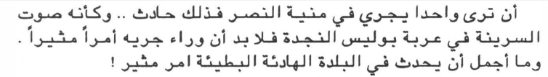
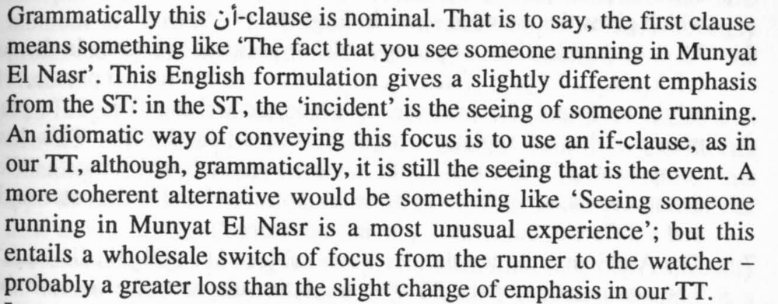
Translation of the text into English:
If you see someone running in Munyat El Nasr, that’s an event. Just as when you hear a police siren, you feel there must be something exciting behind it. And how wonderful it is when something exciting ripples the calm of this quiet, slow village.

Slide 9
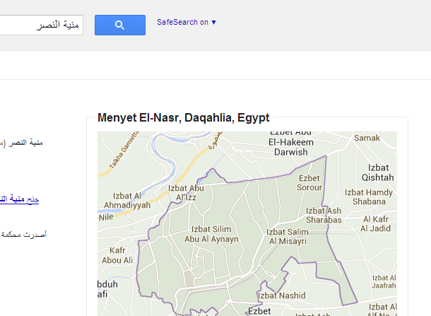
Translation of the text into English:
If you see someone running in Munyat El Nasr, that’s an event. Just as when you hear a police siren, you feel there must be something exciting behind it. And how wonderful it is when something exciting ripples the calm of this quiet, slow village.

Slide 10
Translation of the text into English:
If you see someone running in Munyat El Nasr, that’s an event. Just as when you hear a police siren, you feel there must be something exciting behind it. And how wonderful it is when something exciting ripples the calm of this quiet, slow village.

Slide 11
Translation of the text into English:
If you see someone running in Munyat El Nasr, that’s an event. Just as when you hear a police siren, you feel there must be something exciting behind it. And how wonderful it is when something exciting ripples the calm of this quiet, slow village.

Slide 12
Translation of the text into English:
If you see someone running in Munyat El Nasr, that’s an event. Just as when you hear a police siren, you feel there must be something exciting behind it. And how wonderful it is when something exciting ripples the calm of this quiet, slow village.

Slide 13
Translation of the text into English:
If you see someone running in Munyat El Nasr, that’s an event. Just as when you hear a police siren, you feel there must be something exciting behind it. And how wonderful it is when something exciting ripples the calm of this quiet, slow village.

Slide 14
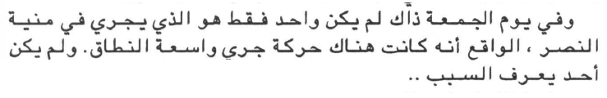
Translation of the text into English:
That Friday, there wasn’t just one person running in Munyat El Nasr - there was a mass of movement of runners, and nobody knew why.

Slide 15
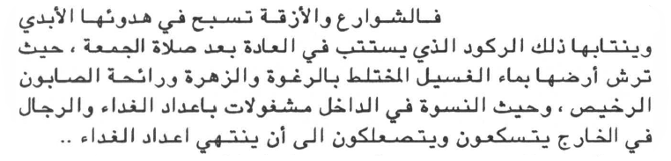
Translation of the text into English:
The streets and alleys were floating with their perpetual calm, and that stagnation which generally sets in following the Friday prayer, when the ground is sprayed with foamy bluish washing water scented with cheap soap, and when women inside busy themselves preparing lunch, while the men loaf around outside until the food is finally ready.

Slide 16
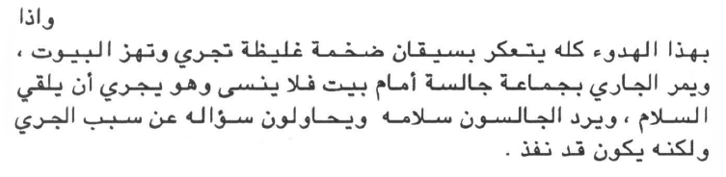
Translation of the text into English:
Suddenly, this calm was distributed by a pair of huge, burly legs running along and shaking the houses. As the runner passed a group of men sitting in front of a house, he did not forget to run and greet them. The men returned his greeting, and tried to ask him why he was running; but by that time he had shot past.

Slide 17
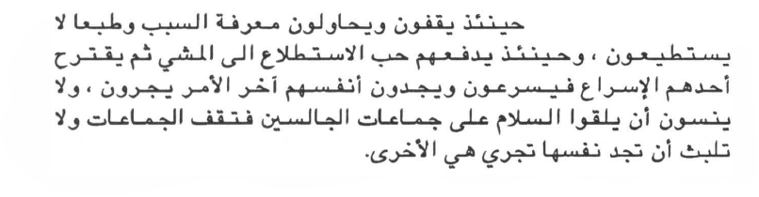
Translation of the text into English:
So they stood up to try and find out why, but of course to no avail; then their curiosity got the better of them, and they began to walk; then one of them suggested that they go a little quicker. Finally, they found themselves running, but they did not forget to greet other groups of sitters, who themselves stood up and before long found they too were running.

Slide 18
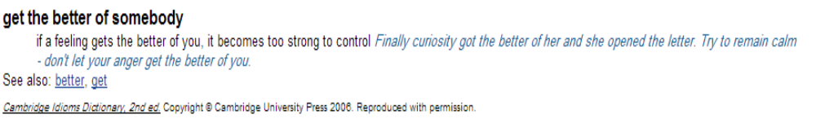
Translation of the text into English:
So they stood up to try and find out why, but of course to no avail; then their curiosity got the better of them, and they began to walk; then one of them suggested that they go a little quicker. Finally, they found themselves running, but they did not forget to greet other groups of sitters, who themselves stood up and before long found they too were running.

Slide 19

بحمد الله

