Slide 1

The Modern Novel
Lecturer: Ahmed K. Alsarhan
جامعة الملك فيصل
عمادة التعلم الإلكتروني والتعليم عن بعد
كلية الآداب
1
جميع الحقوق محفوظة لجامعة الملك فيصل ©
All Rights Reserved for KFU ©

Slide 2
Lecture 1: Social and Historical Background
The Modern Novel

Slide 3
The Novel: Definitions and Distinctions
Genre: Fiction and Narrative
Style: Prose
Length: Extended
Purpose: Mimesis or Verisimilitude
“The Novel is a picture of real life and manners, and of the time in which it is written. The Romance, in lofty and elevated language, describes what never happened nor is likely to happen.”
Clara Reeve, The Progress of Romance, 1785

Slide 4
Verisimilitude
Refers to the illusion that the novel is a representation of real life. Verisimilitude results from:
a correspondence between the world presented in the novel and the real world of the reader
Recognizable settings and characters in real time
what Hazlitt calls, “ the close imitation of men and manners… the very texture of society as it really exists.”
The novel emerged when authors fused adventure and
romance with verisimilitude and heroes that were not supermen but ordinary people, often, insignificant nobodies

Slide 5
Precursors to the Novel
Heroic Epics
Homer’s Iliad and Odyssey, Virgil’s Aeneid, Beowulf, The Song of Roland
Ancient Greek and Roman Romances and Novels
Chariston’s Callirhoe, Petronius’s Satyricon, Apuleius’s The Golden Ass
Oriental Tales
A Thousand and One Nights

Slide 6
Precursors to the Novel
Medieval European Romances: Arthurian tales culminating in Thomas Malory’s Morte Darthur
Elizabethan Prose Fiction: Thomas Nashe’s The Unfortunate Traveller,
Travel Adventures: Marco Polo, Ibn Batuta, Swift’s Gulliver’s Travels, Voltaire’s Candide
Novelle: Boccaccio’s Decameron
Moral Tales: Bunyan’s Pilgrim’s Progress.

Slide 7
The First Novels
Don Quixote (Spain, 1605-15) by Miguel de Cervantes
The Princess of Cleves (France, 1678) by Madame de Lafayette
Robinson Crusoe (England, 1719), Moll Flanders (1722) and A Journal of the Plague Year (1722) by Daniel DeFoe
Pamela, or Virtue Rewarded (England, 1740-1742) by Samuel Richardson
Joseph Andrews (England, 1742) and Tom Jones (1746) by Henry Fielding

Slide 8
Types of Novels
Picaresque Regional
Epistolary Social
Sentimental Mystery
Gothic Science Fiction
Historical Magical Realism
Psychological
Realistic/Naturalistic

Slide 9
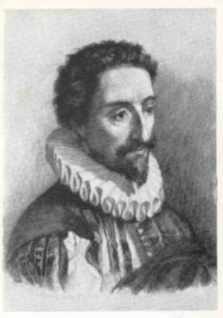
Don Quixote
by Miguel de Cervantes
(1547-1616)
First European novel: part I - 1605; part II - 1615
A psychological portrait of a mid-life crisis
Satirizes medieval romances, incorporates pastoral, picaresque, social and religious commentary
What is the nature of reality?

Slide 10
The Princess of Cleves
Madame de Lafayette
First European historical novel – recreates life of 16th c. French nobility at the court of Henri II
First roman d'analyse (novel of analysis), dissecting emotions and attitudes

Slide 11
The Rise of the English Novel
The Restoration of the monarchy (1660) in England after the Puritan Commonwealth (1649-1660) encouraged an outpouring of secular literature
Appearance of periodical literature: journals and newspapers
  Literary Criticism
  Character Sketches
  Political Discussion
  Philosophical Ideas
Increased leisure time for middle class: Coffee House and Salon society
Growing audience of literate women

Slide 12
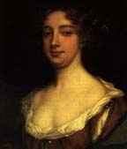
England’s First Professional Female Author:
Aphra Behn
1640-1689
Novels
Love Letters between a Nobleman and his sister (1683)
The Fair Jilt (1688)
Agnes de Castro (1688)
Oroonoko (c.1688)
She also wrote many dramas

Slide 13
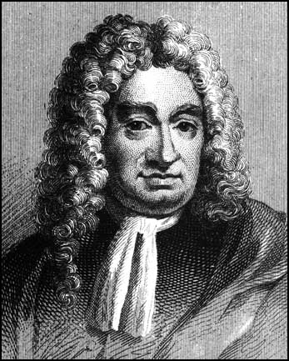
Daniel Defoe
Master of plain prose and powerful narrative
Journalistic style: highly realistic detail
Travel adventure: Robinson Crusoe, 1719
Contemporary chronicle: Journal of the Plague Year , 1722
Picaresques: Moll Flanders, 1722 and Roxana

Slide 14
Picaresque Novels
The name comes from the Spanish word picaro: a rogue
A usually autobiographical chronicle of a rascal’s travels and adventures as s/he makes his/her way through the world more by wits than industry
Episodic, loose structure
Highly realistic: detailed description and uninhibited expression
Satire of social classes
Contemporary picaresques: Jack Kerouac’s On the Road

Slide 15
Epistolary Novels
Novels in which the narrative is told in letters by one or more of the characters
Allows the author to present the feelings and reactions of the characters, and to bring immediacy to the plot, also allows multiple points of view
Psychological realism
Contemporary epistolary novels: Alice Walker’s The Color Purple.

Slide 16
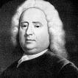
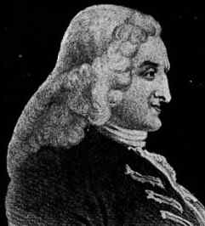
Pioneers of the English Novel
Samuel Richardson
1689-1761
Henry Fielding
1707-1754
Pamela (1740) and
Clarissa (1747-48)
  Epistolary
  Sentimental
  Morality tale: Servant resisting seduction by her employer
Shamela (1741) Joseph Andrews (1742), and Tom Jones (1749)
  Picaresque protagonists
  “comic epic in prose”
  Parody of Richardson

Slide 17
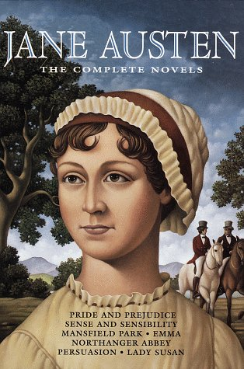
The Novel of Manners:
Jane Austen
Novels dominated by the customs, manners, conventional behavior and habits of a particular social class
Often concerned with courtship and marriage
Realistic and sometimes satirical
Focus on domestic society rather than the larger world
Other novelists of manners: Anthony Trollope, Edith Wharton, F. Scott Fitzgerald, Margaret Drabble

Slide 18
Gothic Novels
Novels characterized by magic, mystery and horror
Exotic settings – medieval, Oriental, etc.
Originated with Horace Walpole’s Castle of Otranto (1764)
William Beckford: Vathek, An Arabian Tale (1786)
Anne Radcliffe: 5 novels (1789-97) including The Mysteries of Udolpho
Widely popular genre throughout Europe and America: Charles Brockden Brown’s Wieland (1798)
Contemporary Gothic novelists include Anne Rice and Stephen King

Slide 19
Frankenstein
by Mary Shelley
1797-1851
One of the most famous gothic novels
Inspired by a dream in reaction to a challenge to write a ghost
story
Published in 1817 (rev. ed. 1831)
Influenced by the Greek myth of Promotheus
Frankenstein is also considered the first science fiction novel

Slide 20
Novels of Sentiment
Novels in which the characters, and thus the readers, have a heightened emotional response to events
Connected to emerging Romantic movement
Laurence Sterne: Tristram Shandy (1760-67)
Johann Wolfgang von Goethe: The Sorrows of Young Werther (1774)
Francois Rene de Chateaubriand: Atala (1801) and Rene (1802)
The Brontës: Anne Brontë Agnes Grey (1847) Emily Brontë, Wuthering Heights (1847), Charlotte Brontë, Jane Eyre (1847)

Slide 21

بحمد الله
جميع الحقوق محفوظة لجامعة الملك فيصل ©
All Rights Reserved for KFU ©

