Slide 1

The Modern Novel
Lecturer: Ahmed K. Alsarhan
جامعة الملك فيصل
عمادة التعلم الإلكتروني والتعليم عن بعد
كلية الآداب
1
جميع الحقوق محفوظة لجامعة الملك فيصل ©
All Rights Reserved for KFU ©

Slide 2
Lecture 2: Emergence and Evolution of the Novel
The Modern Novel

Slide 3
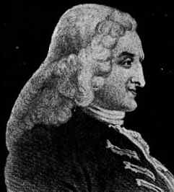
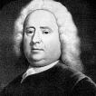
Pioneers of the English Novel
Samuel Richardson
1689-1761
Henry Fielding
1707-1754
Pamela (1740) and
Clarissa (1747-48)
  Epistolary
  Sentimental
  Morality tale: Servant resisting seduction by her employer
Shamela (1741) Joseph Andrews (1742), and Tom Jones (1749)
  Picaresque protagonists
  “comic epic in prose”
  Parody of Richardson

Slide 4
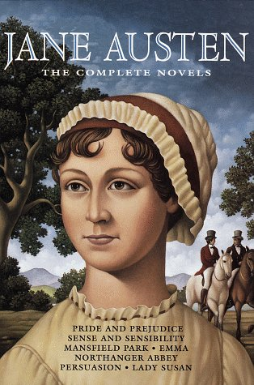
The Novel of Manners:
Jane Austen
Novels dominated by the customs, manners, conventional behavior and habits of a particular social class
Often concerned with courtship and marriage
Realistic and sometimes satiric
Focus on domestic society rather than the larger world
Other novelists of manners: Anthony Trollope, Edith Wharton, F. Scott Fitzgerald, Margaret Drabble

Slide 5
Gothic Novels
Novels characterized by magic, mystery and horror
Exotic settings – medieval, Oriental, etc.
Originated with Horace Walpole’s Castle of Otranto (1764)
William Beckford: Vathek, An Arabian Tale (1786)
Anne Radcliffe: 5 novels (1789-97) including The Mysteries of Udolpho
Widely popular genre throughout Europe and America: Charles Brockden Brown’s Wieland (1798)
Contemporary Gothic novelists include Anne Rice and Stephen King

Slide 6
Frankenstein
by Mary Shelley
1797-1851
One of the most famous gothic novels
Inspired by a dream in reaction to a challenge to write a ghost
story
Published in 1817 (rev. ed. 1831)
Influenced by the Greek myth of Promotheus
Frankenstein is also considered the first science fiction novel

Slide 7
Novels of Sentiment
Novels in which the characters, and thus the readers, have a heightened emotional response to events
Connected to emerging Romantic movement
Laurence Sterne: Tristram Shandy (1760-67)
Johann Wolfgang von Goethe: The Sorrows of Young Werther (1774)
Francois Rene de Chateaubriand: Atala (1801) and Rene (1802)
The Brontës: Anne Brontë Agnes Grey (1847) Emily Brontë, Wuthering Heights (1847), Charlotte Brontë, Jane Eyre (1847)

Slide 8
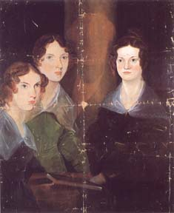
The Brontës
Charlotte (1816-55), Emily (1818-48), Anne (1820-49)
Wuthering Heights and Jane Eyre transcend sentiment into myth-making
Wuthering Heights plumbs the psychic unconscious in a search for wholeness, while Jane Eyre narrates the female quest for individuation

Slide 9
Historical Novels
Novels that reconstruct a past age, often when two cultures are in conflict
Fictional characters interact with with historical figures in actual events
Sir Walter Scott (1771-1832) is considered the father of the historical novel: The Waverly Novels (1814-1819) and Ivanhoe (1819)

Slide 10
Realism and Naturalism
Middle class
Pragmatic
Mimetic art
Objective, but ethical
Sometimes comic or satiric
How can the individual live within and influence society?
Honore Balzac, Gustave Flaubert, George Eliot, William Dean Howells, Mark Twain, Leo Tolstoy, George Sand
Middle/Lower class
Scientific
Investigative art
Objective and amoral
Often pessimistic, sometimes comic
How does society/the environment impact individuals?
Emile Zola, Fyodor Dostoevsky, Thomas Hardy, Stephen Crane, Theodore Dreiser

Slide 11
Social Realism
Social or Sociological novels deal with the nature, function and effect of the society which the characters inhabit – often for the purpose of effecting reform
Social issues came to the forefront with the condition of laborers in the Industrial Revolution and later in the Depression: Dickens’ Hard Times, Gaskell’s Mary Barton; Eliot’s Middlemarch; Steinbeck’s Grapes of Wrath
Slavery and race issues arose in American social novels: Harriet Stowe’s Uncle Tom’s Cabin, 20th c. novels by Richard Wright, Ralph Ellison, etc.

Slide 12
Charles Dickens
1812-1870
By including varieties of poor people in all his novels, Dickens brought the problems of poverty to the attention of his readers:
“It is scarcely conceivable that anyone should…exert a stronger social influence than Mr. Dickens has…. His sympathies are on the side of the suffering and the frail; and this makes him the idol of those who suffer, from whatever cause.”
Harriet Martineau, The London Times called him "pre-eminently a writer of the people and for the people . . . the 'Great Commoner' of English fiction."

Slide 13
Charles Dickens Cont.
1812-1870
Dickens aimed at arousing the conscience of his age. To his success in doing so, a Nonconformist preacher paid the following tribute:
"There have been at work among us three great social agencies: the London City Mission; the novels of Mr. Dickens; the cholera."

Slide 14
The Russian Novel
Russia from 1850-1920 was a period of social, political, and existential struggle.
Writers and thinkers remained divided: some tried to incite revolution, while others romanticized the past as a time of harmonious order.
The novel in Russia embodied those struggles and conflicts in some of the greatest books ever written.
The characters in the works search for meaning in an uncertain world, while the novelists who created them experiment with modes of artistic expression to represent the troubled spirit of their age.

Slide 15
The Russian Novel Cont.
Leo Tolstoy (1828-1910):
Anna Karenina
War and Peace
Fyodor Dostoevsky (1821-1881)
Crime and
Punishment
Notes from Underground
The Brothers Karamazov

Slide 16

بحمد الله
جميع الحقوق محفوظة لجامعة الملك فيصل ©
All Rights Reserved for KFU ©

