Slide 1

The Modern English Novel
Dr. Mohammed Nour Al-Naimi
جامعة الملك فيصل
عمادة التعلم الإلكتروني والتعليم عن بعد
1

Slide 2
Lecture 1
The Modern English Novel

Slide 3
Modernism in literature
An overwiew of early 20th century
literary trends

Slide 4
Definition
Modernism is a literary and cultural international movement which flourished in the first decades of the 20th century. Modernism is not a term to which a single meaning can be ascribed. It may be applied both to the content and to the form of a work, or to either in isolation. It reflects a sense of cultural crisis which was both exciting and disquieting, in that it opened up a whole new vista of human possibilities at the same time as putting into question any previously accepted means of grounding and evaluating new ideas. Modernism is marked by experimentation, particularly manipulation of form, and by the realization that knowledge is not absolute.

Slide 5
A few dates
- 1909
  First “Manifesto” of Italian Futurism
- 1910
  Death of Edward VII
  Post-impressionist exhibition in London
- 1913
  Russian Cubo-futurism
  English Verticism
- 1916-20
  Dada

Slide 6
A few dates
- 1912-17
  Imagism
  Tradition and individual Talent by TS Eliot
- 1922
  - T. S. Eliot’s The Waste Land
  - J. Joyce’s Ulysses
  - Death of M.Proust

Slide 7
Modernism as a movement
Modernism as a movement can be recognized not only
in literature but also in
- The sciences
- Philosophy
- Psychology
- Anthropology
- Painting
- Music
- Sculpture
- Architecture

Slide 8
General Features
Modernism was built on a sense of lost community and civilization
and embodied a series of contradictions and paradoxes, embraced
multiple features of modern sensibility
- Revolution and conservatism
- Loss of a sense of tradition
  lamented in an extreme form of reactionary conservatism celebrated as a means of liberation from the past
- Increasing dominance of technology
  - condemned vehemently embraced as the flagship of progress

Slide 9
Consequences
- Productive insecurity originated
- Aesthetics of experimentation
- Fragmentation
- Ambiguity
- Nihilism
- Variety of theories
- Diversity of practices

Slide 10
Thematic features
- Intentional distortion of shapes
- Focus on form rather than meaning
- Breaking down of limitation of space and time
- Breakdown of social norms and cultural values
- Dislocation of meaning and sense from its normal context
- Valorisation of the despairing individual in the face of an unmanageable future
- Disillusionment
- Rejection of history and the substitution of a mythical past
- Need to reflect the complexity of modern urban life
- Importance of the unconscious mind
- Interest in the primitive and non-western cultures
-Impossibility of an absolute interpretation of reality
- Overwhelming technological changes

Slide 11
Theoretical Background
Marx and Darwin had unsettled men from their secure
place at the centre of the human universe. Their theories
threatened humanist self-confidence and caused a feeling of
ideological uncertainty
Marx had revealed men’s dependence on laws and structures outside their control and sometimes beyond their knowledge. Historical and material determinism.
- Darwin in his conception of evolution and heredity had situated humanity as the latest product of natural selection

Slide 12
Influential thinkers
Physicist Einstein on Relativity (1905)
Physicist Planck on Quantum Theory (1900)
Philosopher Nietzsche on the Will of Power
Philosopher Bergson on the Concept of Time
Psychologist William James on Emotions and Inner Time
Psychologist Freud on the Unconscious (The Interpretation
of Dreams, 1900)
Psychologist Jung on Collective Unconscious
Linguist De Saussure on Language
Anthropologist Frazer on Primitive Cultures

Slide 13
Max Plank (1858-1947)
Considered the founder of quantum
theory, and one of the most important physicists of the twentieth century, he discovered Quantum mechanics
  - the study of the relationship between quanta and elementary particles
  - regarded as the most fundamental framework we have for understanding and describing nature

Slide 14
Albert Einstein (1879-1955)
The Theory of General Relativity
- A metric theory of gravitation
- Einstein's equations link the geometry of a four-dimensional space-time with the energy-momentum contained in that space-time
- Phenomena ascribed to the action of the force of gravity in classical mechanics, correspond to inertial motion within a curved geometry of spacetime
- The curvature is caused by the energy-momentum of matter
- Space-time tells matter how to move
- Matter tells space-time how to curve.

Slide 15
William James (1842-1910)
Pioneering American psychologist and philosopher
- was first to introduce the term stream of consciousness to denote the continuous flow of thoughts, feelings and impressions that makes up our inner lives
Theory of emotions
- emotions feel different from other states of mind
- they have bodily responses that give rise to internal sensations
- different emotions feel different from one another because they are accompanied by different bodily responses and sensations

Slide 16
Sigmund Freud (1856-1938)
Austrian psychologist and psychotherapist
- Discovered a new method to investigate
the mind through analysis of dreams and free associations
- Known for his theories of the unconscious mind and the defense
mechanism of repression
- Renowned for his redefinition of sexual desire as the primary motivational energy of human life directed toward a wide variety of objects
- Famous for his therapeutic techniques, including theory of transference in the therapeutic relationship value of dreams as sources of insight into unconscious desires

Slide 17
Carl G. Jung (1875-1961)
Swiss psychiatrist, influential thinker and the founder of analytical psychology
- He emphasized understanding the psyche through exploring dreams, art mythology, world religion and philosophy
- Developed the concept of collective unconscious, a sort of cultural memory containing myths and beliefs of the human race which work at a symbolical level

Slide 18
Friedrich Nietzsche
(1844-1900)
German philologist and philosopher. His key ideas include
- Tragedy as an affirmation of life
- Eternal recurrence
- Reversal of Platonism
- Repudiation of Christianity
- Will to power (as the motivation that underlies all human behavior)

Slide 19
Henri Bergson (1858-1941)
French philosopher, influential in the first half of the 20th century
developed
- the theory of duration
- time is mobile and incomplete
- for the individual, time speeds up or slows down
- to explore the real time we need to explore the inner life of man
- duration is neither a unity nor a multiplicity
- duration is ineffable
- it can only be shown indirectly through images
- images can never reveal a complete picture of Duration
- duration can only be grasped through intuition and imagination

Slide 20
James Frazer (1834-1841)
Scottish social anthropologist
influential in the early stages of the modern
studies of mythology and comparative
Religion. His most famous work, The Golden Bough
(1890), documents similar magical and religious beliefs
across the globe. He maintained that human belief
progressed through three stages:
  - primitive magic
  - religion
  - science

Slide 21
Ferdinand De Saussure (1857-1913)
Swiss linguist
widely considered as the 'father' of 20th-century linguistics. Main work Course in General Linguistics. Its central notion is that language may be analyzed as a formal system of differential elements
  - linguistic sign
  - signifier
  - signified
  - referent

Slide 22
Painting
Fauvism – Matisse
  Supremacy of colour over form
  Interest in the primitive and the magical
Cubism – Picasso, Braque
  Fragmentation of objects into abstract geometric forms
Abstract paintng – Kandinsky
  Attention to line, colour, shape as subjects of painting
Vorticism – Wyndham Lewis
  Incorporating the idea of motion and change

Slide 23
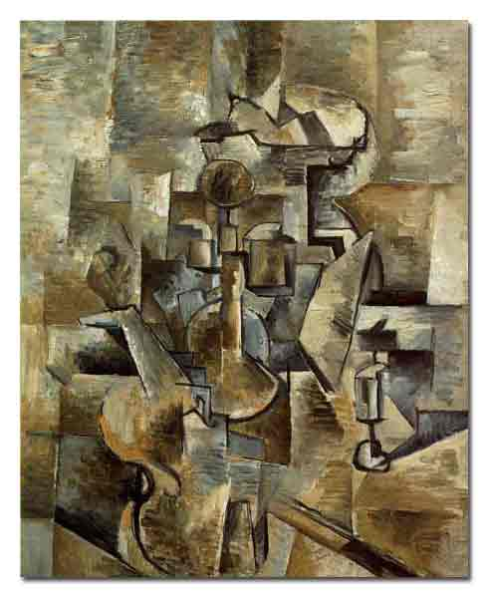
Braque

Slide 24
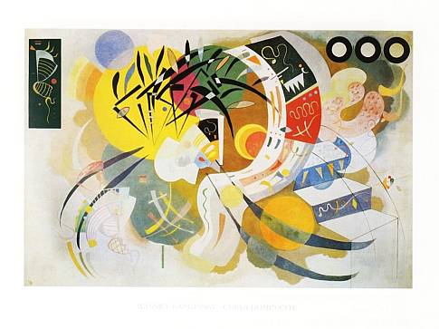
Kandinsky

Slide 25
Music
Stravinsky, Schoenberg
- Dissonance/distorted music effects
- Rejection of rules of harmony and composition
- Serial system of composition

Slide 26
Formal features of poetry
- Open form
- Use of free verse
- Juxtaposition of ideas rather than consequential exposition
- Intertextuality
- Use of allusions and multiple association of words
- Borrowings from other cultures and languages
- Unconventional use of metaphor
- Importance given to sound to convey “the music of ideas”

Slide 27
Modernist novelists
V. Woolf
D.H. Lawrence
J. Conrad
J, Joyce
E.M. Forster
E. Hemingway
W. Faulkner
K.Mansfield
M. Proust
F. Kafka
R. Musil
T. Mann
I. Svevo
L. Pirandello
B. Pasternak
M. Bulgakov

Slide 28
Formal features of narrative
- Experimental nature
- Lack of traditional chronological narrative (discontinuous narrative)
- Break of narrative frames (fragmentation)
- Moving from one level of narrative to another
- A number of different narrators (multiple narrative points of view)
- Self-reflexive about the act of writing and the nature of literature (meta-narrative)
- Use of interior monologue technique
- Use of the stream of consciousness technique
- Focus on a character's consciousness and subconscious

Slide 29
Stream of consciousness
- Aims to provide a textual equivalent to the stream of a fictional character’s consciousness
- Creates the impression that the reader is eavesdropping on the flow of conscious experience in the character’s mind
- Comes in a variety of stylistic forms
- Narrated stream of consciousness often composed of different sentence types including psycho-narration and free indirect style
- characterized by associative (and at times dissociative) leaps in syntax and punctuation

Slide 30
Interior monologue
- A particular kind of stream of consciousness writing
- Also called quoted stream of consciousness, presents characters’ thought streams exclusively in the form of silent inner speech, as a stream of verbalised thoughts
- Represents characters speaking silently to themselves and quotes their inner speech, often without speech marks
- Is presented in the first person and in the present tense and employs deictic words
- Also attempts to mimic the unstructured free flow of thought
- Can be found in the context of third-person narration and dialogue

Slide 31
References
Bradbury, Malcolm, and McFarlane, James, eds. Modernism: A Guide to European Literature, 1890-1930. London: Penguin
Brooker, Peter, ed. Modernism/Postmodernism. London: Longman, 1992
Hassan, Ihab and Hassan, Sally, eds. Innovation/Renovation: New Perspectives on the Humanities. Madison: University of Wisconsin Press, 1983
Huyssen, Andreas. After the Great Divide: Modernism, Mass Culture, Postmodernism. Bloomington: Indiana University Press, 1986
Lodge, David, ed. Modernism, Antimodernism, and Postmodernism. Birmingham: University of Birmingham Press, 1977
Wilde, Alan. Horizon of Assent: Modernism, Postmodernism and the Ironic Imagination. Baltimore and London: Johns Hopkins University Press, 1981.

Slide 37

بحمد الله

