Slide 1

The Modern English Novel
Dr. Mohammed Nour Al-Naimi
جامعة الملك فيصل
عمادة التعلم الإلكتروني والتعليم عن بعد
1

Slide 2
Lecture 3
The Modern English Novel

Slide 3
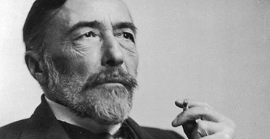
The Modern Age
Joseph Conrad

Slide 4
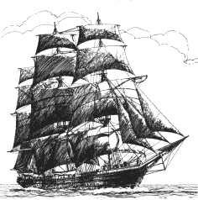
Joseph Conrad - Life
  Nationality
  Careers
  Theme of Double
Born in Poland (1857)
Patriotic family
Exile in Russia
Marseilles in 1874 on French ships
1878 on English ship to Far East
1886 Master Mariner + British Subject
1890 Africa -> Congo Diary
  Sickness -> no more sea -> writing
1924 death

Slide 5
Joseph Conrad - Works
The Nigger of the Narcissus - 1897
Youth – 1898
Lord Jim - 1900
Heart of Darkness – 1902
Nostromo – 1904
The Secret Agent – 1907
Under Western Eyes – 1911
The Shadow Line - 1917
The Rescue – 1920
The Rover - 1923

Slide 6
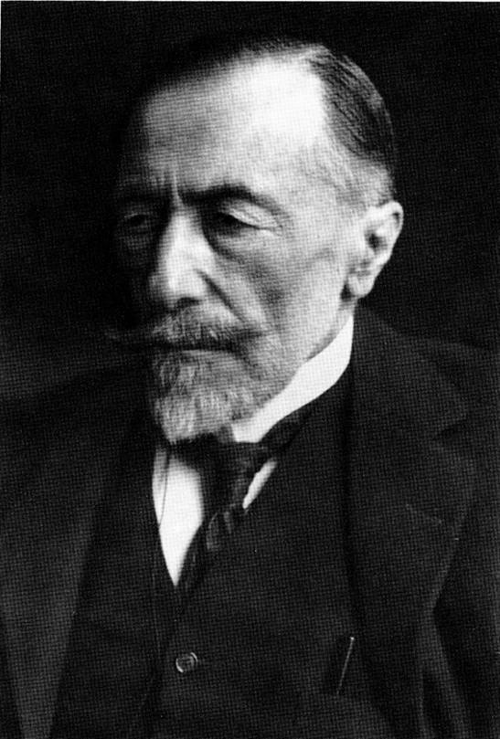
Joseph Conrad - Works
The Nigger of the Narcissus - 1897
Youth – 1898
Lord Jim - 1900
Heart of Darkness – 1902
Nostromo – 1904
The Secret Agent – 1907
Under Western Eyes – 1911
The Shadow Line - 1917
The Rescue – 1920
The Rover - 1923
http://www.operaprojects.org/images/joseph_Conrad.jpg

Slide 7
Conrad – Task Setting Style
Writer’s Task
  No Amusing - No Teaching
  Recording the complexity of life
  Exploring the meaning of human condition
Setting
  Sea and Exotic latitudes (River/Jungle) -> Adventure stories
  Places well known -> to isolate characters -> inner conflicts
  Ship as microcosm
Style
  Oblique
  Extreme situations -> violence misery
  Heroes
    solitary figures, no past, uncertain future
    from outside -> mind of others - actions

Slide 8
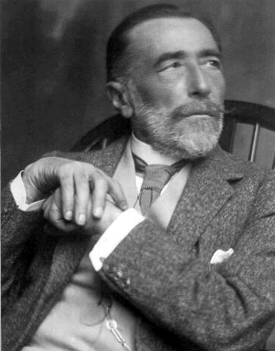
Conrad – Narrative Technique
Time Shifts -> illusion of life
First-person narration
Invisible narrator
Journals
Letters
Same narrator (Marlow) or more than one
Several points of view -> no constraints of omniscent narrator -> reader free to decide and relativism of moral values

Slide 9
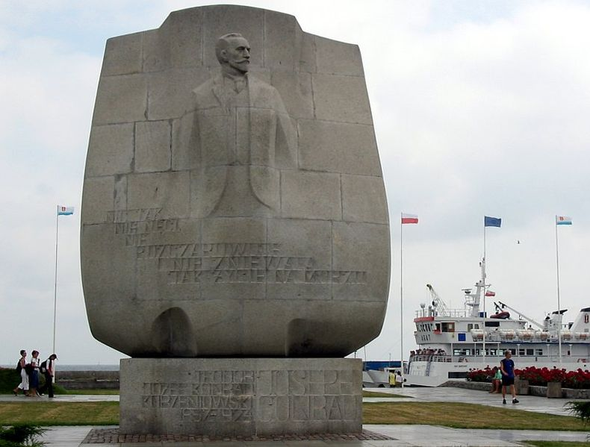
Conrad – Language
Polish
French
English -> ideal expression for complexity of life
Idiomatic dialogue
  question marks
  exclamation marks
  dashes
  Interjections
Variety of adjectives
Complex structures

Slide 10
Characters of Heart of darkness
Marlow
The protagonist of Heart of Darkness. Marlow is philosophical, independent-minded, and generally skeptical of those around him. He is also a master storyteller, eloquent and able to draw his listeners into his tale. Although Marlow shares many of his fellow Europeans’ prejudices, he has seen enough of the world and has encountered enough debased white men to make him skeptical of imperialism.
Kurtz
The chief of the Inner Station and the object of Marlow’s quest. Among Kurtz’s many talents are his charisma and his ability to lead men. Kurtz is a man who understands the power of words, and his writings are marked by an eloquence that obscures their horrifying message. Although he remains an enigma even to Marlow, Kurtz clearly exerts a powerful influence on the people in his life.

Slide 11
His downfall seems to be a result of his willingness to ignore the hypocritical rules that govern European colonial conduct: Kurtz has “kicked himself loose of the earth” by fraternizing excessively with the natives and not keeping up appearances. Kurtz has become wildly successful but he has also indulged his own evil desires and alienated himself from his fellow white men.
General manager
The chief agent of the Company’s African territory and manager of the Central Station. The General manager owes his success to a hardy constitution that allows him to outlive all his competitors. He is average in appearance and unremarkable in abilities, but he possesses a strange capacity to produce uneasiness in those around him, which allows him to exert his control.

Slide 12
Pilgrims
The bumbling, greedy agents of the Central Station. They carry long wooden staves, reminding Marlow of traditional religious travelers. They all want to be appointed to a station so that they can trade for ivory and earn a commission, but none of them actually takes any effective steps toward achieving this goal. They are obsessed with keeping up a veneer of civilization and proper conduct, and are motivated entirely by self-interest. They hate the natives and treat them like animals.
Cannibals
Natives hired as the crew of the steamer. They are a surprisingly reasonable and well-tempered bunch. Marlow respects their restraint and calm acceptance of adversity. The leader of the group, in particular, seems to be intelligent and capable of ironic reflection upon his situation.

Slide 13
Russian trader : A Russian sailor who has gone into the African interior as the trading representative of a Dutch company. He is boyish in appearance and temperament, and seems to exist wholly on the glamour of youth and the audacity of adventurousness. He is a devoted disciple of Kurtz’s.
Kurtz’s African mistress : A fiercely beautiful woman loaded with jewelry who appears on the shore when Marlow’s steamer arrives at and leaves the Inner Station. She seems to exert an undue influence over both Kurtz and the natives around the station, and the Russian trader points her out as someone to fear. Like Kurtz, she is an enigma: she never speaks to Marlow, and he never learns anything more about her.
Kurtz’s Intended : Kurtz’s naïve and long-suffering fiancée, whom Marlow goes to visit after Kurtz’s death. Her unshakable certainty about Kurtz’s love for her reinforces Marlow’s belief that women live in a dream world, well insulated from reality.

Slide 14
Heart of darkness - Key Facts
full title · Heart of Darkness
author · Joseph Conrad
type of work · Novella (between a novel and a short story in length and scope)
genre · Symbolism, colonial literature, adventure tale, frame story, almost a
romance in its insistence on heroism and the supernatural and its preference for
the symbolic over the realistic
language · English
time and place written · England, 1898–1899; inspired by Conrad’s journey to the
Congo in 1890
date of first publication · Serialized in Blackwood’s magazine in 1899; published in
1902 in the volume Youth: A Narrative; and Two Other Stories
publisher · J. M. Dent & Sons, Ltd.

Slide 15
Heart of darkness
narrator · There are two narrators: an anonymous passenger on a pleasure ship,
who listens to Marlow’s story, and Marlow himself, a middle-aged ship’s captain.
point of view · The first narrator speaks in the first-person plural, on behalf of four
other passengers who listen to Marlow’s tale. Marlow narrates his story in the first
person, describing only what he witnessed and experienced, and providing his own commentary on the story.
tone · Ambivalent: Marlow is disgusted at the brutality of the Company and
horrified by Kurtz’s degeneration, but he claims that any thinking man would be
tempted into similar behavior.
tense · Past

Slide 16
Heart of darkness
setting (time) · Latter part of the nineteenth century, probably sometime between
1876 and 1892
setting (place) · Opens on the Thames River outside London, where Marlow is telling
the story that makes up Heart of Darkness. Events of the story take place in
Brussels, at the Company’s offices, and in the Congo, then a Belgian territory.
protagonist · Marlow
Major conflict · Both Marlow and Kurtz confront a conflict between their images of
themselves as “civilized” Europeans and the temptation to abandon morality
completely once they leave the context of European society.
rising action · The brutality Marlow witnesses in the Company’s employees, the
rumors he hears that Kurtz is a remarkable and humane man, and the numerous
examples of Europeans breaking down mentally or physically in the environment of
Africa.

Slide 17
Heart of darkness
falling action · Marlow’s acceptance of responsibility for Kurtz’s legacy, Marlow’s encounters with Company officials and Kurtz’s family and friends, Marlow’s visit to Kurtz’s Intended
themes · The hypocrisy of imperialism, madness as a result of imperialism, the absurdity of evil
motifs · Darkness (very seldom opposed by light), interiors vs. surfaces (kernel/shell, coast/inland, station/forest, etc.), ironic understatement, hyperbolic language, inability to find words to describe situation adequately, images of ridiculous waste, upriver versus downriver/toward and away from Kurtz/away from and back toward civilization (quest or journey structure)
symbols · Rivers, fog, women (Kurtz’s Intended, his African mistress), French warship shelling forested coast, grove of death, severed heads on fence posts, Kurtz’s “Report,” dead helmsman, maps, “whited sepulchre” of Brussels, knitting women in Company offices, man trying to fill bucket with hole in it

Slide 18
Heart of darkness
foreshadowing · Permeates every moment of the narrative—mostly operates on
the level of imagery, which is consistently dark, gloomy, and threatening

Slide 19
Heart of darkness
Summary
At sundown, a pleasure ship called the Nellie lies anchored at the mouth of the Thames, waiting for the tide to go out. Five men relax on the deck of the ship: the Director of Companies, who is also the captain and host, the Lawyer, the Accountant, Marlow, and the unnamed Narrator. The five men, old friends held together by “the bond of the sea,” are restless yet meditative, as if waiting for

Slide 20
Heart of darkness
something to happen. As darkness begins to fall, and the scene becomes “less brilliant but more profound,” the men recall the great men and ships that have set forth from the Thames on voyages of trade and exploration, frequently never to return. Suddenly Marlow remarks that this very spot was once “one of the dark places of the earth.” He notes that when the Romans first came to England, it was a great, savage wilderness to them. He imagines what it must have been like for a young Roman captain or soldier to come to a place so far from home and lacking in comforts.
This train of thought reminds Marlow of his sole experience as a “fresh-water sailor,” when as a young man he captained a steamship going up the Congo River. He recounts that he first got the idea when, after returning from a six-year voyage through Asia, he came across a map of Africa in a London shop window, which reinvigorated his childhood fantasies about the “blank spaces” on the map.

Slide 21
Heart of darkness
Marlow recounts how he obtained a job with the Belgian “Company” that trades on the Congo River (the Congo was then a Belgian territory) through the influence of an aunt who had friends in the Company’s administration. The Company was eager to send Marlow to Africa, because one of the Company’s steamer captains had recently been killed in a scuffle with the natives.
Analysis
Marlow’s story of a voyage up the Congo River that he took as a young man is the main narrative of Heart of Darkness. Marlow’s narrative is framed by another narrative, in which one of the listeners to Marlow’s story explains the circumstances in which Marlow tells it. The narrator who begins Heart of Darkness is unnamed, as are the other three listeners, who are identified only by their professional occupations. Moreover, the narrator usually speaks in the first-person plural, describing what all four of Marlow’s listeners think and feel.

Slide 22
Heart of darkness
The unanimity and anonymity of Marlow’s listeners combine to create the impression that they represent conventional perspectives and values of the British establishment.
For the narrator and his fellow travelers, the Thames conjures up images of famous British explorers who have set out from that river on glorious voyages. The narrator recounts the achievements of these explorers in a celebratory tone, calling them “knight-errants” of the sea, implying that such voyages served a sacred, higher purpose. The narrator’s attitude is that these men promoted the glory of Great Britain, expanded knowledge of the globe, and contributed to the civilization and enlightenment of the rest of the planet.
At the time Heart of Darkness was written, the British Empire was at its peak, and Britain controlled colonies and dependencies all over the planet. The popular saying that “the sun never sets on the British Empire” was literally true. The main topic of Heart of Darkness is imperialism, a nation’s policy of

Slide 23
Heart of darkness
exerting influence over other areas through military, political, and economic coercion. The narrator expresses the mainstream belief that imperialism is a glorious and worthy enterprise. Indeed, in Conrad’s time, “empire” was one of the central values of British subjects, the fundamental term through which Britain defined its identity and sense of purpose.
From the moment Marlow opens his mouth, he sets himself apart from his fellow passengers by conjuring up a past in which Britain was not the heart of civilization but the savage “end of the world.” Likewise, the Thames was not the source of glorious journeys outward but the ominous beginning of a journey inward, into the heart of the wilderness. This is typical of Marlow as a storyteller: he narrates in an ironic tone, giving the impression that his audience’s assumptions are wrong, but not presenting a clear alternative to those assumptions. Throughout his story, distinctions such as inward and outward, civilized and savage, dark and light, are called into question. But the irony of

Slide 24
Heart of darkness
Marlow’s story is not as pronounced as in a satire, and Marlow’s and Conrad’s
attitudes regarding imperialism are never entirely clear.
From the way Marlow tells his story, it is clear that he is extremely critical of imperialism, but his reasons apparently have less to do with what imperialism does to colonized peoples than with what it does to Europeans. Marlow suggests, in the first place, that participation in imperial enterprises degrades Europeans by removing them from the “civilizing” context of European society, while simultaneously tempting them into violent behavior because of the hostility and lawlessness of the environment. Moreover, Marlow suggests that the mission of “civilizing” and “enlightening” native peoples is misguided, not because he believes that they have a viable civilization and culture already, but because they are so savage that the project is overwhelming and hopeless. Marlow expresses horror when he witnesses the violent maltreatment of the natives, and he argues that a kinship exists between black Africans and

Slide 25
Heart of darkness
and Europeans, but in the same breath he states that this kinship is “ugly” and horrifying, and that the kinship is extremely distant. Nevertheless, it is not a simple matter to evaluate whether Marlow’s attitudes are conservative or progressive, racist or “enlightened.”
In the first place, one would have to decide in relation to whom Marlow was conservative or progressive. Clearly, Marlow’s story is shaped by the audience to whom he tells it. The anonymous narrator states that Marlow is unconventional in his ideas, and his listeners’ derisive grunts and murmurs suggest that they are less inclined to question colonialism or to view Africans as human beings than he is. His criticisms of colonialism, both implicit and explicit, are pitched to an audience that is far more sympathetic toward the colonial enterprise than any twenty-first-century reader could be. The framing narrative puts a certain amount of distance between Marlow’s narrative and Conrad himself.

Slide 26
Heart of darkness
This framework suggests that the reader should regard Marlow ironically, but there
are few cues within the text to suggest an alternative to Marlow’s point of view.

Slide 27

بحمد الله

