Slide 1

Course Title:
The Modern Novel
Instructor:
Dr Abdulgawad Elnady
Associate Professor of Literature, Department of English,
King Faisal University.
King Faisal University
Deanship of E-Learning
1

Slide 2
Second Lecture

Slide 3
Quick Revision
The Victorian novel was quite interested in dealing with the problems of society.
It was full of realism.
Lots of novels were written in this age in celebration of the greatness of the British empire: the greatest nation and the greatest novel.
The form of the Victorian novel was stronger and much more improved than that of the 18th century.

Slide 4
Quick Revision
One famous Victorian novelist who worked for the improvement of society through criticizing it is (Forster- Woolf- Dickens).
The greatest age of the English novel was (romantic- classic- realistic).
The form of the Victorian novel is (the same as- stronger than- worse than) that of the novel in the 18th century.
Many women novelists appeared in English literature in the (17th- 18th- 19th) century.

Slide 5
History Repeats Itself
How does history repeat itself?
The novel in the 18th century dealt with the problems of society and the suffering of people.
At the start of the 19th century writers left realism and preferred to talk about nature, love, and beauty. This new shift away from society was called Romanticism.
Then the greater part of the 19th century was a return back to realism. It was the greatest age of realism in the English novel.

Slide 6
History Repeats Itself
By the end of the 19th century and the start of the 20th, writers got sick of the traditional realism of the 19th century. They came up with something totally different, this time it was called Modernism.
History has really repeated itself in the following way:
18th century realism
Romanticism at the start of the 19th century
A whole century of realism in the Victorian age
Break with realism at the fin de siècle
Modernism

Slide 7
Modernism
What is modernism in brief?
It is a rebellion against old traditions of form and content. Classical, conventional ways of expression and even subject matter were rejected and newer, forms and themes were looked for.

Slide 8
Modernism
The ordered, stable and inherently meaningful world view of the nineteenth century could not, wrote T.S. Eliot, accord with "the immense panorama of futility and anarchy which is contemporary history." Modernism thus marks a distinctive break with Victorian bourgeois morality; rejecting nineteenth-century optimism, they presented a profoundly pessimistic picture of a culture in disarray.

Slide 9
Modernism
“Modernism” is an international artistic movement, flourishing from the 1880s to the end of WW II (1945), known for radical experimentation and rejection of the old order of civilization and 19th century optimism; a reaction against Realism and Naturalism

Slide 10
Modernism
when did it start?
According to Virginia Woolf, on or about 1910, the world changed. So she believes it began at about this time.
Other scholars see that it began at the fin de siècle of the 19th century until the end of the 2nd world war in 1945.
The words fin de siècle mean: the end of the century.

Slide 11
Questions
The words fin de siècle mean: (the end of the century- the start of the century- the middle of the century).
Modernism means writers used (different- the same- opposite) ways of expression.
Modernist writers are (optimistic- pessimistic- neutral).
History repeats itself in English literature, which means every age (relies on romanticism-reacts to realism- is realistic)

Slide 12
Questions
Modernist writers (liked- objected to- supported) the order and stability of the 19th century.
Modernism started in (the 19th century- the 21st century- the end of the 19th and the beginning of the 20th century)
According to Virginia Woolf, modernism began in (1910-1945-1888).

Slide 13
ModernismMajor tenets:
Break with all traditional approaches to form and content.
Experimentation
Free verse
Fragmentation: nothing connects with anything else.
Dissatisfaction with the world of politics and the attempt to escape from it through invention of some forms like fables and journeys.
Again history repeats itself. Robinson Crusoe is an 18th century novel that used the trope of the journey. It is used again William Golding (Lord of the Flies) and George Orwell (Animal Farm).

Slide 14
Modernism
In literature, the movement is associated with the works of (among others) Eliot, James Joyce, Virginia Woolf, W.B. Yeats, Ezra Pound, Gertrude Stein, H.D., Franz Kafka and Knut Hamsun. In their attempt to throw off the aesthetic burden of the realist novel, these writers introduced a variety of literary tactics and devices.

Slide 15
Questions
Some writers associated with modernism are (James Joyce- Charles Dickens- Daniel Defoe).

Slide 16
Modernism: some more tenets
Marked by a strong and intentional break with tradition. This break includes a strong reaction against established religious, political, and social views.
Belief that the world is created in the act of perceiving it; that is, the world is what we say it is, not what others tell us about it.
There is no such thing as absolute truth. All things are relative.
No connection with history or institutions. Their experience is that of alienation, loss, and despair.
Championship of the individual and celebration of inner strength.
Life is unordered.

Slide 17
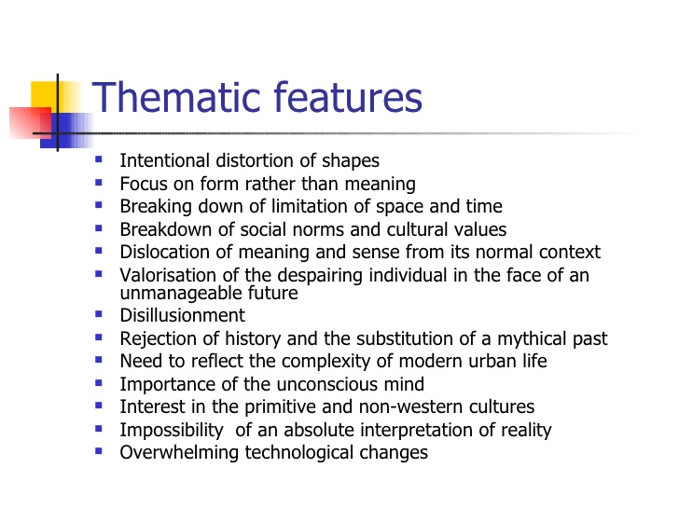

Slide 18
Questions
Modernism is marked by a strong and intentional break with tradition:
It respects and imitates tradition
It is a rebellion against tradition
It uses the same techniques and methods of the past
It values traditional concepts

Slide 19
How far can Animal Farm be considered a modernist novel?
Breaks away with the form of the 19th c novel
Breaks away with traditional language of fiction
Grapples with the predicament of the modern man who sees himself dissociated from the world of politics around him.
Uses new experimental form summoned from history.
It is pessimistic.
Predicts a dark future for humanity
Uses parody
Calls for the same mottos of the French Revolution
1945

Slide 20
How far can Animal Farm be considered a modernist novel?
Animal Farm by George Orwell
1945

Slide 21
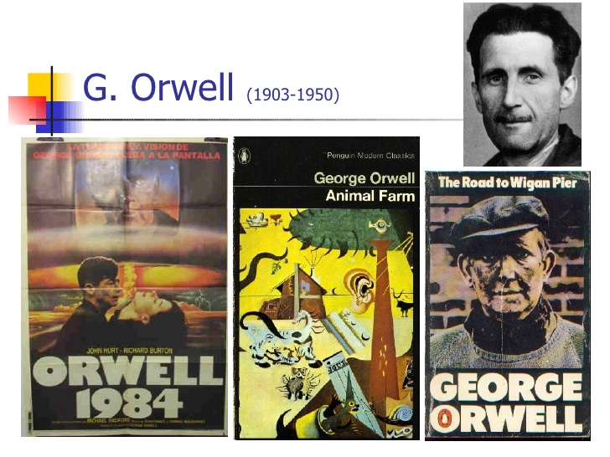

Slide 22

بحمد الله

