Slide 1

Research Methods & Design
Dr. Abdullah Al Fraidan
جامعة الملك فيصل
عمادة التعلم الإلكتروني والتعليم عن بعد
1

Slide 2
Lecture 8
Refining Research Ideas and Beginning
to Design your Study

Slide 3
Elements of Research Design:
Comparison/Control Groups
■ Selecting a comparison group:
Between Groups Designs
■ Compare it to another group (that is similar to
research group except with respect to the
treatment/construct you are measuring)
Within Group Designs
■ Can compare one group to itself over time
(i.e., before treatment and after treatment)
■ Note: qualitative/descriptive studies do not use
comparison groups – they just describe…really well

Slide 4
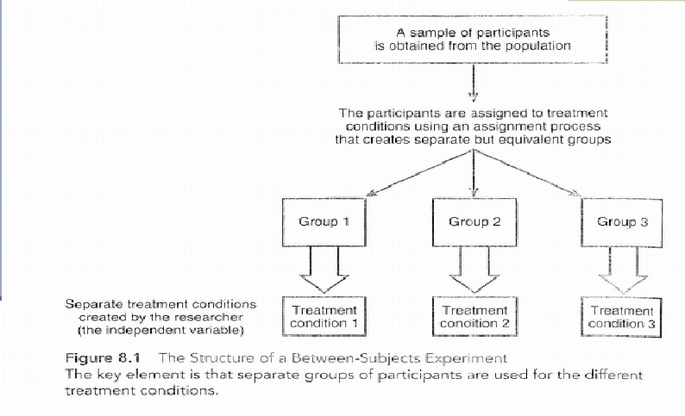
Elements of Research Design: Between Groups Design
Source: Gravetter, F.J., & Forzano, L. B. (2006). Research Methods for the Behavioral Sciences (2nd ed.). United
States of America: Thomson Wadsworth.

Slide 5
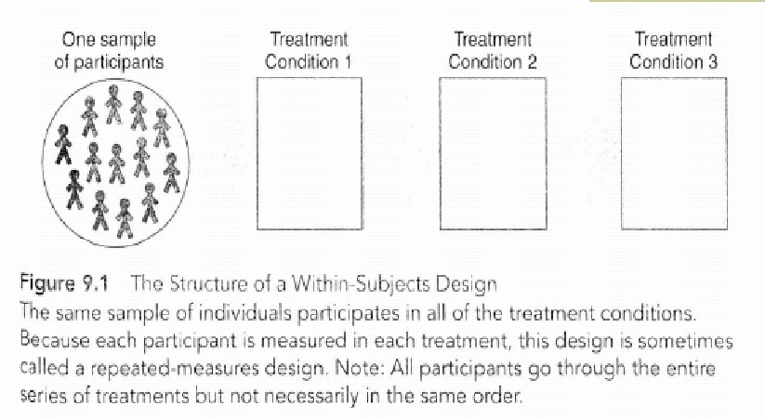
Elements of Research Design: Within
Group Design
Source: Gravetter, F.J., & Forzano, L. B. (2006). Research Methods for the Behavioral Sciences (2nd ed.). United
States of America: Thomson Wadsworth.

Slide 6
Elements of Research Design: One time vs.
over time research
■ Cross-sectional method
▪ Same group of people are observed at one
point in time
■ Longitudinal method
■
Same group of people are observed at
different points in time as they grow older

Slide 7
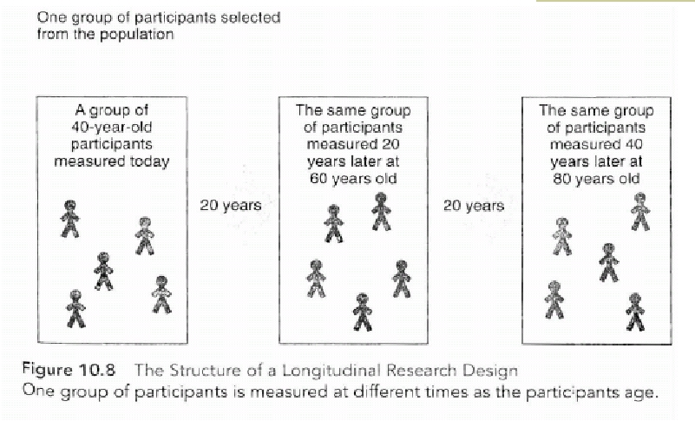
Elements of Research Design: Longitudinal Method
Source: Gravetter, F.J., & Forzano, L. B. (2006). Research Methods for the Behavioral Sciences (2nd ed.). United
States of America: Thomson Wadsworth.

Slide 8

بحمد الله

