Slide 1

Sociolinguistics
Dr. M. Al-Hilal
جامعة الملك فيصل
عمادة التعلم الإلكتروني والتعليم عن بعد
1

Slide 2
Lecture 2
Sociolinguistics

Slide 3
In this Lecture, we will discuss the following:
1- Power and language.
-Definition of power
-How can language impose power?
2- Saussure’s theory of language.
3- Sample exam questions for lectures (1+2)

Slide 4

Definition of power
Power is The ability of its holders to force compliance or obedience of other people to their will.
Eg. A police office can use power to stop criminals or thieves and make them comply with the law.

Slide 5
How can language impose power?
Statistics published by the State of the World Forum (September 2000):
● Number of pages on the World Wide Web: 320,000,000
This means that:
-The English language has the power to dominate the the Web. It has become so widespread.
● Percentage of all websites in English: 80
This means that:
If you do not speak a certain language you are excluded from some kind of power.

Slide 6
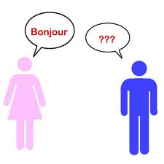


How can language impose power?
Which language we speak can be pathway to power
Knowing a language is power.
E.g. People who have knowledge (language or an skill) have the power to make you feel ignorant or confused because they have knowledge that you do not have.
E.g. An average person vs. an expert

Slide 7
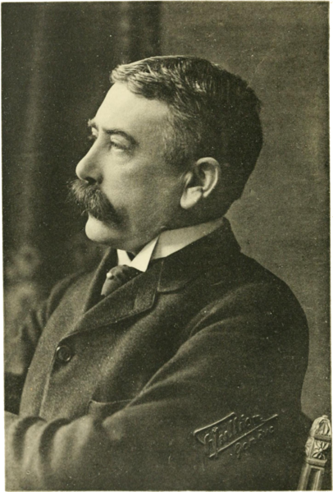
Saussure’ theory of language
Ferdinand de Saussure (1857-1913) was a Swiss linguist whose ideas laid a foundation for many significant developments in linguistics in the 20th century.
Theory: Language as a Representational System

Slide 8


Principles of Saussure’ theory of language
As soon as you hear or read a word, you know what concepts it refers to.
Ex. Tree
watch

Slide 9
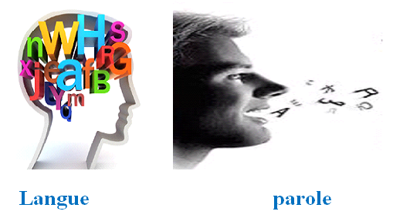
Saussure divided language into two parts.
1- Langue is ‘our [innate] knowledge of the systematic correspondences between sound and meaning which make up our language (including the knowledge of what utterances are possible . . . and what utterances are not).
E.g. * see tomorrow I will
I will see you tomorrow.
2- Parole: is the actual use of language in both speech and writing

Slide 10
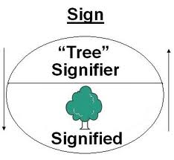
Principles of Saussure’ theory of language
Signifier and signified
Signifier: the sound sequence which makes up a label
Signified: is the meaning or concept associated with the signified.
Sign: is the correspondence between signifier and the signified. It is the association that binds the signifier and the signified together.

Slide 11

Principles of Saussure’ theory of language
The link between the signified and the signifier is arbitrary
English | French | Arabic | Spanish | German
Car | Voiture | سيارة | coche | Auto

Slide 12
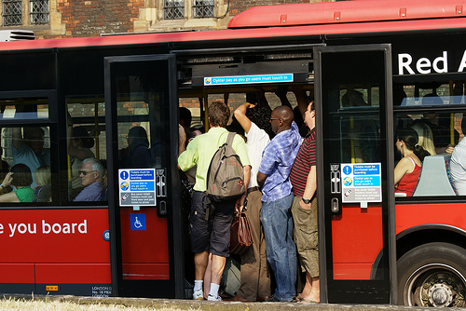
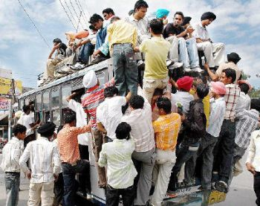
Sign partially derive meaning from their relationship with other associated signs.
Crowded overcrowded
Crowded
We know the meaning of overcrowded through its relation with crowded

Slide 13

Signs do not exist in isolation, but in systems of associative relationship.
White Tulip Red Tulip
We know the meaning of white tulip through its association with red tulip.

Slide 14
Sample exam questions: lectures (1 and 2).
Lecture 1
…………….. is the study of how a listener recognize words and utterances.
a. Psychosis
b. Psychotherapy
c. Psychology
d. Psycholinguistics
Psycholinguistics is the study of………………………
a. How to describe the sounds of a language.
b. How to learn languages.
c. How to teach languages
d. how a listener recognizes words and utterances.
………… refers grammatical rules which determine how words can be combined into phrases and sentences:
a. Morpheme
b. philosophy
c. Syntax.
d. Morphology

Slide 15
Sample exam questions: lectures (1 and 2).
The ………..is used to keep communication lines open and also keep social relationships well
a. aesthetic function
b. phatic function
c. Referential function
d. Affective function
There is more than one ……………of English, eg. Indian English, American English
variety
verb
Language
Terminology
Aesthetic language is usually used in …………..not in science
Mathematics
Physics
Poetry
Morphology

Slide 16
Sample exam questions: lectures (1 and 2).
Choose the example that expresses the affective use of language:
a. It is very hot to day.
b. Wow, she is very beautiful
c. Go to the end of the road.
d. Put those books on the table.

Slide 17
Sample exam questions: lectures (1 and 2).
Lecture 2
Ferdinand de Saussure (1857-1913) was a ……..linguist
Syrian
Swiss
British
American
Saussure divided language into two parts: langue and ………
a. paradox
b. Pardon
c. Parole
d. grammar

Slide 18
Sample exam questions: lectures (1 and 2).
………is the actual use of language in both speech and writing
linguistics
B. language
Competence
Parole
The link between the signifier and the signified is ………..
Regular
Systematic
Arbitrary
Logical
…….is The ability of its holders to force compliance or obedience of other people to their will.
Parole
Language
Power
signifier

Slide 19

بحمد الله

