Slide 1

Sociolinguistics
Dr. M. Al-Hilal
جامعة الملك فيصل
عمادة التعلم الإلكتروني والتعليم عن بعد
1

Slide 2
Lecture 6
Sociolinguistics

Slide 3
In this Lecture, we will discuss the following:
How is English sexist? Some ways of using language are sexist
Unmarked and marked terms
5.2.3 Semantic derogation
5.2.4 Sexism in discourse
5.2.4 Sexism in discourse
5.3 Do women and men talk differently?
5.3.1 How much talk?
5.3.2 interruption
5.3.3 Back channel support
5.3.4 hedges and epistemic modal forms
5.3.5 Topic development

Slide 4
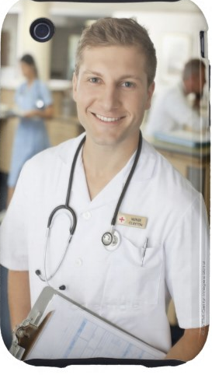
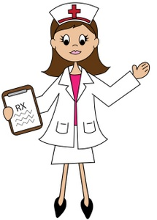
Marked and Unmarked terms
Marked means noticeably unusual. Marked terms refer to anything which deviates from the norm and this deviation is signalled by additional information
Unmarked
linguistic forms are neutral in so far as they represent the ‘norm’, and carry no additional information.
E.g. The unmarked form nurse is often assumed to refer to a woman. To refer to a nurse who is a man, the additional term male is often added: male nurse (the marked form).
Male nurse
Deviates from the norm.
Carries additional information
Marked form
Nurse
Represent the norm
Carries no additional information
Unmarked form

Slide 5
Marked and Unmarked terms
It is common for ‘unmarked’ terms to refer to males:
E.g.
waiter
host
actor
while to refer to a female, the terms are ‘marked’ by adding a suffix such as –ess.
E.g.
waitress
hostess
actress
This can make terms used for females different from the ‘standard’
These examples can be interpreted as sexist because they imply that ‘normal’ or the high status people are men.

Slide 6
5.2.3 Semantic derogation
Semantic Derogation.
Semantic is a linguistic term referring to meaning; deroge means ‘to cause to seem inferior.
Master vs. Mistress
‘He is my master’
usually means ‘he is my boss’ or ‘he has more power than
me’.
‘She is my mistress’
is usually interpreted as meaning ‘she is my illicit lover’.
Thus, words for women tend to lose status and refer to women with a sexual connotation.
This has clearly happened to mistress and not to master.

Slide 7
5.2.4 Sexism in discourse
Sexism is sometimes located not in specific words but in the discourse, i.e. in a whole utterance or sentence
E.g.
Lying politicians, spin doctors and CHEATING SPORTSMEN (and HUSBANDS) will suddenly find life uncomfortable.
(Robin McKie in The Observer, 10 March 2002)
The above example shows how sexism in discourse can be used where the reference is to men (sportsmen and husbands) not women.

Slide 8
5.2.5 Other explicit examples of sexism
Explicit means clear or obvious = direct examples of sexism
E.g. Direct insults.
A journalist explains why media award ceremonies are given so much media coverage:
“We get to see beautiful actresses and interesting actors’.
The Independent newspaper (28 February 2002).
This shows the emphasis on women’s looks and on men’s personalities.

Slide 9


E.g. Advertisements
In 2002, a well-known chocolate bar appeared with a new label. The label appears to insult girls by clearly stating that this product is “NOT FOR GIRLS”
- Using a dark blue foil (masculine symbol).
the wrapping has a circular icon of a woman crossed with a red line.
The product seems to use the term girl and the icon as insults

Slide 10
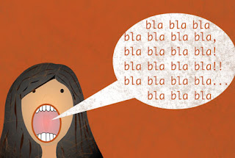
Is there any difference between men’s and women’s talk?
- Common stereotypes about women’s talk: a. women talk more than men b. women never stop talking
This implies that women’s talk is plentiful but rather pointless.
New Research results:
Men on the whole talk far more than women.
The fact that we tend to assume that women talk more in spite of the evidence /research indicates that women and women’s activities are undervalued.
5.3 Do women and men talk differently?

Slide 11
Differences at the level of phonology: women and men vary in their pronunciation.
Syntactic differences: differences in the kinds of grammatical constructions they use.
Discoursal differences: differences in the kinds of things they talk about.
5.3.1 How much talk?
5.3.2 interruption
5.3.3 Back channel support
5.3.4 hedges and epistemic modal forms
5.3.5 Topic development
What are the differences between women’s and men’s use of language?

Slide 12
Research Results:
1- In a mixed-sex conversation, the average amount of time for which a man talks is approximately twice as long as the average amount for which a woman talks.
2- Boys talk more in front of the class than girls do, and absorb more of the teacher’s time.
As a consequence of this research, changes to teaching styles in the UK have been made to distribute the amount of classroom talk, and the teacher’s time, more fairly.
5.3.1 How much talk?

Slide 13
The extent to which men interrupt women ….Men interrupt women more than they interrupt other men, indicate that men act as if they have more right than women to speak in mixed-sex conversations, and that women act as if they had less right to speak than men.
5.3.2 Interruption

Slide 14
Back channel support is the verbal and non-verbal feedback listeners give to speakers.
Research suggests women are often more active than men in supportive roles in conversation.
Listeners can give feedback by saying things like: mmm, uhuh, yeah, nodding, smiling, frowning and by other body language including gestures.
5.3.3 Back channel support

Slide 15
Hedges are linguistic forms which ‘dilute’ an assertion.
E.g. sort of, like, I think and kind of. modal auxiliary verbs can be used to indicate that you don’t want to sound completely certain about something. E.g. Should, would, could, may and might.
Studies suggest that women exploit hedges and epistemic modal forms more than men
5.3.4 Hedges and epistemic modal forms

Slide 16
A. Women are less confident than men and feel nervous about asserting anything too strongly.
B. women prefer to avoid conflict and to allow disagreement to take place without explicit confrontation
Why do women use hedges and epistemic forms?

Slide 17
Men and women vary is in the topics they choose to discuss.
5.3.5 Topic development
Women,
select more personal topics: E.g. family, emotions and friendships.
Men,
prefer more impersonal topics, often based on factual or technical knowledge
E.g. football, cars or home improvements.

Slide 18

بحمد الله

