Slide 1

Sociolinguistics
Dr. M. Al-Hilal
جامعة الملك فيصل
عمادة التعلم الإلكتروني والتعليم عن بعد
1

Slide 2
Lecture 14
Sociolinguistics

Slide 3
In this Lecture, we will discuss the following:
ATTITUDES TO LANGUAGE (Chapter 11)
11.2.4 Attitudes to Pronunciation and accent
11.3 The effects
Final exam discussion.

Slide 4
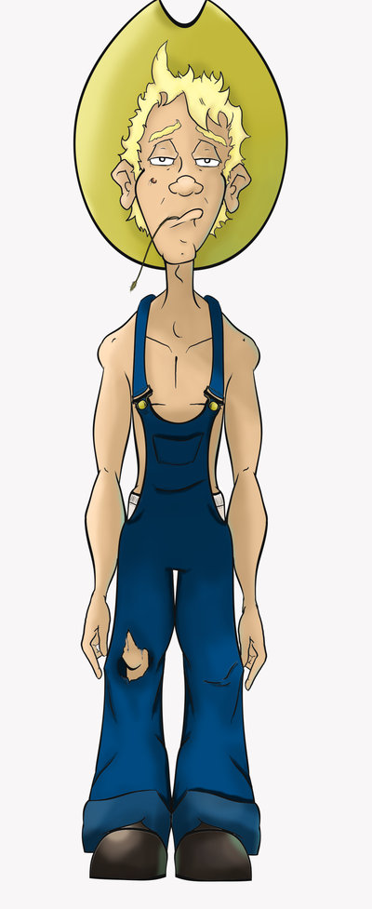
11.2.4 Attitudes to Pronunciation and accent
-The way in which something is said is often as influential for the message as what is said.
we commonly have stereotypical ideas about people on the basis
of their accents.
‘Country bumpkin’
Country bumpkin refers to a person, usually from a rural area,
who speaks or behaves in a manner that indicates a lack
of sophistacation.
-Countryside accents can be used to denote lack of
intelligence with the stereotypical image of the
‘country bumpkin’
Country Bumpkin
Image source:
http://pinkminx09.deviantart.com/art/Country-Bumpkin-153769582

Slide 5
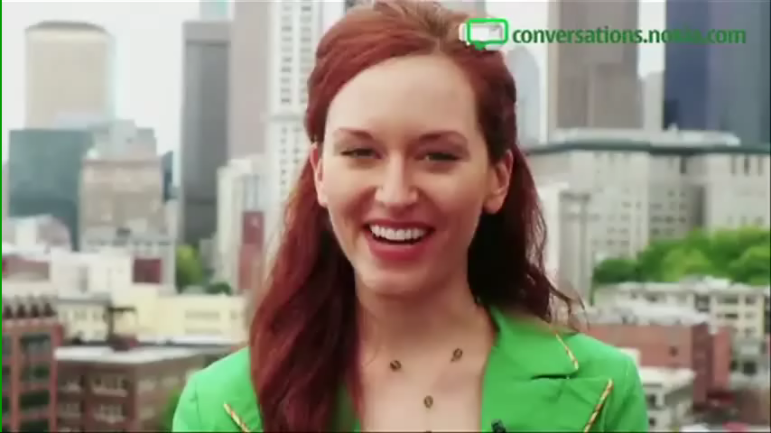
11.2.4 Attitudes to Pronunciation and accent
Lippi-Green 1(997: 215) points out that in the United States, lack of intelligence is associated with women with southern accents.
E.g.
Alabama, Georgia, Tennessee, Mississippi, North Carolina, South Carolina, Louisiana, Arkansas, etc. E.g.
Video Source: http://www.youtube.com/watch?v=R30D7v5RRSY
I

Slide 6
11.2.4 Attitudes to Pronunciation and accent
-Birmingham accent or a southern states accent is linked with criminality.
E.g. The Daily Mail (1 October 1997) reports that ‘crime suspects with a Birmingham accent are twice as likely to be considered guilty’.
-‘Noo Yawkese’, is similarly stigmatised and its speakers are regarded as less trustworthy than those using the more standard American accent.

Slide 7
Matched guise experiment
Matched guise experiment is a method of investigating people’s attitudes to different languages. It involves informants listening to several recordings of the same ‘script’ spoken by the same speaker. The informants are then asked to judge each speaker’s personal characteristics based on what they hear.

Slide 8
11.3 The effects
A- A survey quoted in the Glasgow Herald (28 October 1997) reports that, in Britain, speakers with Scottish accents are rated the highest on sex appeal (sexual attractiveness).
B- In the United States, negative and criminal stereotypes are associated with Spanish-accented speakers
C- (Lippi-Green 1997: 236) shows that stereotypes are reinforced in the media. E.g. Mexican-Americans are portrayed negatively:
‘recent stereotypes in film and television . . . have one thing in common: Mexican Americans are almost always portrayed as violent: they are drug-pushers, gang-members, pimps’

Slide 9
11.3 The effects
D-Effects Lippi-Green records the evidence of a research student who was discussing language styles with a businessman whose job was to hire sales personnel. The businessman was positive that he wouldn’t hire anyone with a Mexican accent.
E- ‘Noo Yawkese’ (i.e. New York speaker) find their accents a liability (problem): The Washington Post (16 December 1997) states:
‘natives of New York can get rich faster if they sound like they are from someplace else’.

Slide 10
11.3 The effects
F- In Britain, reports in the press indicate that the way people speak affects their job prospects.
E.g.
The Daily Telegraph (12 March 1994) covers the story of an employee of a Birmingham company who was fired for having a Birmingham accent.
G- A survey by the Institute of Personnel and Development confirms that
‘employers tend to look down their noses at those who speak in the accents of Liverpool, Glasgow and Birmingham’ (The Guardian, 3 January 1993).

Slide 11
11.3 The effects
Effect of language attitudes on Education.
Giles and Coupland (1991:45) shows that teachers’ perceptions of pupils’ language can influence pupils’ academic assessment:
“research indicates that the perception of children’s so-called ‘poor’ speech characteristic leads teachers to make negative inferences about their personalities, social background and academic abilities. (Giles and Coupland 1991: 45)

Slide 12
Final exam discussions.
1- There will be 70 questions. 1 mark for each questions
2- multiple choice questions, four choices a. b.c. d.e.
3- Exam Questions will be from the slides.
4- The exam questions cover all lectures.

Slide 13
Sample exam questions:
In the United States, negative and …………. are associated with Spanish-accented speakers
criminal stereotypes
critical stiff types
curly stripe
crispy meal file
-Mexican stereotypes in film and television have one thing in common: Mexican Americans are almost always portrayed as ……..: they are drug-pushers, gang-members, pimps’
calm
violent
nice
Quiet
Matched guise experiment is a method of investigating people’s ……. to different languages.
attires
latitudes
attitudes
tattoos

Slide 14
Sample exam questions:
Speakers tend to use their linguistic identity for the different reasons:
A. to disguise their membership of a particular social or regional group.
B. to distance themselves from a particular social or regional group.
C. to move closer to another group they want to belong to.
D. All the above

Slide 15

بحمد الله

