Slide 1

Psycholinguistics
Dr. Abdulaziz Alturki
جامعة الملك فيصل
عمادة التعلم الإلكتروني والتعليم عن بعد
كلية الآداب
1
جميع الحقوق محفوظة لجامعة الملك فيصل ©
All Rights Reserved for KFU ©

Slide 2
Lecture 5
Language acquisition
Developmental stages

Slide 3
Developmental stages
Psycholinguistics Lecture 5
Universal milestones. p.106

Slide 4
Pre-birth to 12 months
Psycholinguistics Lecture 5
Pre-birth sensitivity to language. p.107
Hearing begins to develop around 18 weeks of gestation. (4 months)
By the third trimester, the fetus responds to auditory stimulation.
38 weeks old fetuses have a preference for their own mothers’ voice over that of a stranger. (8.8 months)

Slide 5
Psycholinguistics Lecture 5
After birth, children recognize their mother language as distinct from other languages. p.107

Slide 6
1st six months
Psycholinguistics Lecture 5
Coos, gurgles. p.109

Slide 7
Second six months
Psycholinguistics Lecture 5
Babbling (e.g. single syllables -CV). p.109
The consonant is usually a stop sound. Vowel is /a/
The vocalisations have sentence-like intonation. p.110

Slide 8
12-24 months
Psycholinguistics Lecture 5
First word -12-18 months (one-word-stage). p.110
This is also called a ‘holophrastic period’ (e.g. milk - I want milk - the cat is drinking milk..etc).
Underextension vs. overextension. p.111 (e.g. flower X rose vs. dog= cat).

Slide 9
Psycholinguistics Lecture 5
When the child’s vocabulary reaches about 50 words, the child starts putting words together and s/he starts learning new words quickly. p.111
6-year old children roughly know 8000-14000 words.
Average of 4-8 new words everyday.

Slide 10
Preschool years
Psycholinguistics Lecture 5
Children show knowledge of L1 word-order. p116
Sentences start to lengthen.
Mean length of utterances (MLU). (free & bound morphemes in a language sample/ the number of utterances. p.117
There is high correlation between MLU and age.

Slide 11
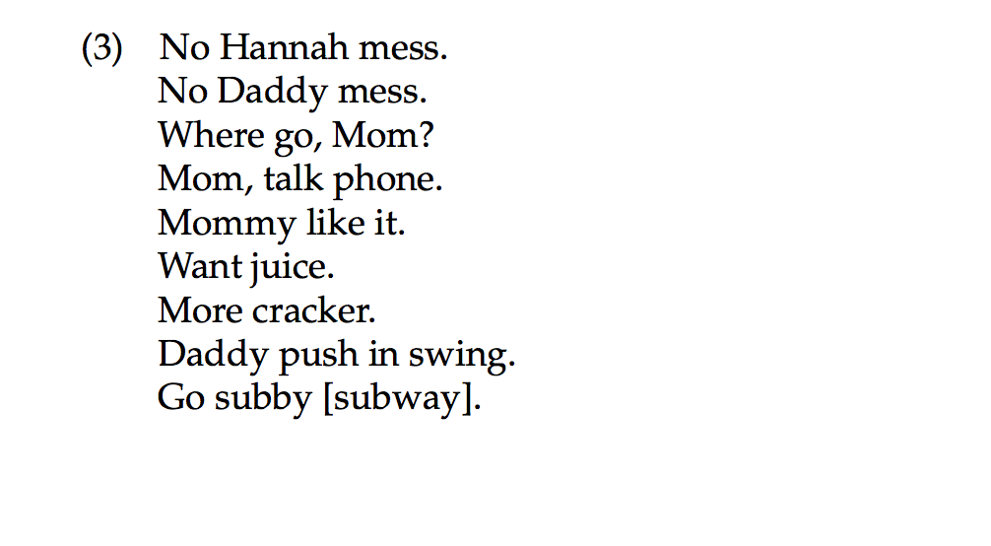
Hanna (23 month old girl)

Slide 12
Psycholinguistics Lecture 5
1- No bound morphemes or tense markers on verbs or plural markers.
2- No subjects

Slide 13
Third year.
Psycholinguistics Lecture 5
Sentences gradually lengthen, bound morphemes and function words emerge.
Morphemes emerge gradually in a similar order (e.g. -ing present progressive - Kitty sleeping)
Past tense mistakes (e.g. ‘goed’ indicate overgeneralization).

Slide 14
At age 3
Psycholinguistics Lecture 5
Complex sentences are produced (with variation). p.122
I want Mommy do it.
I see you sit down.
Watch me draw circles
Children begin producing relative clauses spontaneously around the age of 3-4. p.123

Slide 15
Psycholinguistics Lecture 5
In general, there is a considerable period between the time a child first uses a form and consistent use of it (e.g. past tense). p.124
At around 5-6, language becomes more systematic

Slide 16
Psycholinguistics Lecture 5
7,8 & 9 year olds start to use derivational morphemes (e.g. -ness, -ful and -ment). p124-125

Slide 17
Psycholinguistics Lecture 5
Discourse ability & metalinguistic awareness develop as children grow older. p. 126-128

Slide 18

بحمد الله
جميع الحقوق محفوظة لجامعة الملك فيصل ©
All Rights Reserved for KFU ©

