Slide 1

Sociolinguistics
Dr. M. Al-Hilal
جامعة الملك فيصل
عمادة التعلم الإلكتروني والتعليم عن بعد
1

Slide 2
Lecture 7
Sociolinguistics

Slide 3
In this Lecture, we will discuss the following:
5.4 Possible explanations
5.4.1 Dominance
5.4.2 Difference
5.4.3 Analysis of gender
Chapter 6: Language and ethnicity
6.1 Introduction
6.2 What is ethnicity?
6.3 The language of prejudice
6.3.1. the use of our
6.3.2 Negative labelling
Reclamation

Slide 4
5.4 Possible explanations
Why men’s and women’ talks are different.
5.4.1 Dominance
Dominance Theory: takes the difference in power between women and men as the main cause of discoursal variation.
According to this theory:
Men tend to have more power than women:
  physically,
  financially
  and in workplace hierarchies.
Weak points of Dominance theory:
1- women are represented as ‘powerless victims’,
2- shows men as undermining, excluding and demeaning women.

Slide 5
5.4.2 Difference
Difference theory
It suggests that women and men develop different styles of talking because they are segregated at important stages of their lives.
E.g.
playing in single-sex groups as children,
having same-sex friendships in adult life
This leads to have separate rules for behaviour and, in particular, for talking.

Slide 6
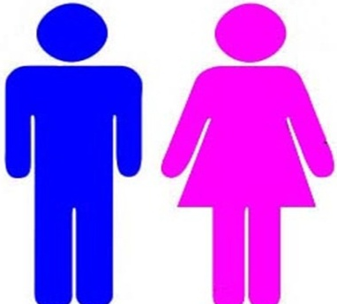
5.4.3 Analysis of gender
Gender plays an important role in the difference between men’s and women's talk:
Adopting a certain style of talking to indicate our gender:
E.g.
We use clothes to indicate gender

Slide 7
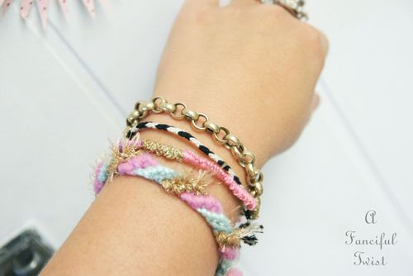
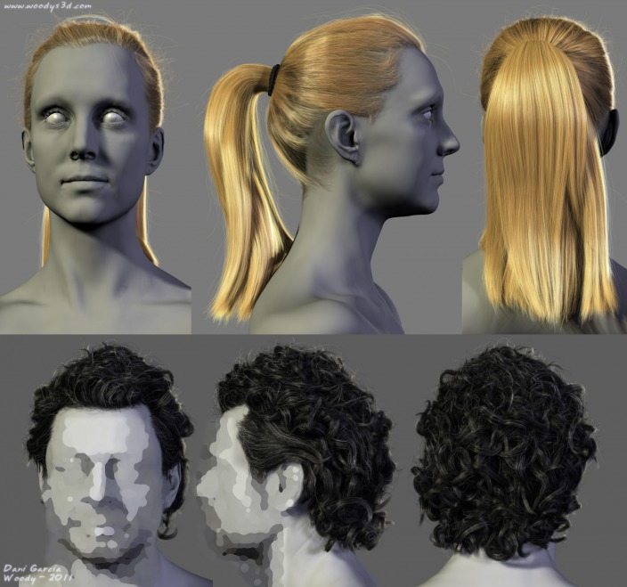
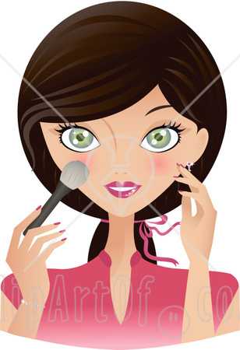
We use jewelry , hairstyles and makeup to indicate our gender.
Similarly, we adopt a style of talk to indicate our gender

Slide 8
Chapter 6: Language and ethnicity
6.1 Introduction
Sometimes people assume that you belong to a certain country/city based on your looks (skin or colour), language, etc.
6.2 What is ethnicity?
The attribution, or claim, to belong to a particular cultural group on the basis of genetics, language, or other cultural manifestations.
-Ethnic majority and Ethnic minority
Ethnic majority is a group which has a socially dominant culture.
Ethnic minority Refers to members of minority groups

Slide 9
Ethnic majority vs Ethnic minority
The ethnic majority has been established for a longer period of time and the minority groups are the more recent products of migration.
However, this is not always true
E.g.
Native Americans (and their cultures) became displaced and marginalised
by later European migrants.

Slide 10
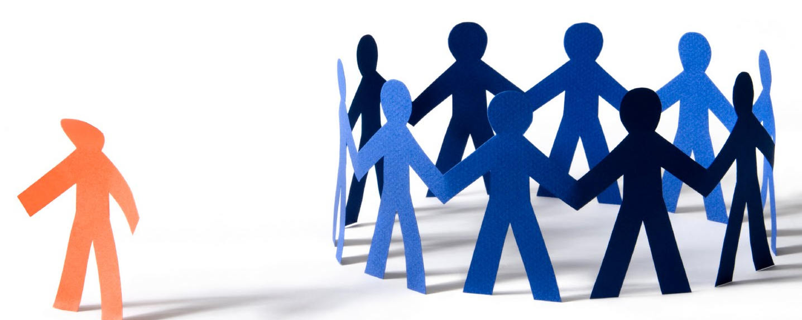
The language of prejudice
Prejudice refers to preconceived, usually unfavorable, judgments toward people because of gender, social class, age, disability, religion, sexuality, race/ethnicity, language, nationality or other personal characteristics.

Slide 11
Use of our
E.g. The British National Party’s aim is to nurture a ‘feeling of national and cultural unity among our people’, and makes reference to ‘our ancestors’ whose efforts have made Britain ‘our country’.
This shows that The intended audience not only belongs to a British majority but also shares the same beliefs and attitudes. Non-White, British-born people are clearly excluded.

Slide 12
6.3.2 Negative labelling
The word Black was often linked in the British media with negative signs such as hate, fight, riot
The word Jamaican indicates illegal drugs entering the country
The word small islander (which refers to people who have migrated from poorer and smaller islands) is derogatory

Slide 13
Reclamation
Reclamation is when members of ethnic minorities sometimes attempt to reduce, or remove, the power of derogatory ethnic labelling by using those terms among themselves, as positive markers of group identity.
E.g. Niggers can be used to indicate ethnic solidarity
Nevertheless, the term still retain negative connotations because it is still used as an ethnic abuse.

Slide 14

بحمد الله

