Slide 1

Sociolinguistics
Dr. M. Al-Hilal
جامعة الملك فيصل
عمادة التعلم الإلكتروني والتعليم عن بعد
1

Slide 2
Lecture 9
Sociolinguistics

Slide 3
In this Lecture, we will discuss the following:
7.3 Talking to young children and the elderly (chapter 7).
7.3.1 Language characteristics of the under-fives and over-sixty-fives.
    7.3.2 Child Directed Language
7.3.3 Similarities between Child Directed Language and ‘Elder Directed’ Language
7.3.4 Why might these similarities occur?

Slide 4
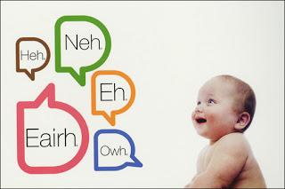
7.3.1 Language characteristics of the under-fives and over-sixty-fives
Language characteristics of the under-fives
1- The pitch of their voice is quite high relative to that of adults.
2- Their early pronunciations of words can be quite different from the adult versions.
Child’s talk

Slide 5
Language characteristics for the over-sixty-fives.
1- The over-sixty-fives are experienced language users.
2- Older people may require slightly longer processing time to produce and understand complex sentences.
3- Hearing often becomes less acute as people get older, and this can lead to
a reduced understanding of rapid or whispered speech
or speech in a noisy environment.
4- The ageing of the vocal cords and muscles controlling breathing and facial movement results in slower speech .

Slide 6
7.3.2 Child Directed Language (CDL)
(CDL), sometimes called ‘Baby Talk’ or ‘Motherese
Definition:
Child Directed Language is a special style used in speech to young children.
Characteristics of Child Directed Language.
● calling the child by name, often using a ‘pet’ name or term of endearment
● shorter, grammatically simpler sentences
● more repetition
● more use of questions or question tags (‘That’s nice, isn’t it?’)
● use of ‘baby-talk’ words
● expanding on and/or finishing a child’s utterance.

Slide 7
7.3.2 Child Directed Language
Characteristic of the Sound of CDL
● higher pitch
● slower speed
● more pauses, particularly between phrases.
● clearer, more ‘distinct’ pronunciation
● exaggerated intonation. E.g. A very prominent rising tone used for questions.

Slide 8
Characteristics of young children conversation with their parents.
1- Young children are usually perceived to be incompetent turn-takers
2- The younger the children, the more likely their attempts to initiate a new
topic will be ignored by older speakers
3- The younger the children, the more likely they are to be interrupted or overlapped (two speakers talking simultaneously).
4- There is a high proportion of ‘directive’ and ‘instructive’ talk from adults

Slide 9
7.3.3 Similarities between CDL and ‘Elder Directed’ Language
● Similarity in the content of the talk
● Similarity in the sound of the talk
● Similarities in the ways speakers interact
Similarity in the content of the talk
● simpler sentences,
● more questions
● repetitions,
● use of pet names.
Similarity in the sound of the talk
● higher pitch
● slower speed
● exaggerated intonation

Slide 10
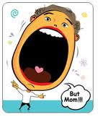

7.3.3 Similarities between CDL and ‘Elder Directed’ Language
Similarities in the ways speakers interact
● interrupting
● overlapping
● treating the person’s contribution as irrelevant to the conversation
● using directive language

Slide 11
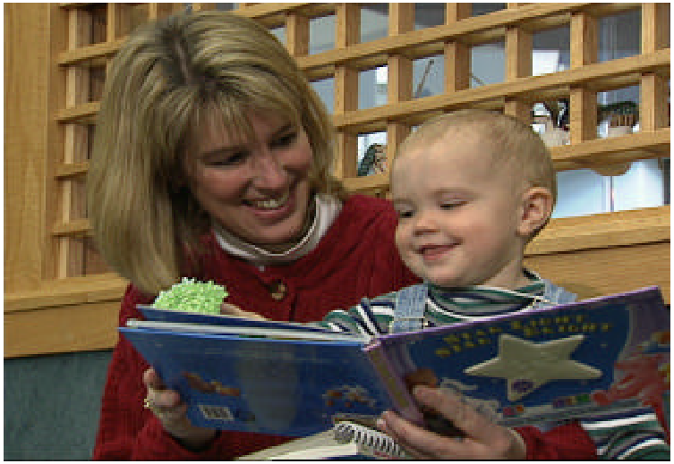
Why do we use CDL?
1- Parents used it as a language-teaching tool.
2- to ensure understanding children who are not fully competent language users.
3- CDL asserts the power of the caregiver in relation to the child.
4- using CDL reflects affection and nurturance toward the recipient and a willingness to accommodate to their needs.

Slide 12
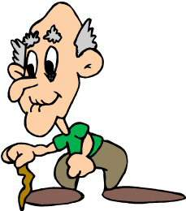
7.3.4 Why might these similarities occur?
1-Its use could be connected to cultural expectations and stereotypes
about people in these groups.
2- Experiments have shown that speakers with an ‘elderly’ voice tend to
be rated as vulnerable, forgetful and incompetent more often than speakers
with younger voices.
3- Expectations of the elderly having a decline in physical and mental capacity
expectations and stereotypes
of old age

Slide 13

بحمد الله

