Slide 1

Language & IT
Dr. Abdullah Al Fraidan
جامعة الملك فيصل
عمادة التعلم الإلكتروني والتعليم عن بعد
1

Slide 2
Lecture 2
UUEG Software (Azar Interactive)

Slide 3
UUEG Software
http://www.azarinteractiveonline.com/tour/

Slide 4
Evaluation of UUEG
Before beginning the evaluation itself, it is necessary to give a brief description of the software, which is based on Betty Azar's book (2009). Due to space restriction, I will only provide an analysis of just one chapter of the book with intercepted description of the methods used in implementing the software in classroom. The analysed chapter is divided into four parts, each focusing on the following tenses: the present perfect, the present perfect progressive, the past perfect, and the past perfect progressive. Each section includes several quizzes, exercises and one crossword game, and these are followed by three main tasks covering listening, speaking and reading comprehension (named by myself). To finish, there is a test that enables students to assess their achievements.

Slide 5
Evaluation of UUEG
Analytically speaking, the chapter follows Ur’s framework (1988) for teaching grammar: presentation, explanation, practice, and test. The chapter starts with a preview of the tense, comparing it to, and/or contrasting it with, similar tenses – a method that is claimed to be effective by Walker (1967). Learners can either read or listen to the preview before examining a chart that exemplifies the tense. Following this, students are presented with a range of nearly all the typical mechanical drills, such as gap filling, error recognition, cloze, and multiple choices. Some of the quizzes come with animated pictures, and the exercises are represented in a linear progression – i.e. they become more difficult as the students advance. I would consider some of these exercises to be preparatory activities for the main tasks; for example, exercise 11 (Fig.1) prepares the students for the speaking task in exercise 16 (Fig.2).
Within the program there are five main buttons located at the top of every page. These are made up of ‘outline’ (which outlines the whole chapter in detail), ‘report’ (enabling students to check their progress after each step), ‘glossary’, ‘help’ (where learners find help topics), and ‘contents’.

Slide 6
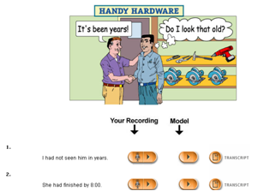
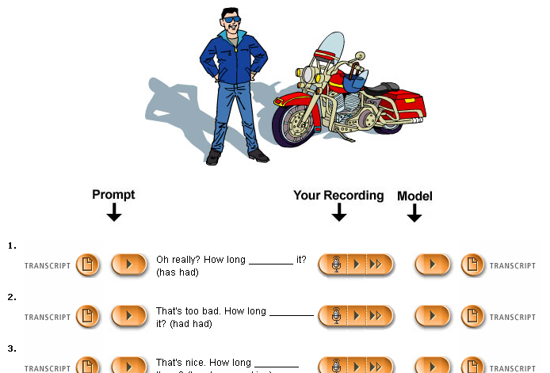
Evaluation of UUEG

Slide 7
Evaluation of UUEG
The listening task suggests that students listen to the recording of an international student’s experience before answering the corresponding questions. A transcript of the dialogue is available.
In the speaking task (Fig.2) there is a 'record and compare' function that enables learners to listen to a prompt before reiterating the sentences whilst recording their speech. This enables them to compare their recordings to those of the model. Transcripts of the prompts and the model’s words are available, and it is possible to play both of the recordings again and again.
The reading task comes in the form of a passage that includes some difficult hyperlinked words. By clicking on each, there appears a pop-up window that is linked to the glossary page. This displays the word’s meaning along with a list of the other hyperlinked words, thus allowing students to check the meaning of other vocabulary. Multiple-choice comprehension questions follow the passage.
The above outlines what the software suggests for each task. However, it was I ’s decision to ask the students to discuss these undertakings in the specially-designed chat rooms, thereby making each task more communicative. I also decided to add further activities to each, and I discussed this idea later on in the evaluation. In order to motivate the students, I offered bonus marks for those who participate in the discussion and extra activities.

Slide 8
Chapelle (2001) evaluation scheme
For the purpose of this evaluation, it will be useful to begin with an outline of Chapelle’s
Scheme (2001). Chapelle argues that CALL evaluation should be carried out using the theories of second language acquisition. There are two stages in her scheme: judgmental and empirical. In the judgmental stage, Chapelle (2001) analyses the software using two levels: the program and the teacher. In other words, she considers what learning conditions are set out by the software and what the teacher plans to do with the program respectively.
According to Chapelle (2001), however, this is not enough. She also addresses the question of what the learner actually does with the software by conducting an empirical evaluation. Whilst she focuses on different questions in each stage, she uses the same criteria in both. These criteria are: language learning potential, learner fit, meaning focus, positive impact, authenticity, and practicality. I shall judge the software by analysing the tasks using two of Chapelle's criteria: language learning potential, and learner fit.

Slide 9
Chapelle (2001) evaluation scheme
For the purpose of this evaluation, it will be useful to begin with an outline of Chapelle’s
Scheme (2001). Chapelle argues that CALL evaluation should be carried out using the theories of second language acquisition. There are two stages in her scheme: judgmental and empirical. In the judgmental stage, Chapelle (2001) analyses the software using two levels: the program and the teacher. In other words, she considers what learning conditions are set out by the software and what the teacher plans to do with the program respectively.
According to Chapelle (2001), however, this is not enough. She also addresses the question of what the learner actually does with the software by conducting an empirical evaluation. Whilst she focuses on different questions in each stage, she uses the same criteria in both. These criteria are: language learning potential, learner fit, meaning focus, positive impact, authenticity, and practicality. I shall judge the software by analysing the tasks using two of Chapelle's criteria: language learning potential, and learner fit.

Slide 10

بحمد الله

