Slide 1

Language & IT
Dr. Abdullah Al Fraidan
جامعة الملك فيصل
عمادة التعلم الإلكتروني والتعليم عن بعد
1

Slide 2
Lecture 13
NLP
Natural Language Processing

Slide 3
The Problem of Syntactic Analysis
Assume input sentence S in natural language L
Assume you have rules (grammar G) that describe syntactic regularities (patterns or structures) found in sentences of L
Given S & G, find syntactic structure of S
Such a structure is called a parse tree

Slide 4
Example 1
S
S → NP VP
VP → V NP
VP → V
NP → I
NP → he
V → slept
V → ate
V → drinks
NP
VP
he
V
slept
Grammar
Parse Tree

Slide 5
More Complex Sentences
I can fish.
I saw the elephant in my pajamas.
These sentences exhibit ambiguity
Computers will have to find the acceptable or most likely meaning(s).

Slide 6
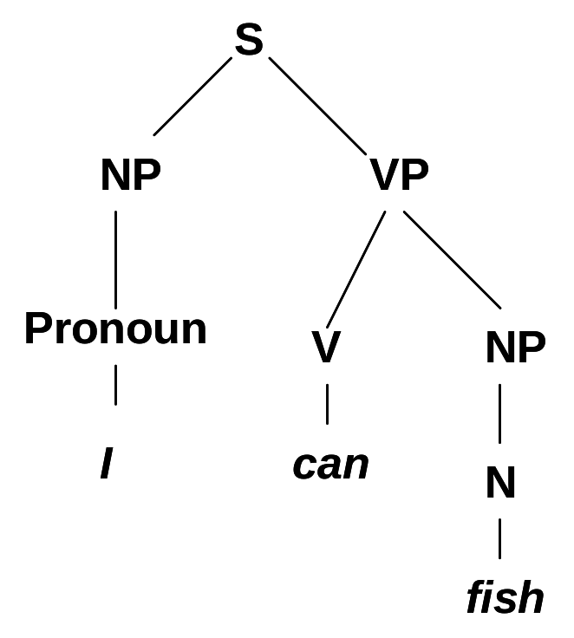
Meaning from a Parse Tree
I can fish.
We want to understand
  Who does what?
    the canner is me, the action is canning, and the thing canned is fish.
    e.g. Canning(ME, FishStuff)
    This is a logic representation of meaning
We can do this by
associating meanings with lexical items in the tree
then using rules to figure out what the S as a whole means

Slide 7
Meaning from a Parse Tree (Details)
Let’s augment the grammar with feature constraints
S → NP VP
  <S subj> =<NP>
  <S>=<VP>
VP→ V NP
  <VP> = <V>
  <VP obj> =<NP>
[subj: *1
pred: *2
obj: *3]
[pred: *2
obj: *3]
*1[sem: ME]
*3[sem: Fish
Stuff]
*2:[pred: Canning]

Slide 8
Grammar Induction
Start with a tree bank = collection of parsed sentences
Extract grammar rules corresponding to parse trees, estimating the probability of the grammar rule based on its frequency
    P(A→β | A) = Count(A→β) / Count(A)
You then have a probabilistic grammar, derived from a corpus of parse trees
How does this grammar compare to grammars created by human intuition?
How do you get the corpus?

Slide 9

بحمد الله

