Slide 1

English Language Course
Fouzi Slisli and M. Al-Hilal
King Faisal University
Deanship o E-leaning and Distant Leaning
1

Slide 2

Lesson 6
Expressing the Future

Slide 3
The Future
Different ways to express the future.
Will and shall
Be going to
The Simple Present Tense
The Present Contiguous Tense

Slide 4

The Future
Different ways to express the future.
Will and shall
Will and shall are used to express the future; they express a prediction about the future. They are always followed by the base form of the verb.
Ex.
This book will teach you how to cook.
We shall know our exam results soon.
Past present future
(NOW)

Slide 5
The Future
Different ways to express the future.
Will VS. shall
Shall | I and we
Will | He She It They you
Contracted forms:
We shall= We’ll
He will= He’ll

Slide 6
The Future
Different ways to express the future.
Will and shall
We use Will and shall for instant decisions. The speaker did not plan for the action.
Ex.
It is raining. I shall take my umbrella.
(An accident happened). We shall call the ambulance.

Slide 7
Forming Negative Sentences in the Present Perfect
We add the negation particle NOT after will (will not) or shall (shall not).
Ex.
Sally will study English. Sally will not study English.
I We | shall not | study English
You They He She It | Will not

Slide 8
Forming Question Sentences in the Present Perfect
We place have/has before the subject, then we add a question mark (?) at the end of the sentence.
Ex.
Sally will study English.
Will Sally study English?
Shall | I We | study English?
Will | He She It You They

Slide 9
The Future
Different ways to express the future.
Be going to
Be going to is used to (a) indicate a situation which points to the future
and to (b) express a present intension).
- It is going to rain. (we can see the clouds).
- The match is going to end soon. (we can see the time).
- They are going to start new business. (we can see the preparation)

Slide 10
The Future
Different ways to express the future.
The Simple Present Tense.
We can use the simple present to indicate the future when we talk about an action as a part of timetable.
Ex.
My train leaves at 8:30.
The manger meets the staff on Monday at 9:00 O’clock.

Slide 11
The Future
Different ways to express the future.
The Present Contiguous Tense.
We use the present continuous to indicate the future when the action/event referred to is already planned or arranged.
Ex.
I am meeting Sally at 11:30.
Sally is going to the party tonight.

Slide 12
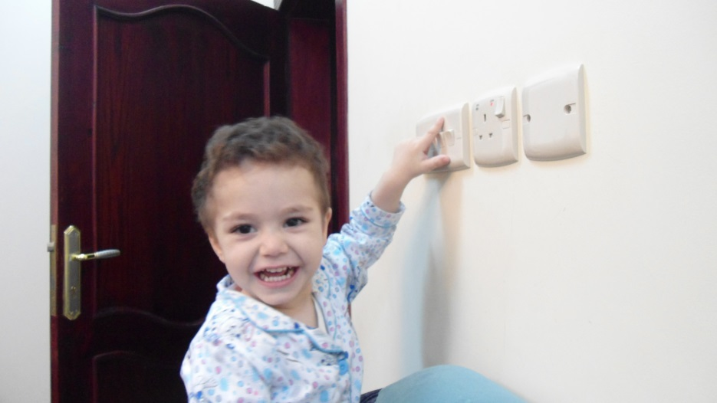
Practice
Turn off
- The boy will turn the lights off. (instant decision).
- The boy is going to turn the lights off. (present intention)

Slide 13

Practice
come
Sally is coming to the party. (arranged event)

Slide 14

Practice
Knock on
(He found where her flat is): He will knock on the door.

Slide 15
بحمد الله

