Slide 1

Graduation Project
Dr. Ahmad Alsagoafi
جامعة الملك فيصل
عمادة التعلم الإلكتروني والتعليم عن بعد
كلية الآداب
1

Slide 2
Lecture Six
Presentation of the Proposal

Slide 3
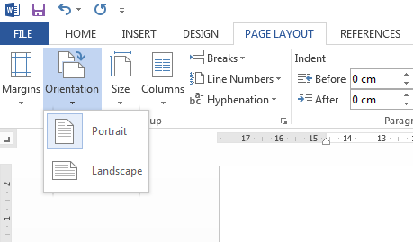
Presentation of the Proposal
Page layout:
Page orientation should be set to Portrait (not Landscape).
How to Change Page Layout in Microsoft Word 2010 Tutorial
http://www.youtube.com/watch?v=hhOSsitOmlk
5.2

Slide 4
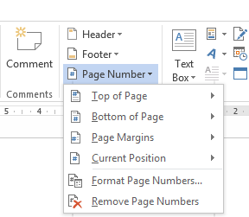
Presentation of the Proposal
NUMBERING OF PAGES:
All pages, including abstract, appendices, indices, drawings, maps, pages of photographs, etc, should be numbered consecutively in one sequence starting with the title page as 1.
Word 2010 - Adding Page Numbers to Documents
http://www.youtube.com/watch?v=ToBIKmXgoWE

Slide 5
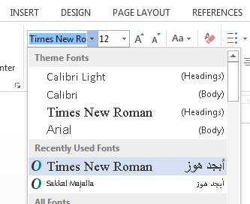
Presentation of the Proposal
FONT: Size 12 in Times New Roman
How to change the Default Font and Font Size in Word 2010 and 2013
http://www.youtube.com/watch?v=B_vkhEOFM1c

Slide 6
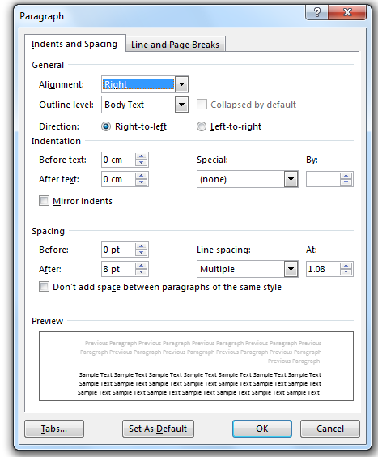
Presentation of the Proposal
TYPING:
Double or one-and-a-half spacing should be used in typescript except for indented
quotations or footnotes, for which
single spacing may be used.
How to Change the Line Spacing in Microsoft Word 2010
http://www.youtube.com/watch?v=WqF76UkOdOE

Slide 7
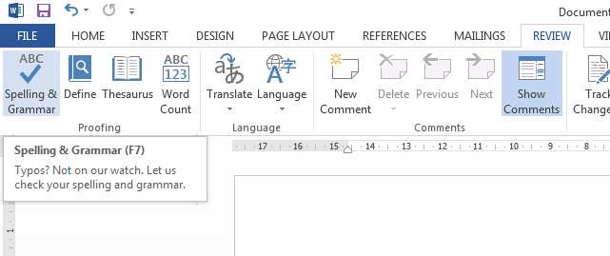
Presentation of the Proposal
Spelling mistakes
Microsoft Word Spell Check
http://www.youtube.com/watch?v=qMnvlWqFf_0
.

Slide 8
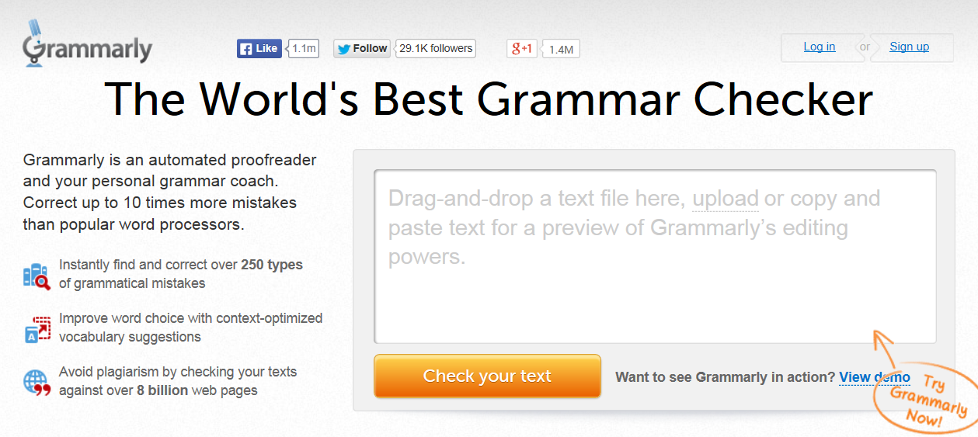
Presentation of the Proposal
Grammar mistakes
http://www.grammarly.com/

Slide 9
Presentation of the Proposal
TITLE PAGE:
The full title (and sub-title if any) of the proposal
Submitted by [ Full Name ] [ month and year of submission].
I certify that all material in this proposal which is not my own work has been identified and that no material has previously been submitted and approved for the award of a degree by this or any other University.
(Signature) ………………………………………………………………………………

Slide 10

بحمد الله

