Slide 1

Introduction to American Literature
Dr. Abdullah Al-Badarneh
جامعة الملك فيصل
عمادة التعلم الإلكتروني والتعليم عن بعد
كلية الآداب
1

Slide 2
Lecture Two:
Colonial Literature
(The Puritan Period)

Slide 3
American Colonial Literature:
The immigration of the Pilgrims to New England occurred in stages. But that they had to go somewhere became apparent soon enough. Theirs was the position of the Separatist: they believed that the reforms of the Anglican church had not gone far enough, that, although the break with Catholicism in 1535 had moved some way toward the Puritan belief in and idea of religious authority grounded solely in Scripture.
But theirs was a religious, not a political agenda; moral and theological principles were involved, and from their perspective, there could be no compromise.
To establish themselves as rightful interpreters of the Bible independent of an inherited social and cultural order, they removed from the Anglican Church in order to re-establish it as they believed it truly should be. This of course meant leaving the country, and they left for Holland in 1608 and for the New World in 1620.

Slide 4
American Colonial Literature:
American Colonial literature refers to the writings that emerged from the original U.S. colonies during the period from 1607 to the late 1700s.
It was largely influenced by British writers and was created to inform people about Puritans’ life, religious disputes, and settlement issues.
Many of the characteristics of Colonial American literature can be found in the poems, journals, letters, narratives, histories and teaching materials written by settlers, religious figures and historical icons of the period.
Genres that the Puritans favored:
  Sermons
  religious poetry
  historical narratives
  THEY DID NOT FEEL THAT LITERATURE WAS FOR ENTERTAINMENT. Novels and plays were frowned upon, due to a perceived lack of practical religious value.

Slide 5
How did religion shape the literature of the Puritan period?
We will look into themes, formats, and purposes of the Puritan writers to answer this question.
The Puritans wrote about the religious foundations of many of their settlements, especially the exodus from Britain, and employed the constant theme that God should be worshipped. They also used texts that prepared them for worship. This literature helped spread the message of God, suggesting that "life was a test" and the soul would face damnation if that test was failed. Ambition and hard work were continuously stressed. Many of the Puritan works were written in poetry form. Anne Bradstreet's poetry, the "Bay Psalm Book," and Pastor Edward Taylor's "Preparatory Mediations" are good examples of religious texts of the era.

Slide 6
So, when was the Puritan Part of the Colonial Period?
Early 1600’s to about 1750 or so.
The reason we call this part of the Colonial Period (which represents all of the time that the British ruled the colonies in North America) the PURITAN period is because of the overarching influence of the Puritans and their specific religious practices.
In 1620, a hundred or so English men and women settled in Plymouth, Massachusetts, fleeing from religious persecution.
An example of such persecution:
  One Englishman who had written a pamphlet to reform the Church of England was put in jail, fined, whipped, had the top of his ears cut off, his forehead burned with a hot iron, and his nose slit.

Slide 7
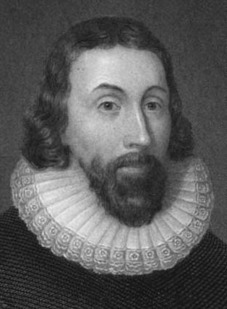
Puritan DIVINE MISSION
John Winthrop
  “We shall be as a City upon a Hill, the eyes of all people are upon us; so that if we shall deal falsely with our God in this work we have undertaken and so cause him to withdraw his present help from us, we shall be made a story and a by-word through all the world.”
        From his Bay Colony Journal
John Winthrop

Slide 8
Puritan Thought:
Three Puritan Principles
1- They wished to have their feelings changed through God’s grace. They wanted to be cleansed of envy, vanity, and lust.
2- They valued plainness—simplicity, especially in church.
3- They saw their bringing Christianity to America as a divine mission.
Puritan terms and influences
Predestination: the idea that God knows where each person will end up in eternity.
  The Puritans believed that those who were blessed with wealth and prosperous family lives were a part of those “elected” to go to heaven.
  This concept can be seen in “Sinners in the Hands of an Angry God” by Jonathan Edwards.

Slide 9
Puritan terms and influences
Protestant work ethic: The Puritans believed that hard work was a way of winning God’s favor, and wealth accumulated through hard, honest work was seen as a sign of Godliness and was encouraged of all Puritans.
  This “protestant work ethic” is a major foundation of the American way of life.
Plain style: Believe it or not, William Bradford (Of Plymouth Plantation) is well known for his plain style.
  This simply means that his prose is not ornamental, and is not intended to be showy.
  This falls in line with the Puritan belief that one should not call attention to oneself.
  This is opposite of Shakespeare, whose writing in England was very showy and meant to showcase his skill as a writer.

Slide 10
How did religion shape the literature of the Puritan period?
Religious values were put above all else in every area of these people’s lives.
  This led to a focus on practical literature (sermons, hist. narrative, poetry with a spiritual message).
  This also led to a certain style of writing that mirrored the Puritans style of living. (plain style)
  Themes were religious in nature and reflected Puritan values.

Slide 11
The Puritan 10 Commandments
1) Thou shalt not miss church and community meetings.
2) Thou shalt work hard and support my fellow pilgrims.
3) Thou shalt worship a strict and Christian God.
4) Thou shalt put the Lord first in my life and obey his words.
5) Thou shalt live by the 10 Commandments as written in the Holy Bible.
6) Thou shalt not dress in bright colors or dance in a wicked manner.
7) Thou shalt not perform witchery nor conjure the devil.
8) Thou shalt not have any opinions or beliefs not held by the entire community.
9) Thou shalt build my home simply and not clutter it with decorations.
10) Thou whom shalt disobey these commandments will be banished or be hanged.

Slide 12
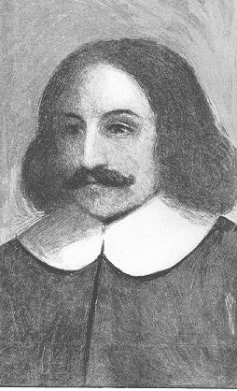
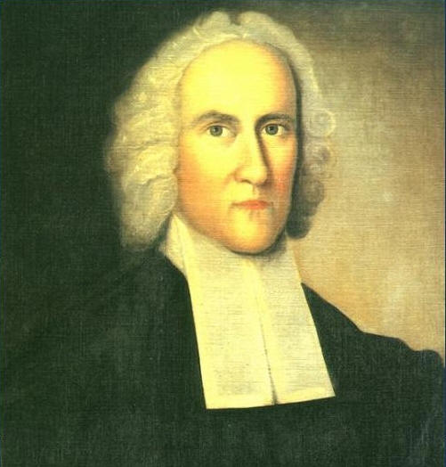
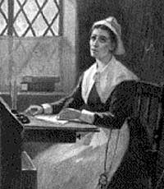
Puritan Writers to remember
William Bradford Of Plymouth Plantation (HISTORICAL NARRATIVE)
Anne Bradstreet “Upon the Burning of Our House,” and “To My Dear and Loving Husband.” (POETRY)
Jonathan Edwards “Sinners in the Hands of an Angry God” (SERMON)

Slide 13
Puritan Writing
The Purpose of Literature is
To Educate

Slide 14
Examples on Anne Bradstreet’s Poetry
“Dialogue Between Old England and New” by Anne Bradstreet
New England
Alas, dear Mother, fairest Queen and best,
With honour, wealth, and peace happy and blest,
What ails thee hang thy head, and cross thine arms,
And sit i’ the dust to sigh these sad alarms?
What deluge of new woes thus over-whelm
The glories of thy ever famous Realm?
What means this wailing tone, this mournful guise?
Ah, tell thy Daughter; she may sympathize.
Dear Mother: England
Thy Daughter: America
“For Deliverance From A Feaver” by Anne Bradstreet
O, heal my Soul, thov know'st I said,
Tho' flesh consume to novght;
What tho' in dust it shall bee lay'd,
To Glory't shall bee brovght.
Thou heardst, thy rod thou didst remove,
And spar'd my Body frail,
Thou shew'st to me thy tender Love,
My heart no more might quail.
O, Praises to my mighty God,
Praise to my Lord, I say,
Who hath redeem'd my Soul from pitt:
Praises to him for Aye!
Commentary: Bradstreet is relieved that God has delivered her from her fever. Early in the poem, she clearly expresses her fear of God's displeasure and vows to accept her death as a pathway to God's glory, she seems extremely relieved to that He allows her to live.

Slide 15

بحمد الله

